Slide 1





School Safety & Communication Continuity

Slide 2

Agenda
Current Challenges in School Safety & Communication
High Speed Internet & Failover Solutions
AI Based Gun Detection Technology Overview
Unified Communication Tools
Smart Transportation Technology
Critical Communication Modernization
Network & Wireless Priority Access
Q&A and Next Steps
© 2025 Premier Wireless. All rights reserved.

Slide 3
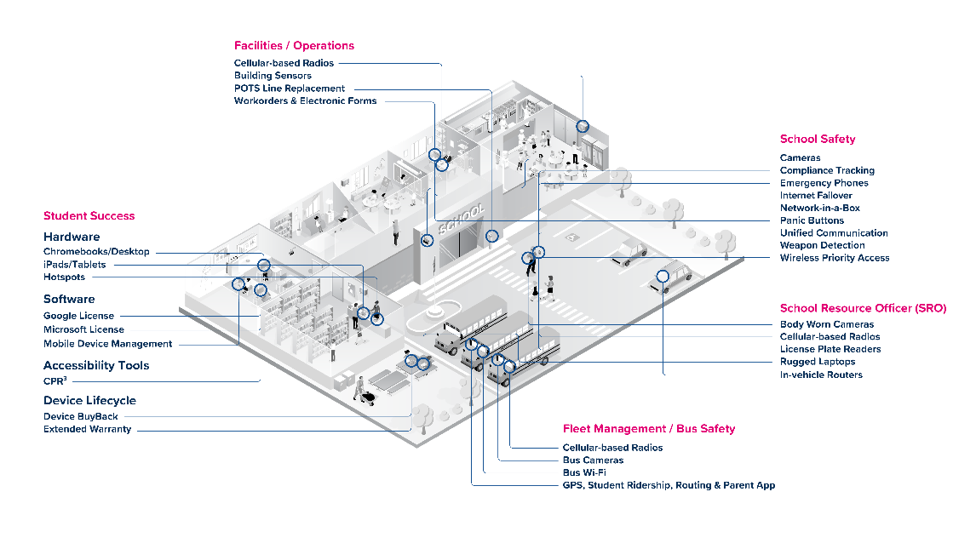
K-12 Education Landscape
From front office to school bus, campuses rely on seamless safety and connectivity—not just classroom tech.
https://info.premierwireless.com/k-12-education-landscape
© 2025 Premier Wireless. All rights reserved.

Slide 4

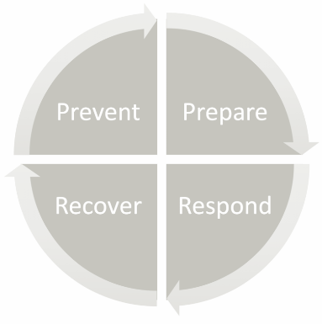
Planning for the Unpredictable
  Preparing for the unexpected
Power Outages
Weather Events
Natural Disasters
Medical Emergencies
Active Shooters
Pandemics
School Events
© 2025 Premier Wireless. All rights reserved.

Slide 5

Campus & In-building Coverage
  Where are your coverage challenges?
Hallway
Classrooms
Cafeteria
Gyms
Administration offices
Playground
Sporting fields
Parking lots
  Cellular Coverage enhancements
T-Mobile Advanced Network Solutions (ANS)
Distributed Antenna Systems (DAS)
© 2025 Premier Wireless. All rights reserved.

Slide 6

Built-in Redundancy
  What happens when your network goes down?
Phones go down
Access control fails
Door Sensors and Alarms disabled
Security systems are compromised
Camera Access is lost
Emergency Alerts and PA systems cannot function
HVAC and Lighting Controls Impacted
When all else fails… What is Plan B?
Or Even Plan C?
© 2025 Premier Wireless. All rights reserved.

Slide 7
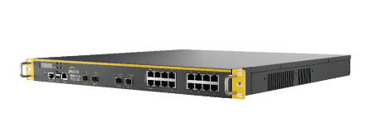
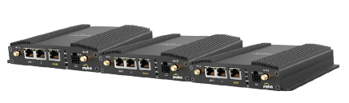
Redundant. Reliable. Ready to Learn.
  Key Features
Premier EDU CampusLink delivers continuous, uninterrupted internet access with fast failover and SpeedFusion bonding to ensure a resilient and always-on network. CampusLink will ensure your students and teachers have the bandwidth and uptime they need to teach and learn.
Multi-WAN redundancy – LTE, 5G, and fiber
Automatic failover for seamless uptime
SpeedFusion Bandwidth Bonding
Scalable, campus-wide coverage
Easy integration with existing networks
Peplink Balance 2500 EC
Peplink BR1 Pro 5G
© 2025 Premier Wireless. All rights reserved.

Slide 8
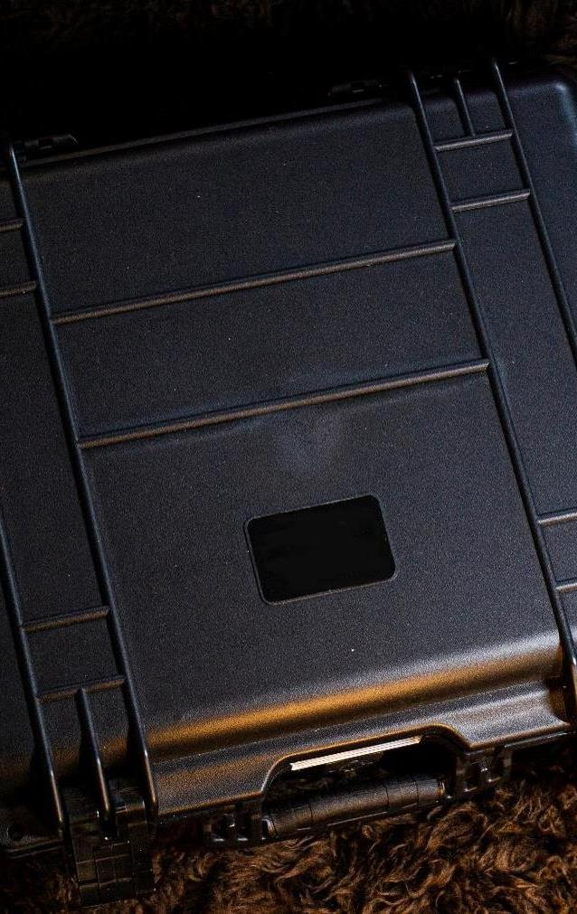
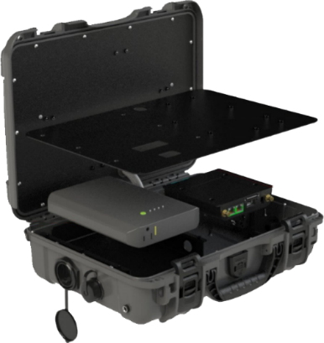
Portable Communication Center
  Premier’s 5G mobile network-in-a-box
Mobile Communication Center
50-100 (or more) Endpoints
Communication Continuity
Reunification Plans
Recovery Plans
IP54 Rated for Water & Dust
© 2025 Premier Wireless. All rights reserved.​

Slide 9

SAVE TIME.
SAVE LIVES.
Weapons Detection. Human Verified.

Slide 10

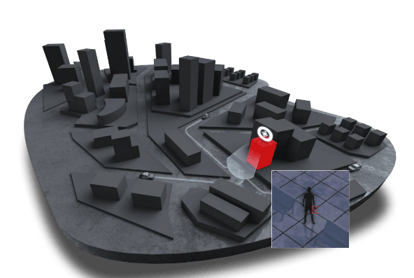
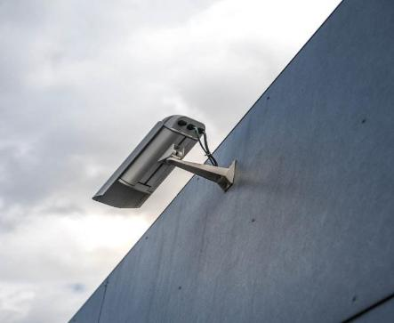
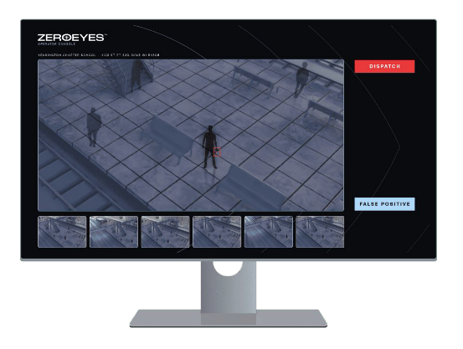

DETECTION
VERIFICATION
ALERT
© 2025 Premier Wireless. All rights reserved.

Slide 11
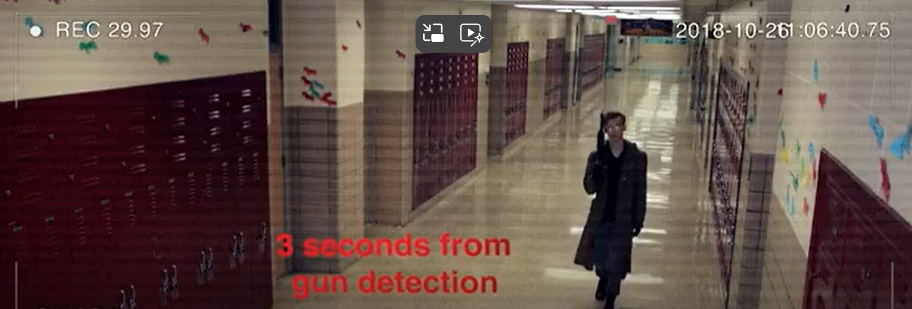
ZeroEyes Gun Shot Detection
WATCH ON YOUTUBE
© 2025 Premier Wireless. All rights reserved.

Slide 12














The ZeroEyes Story
Launched April 2018 following Parkland, FL shooting
Ivy League MBAs + Fortune 500 Corporate Experience
© 2025 Premier Wireless. All rights reserved.

Slide 13
















The ZeroEyes Story
  Reach
45 States
3 Countries
450 Schools
Dozens of Industries
Thousands of Buildings
Education
Commercial
Government
© 2025 Premier Wireless. All rights reserved.

Slide 14
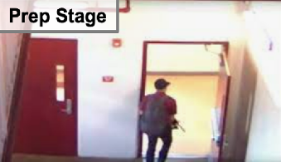

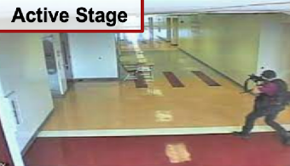

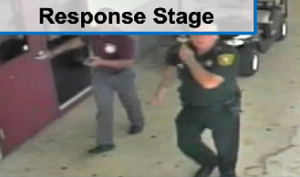
PARKLAND, FL SCHOOL SHOOTING
34 PEOPLE SHOT, 17 KILLED & 17 SERIOUSLY INJURED
STAGING
FIRST
SHOTS
CHAOS
INNACURATE
REPORTS
POLICE
ARRIVE
WAIT
& HOLD
MAKE
ENTRY
3 min (Parking Lot & Stairwell)
5 min
16 min
PREP STAGE
ACTIVE STAGE
RESPONSE STAGE
~20 seconds, shooter loading AR15
Shows assault rifle in front of several cameras
Nobody alerts the police!
Inaccurate Data / Unknowns
“Fog of War”
Thought noise from firecrackers
No Situational Awareness
Precious time wasted to stop threat & treat injured
No geo-coordinates
Radio comms only
No Situational Awareness
Shooter escapes
Victims bleed out
Over One Hundred and Thirty 9-1-1 Calls w/ Conflicting - Inaccurate Info
© 2025 Premier Wireless. All rights reserved.

Slide 15
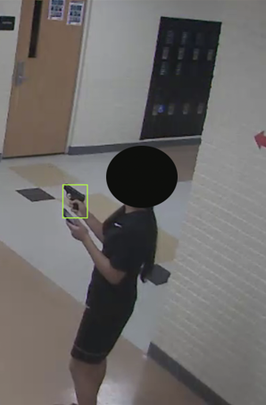

Actual Gun Detection,
POLICE NOTIFIED WITHIN 4 SECONDS
Schools nationwide have been on alert over TikTok challenge encouraging kids to bring weapons to school
A female student in New Mexico took part in the TikTok Challenge
She was apprehended by police in 15 seconds as a result of ZeroEyes
WATCH ON YOUTUBE
© 2025 Premier Wireless. All rights reserved.

Slide 16
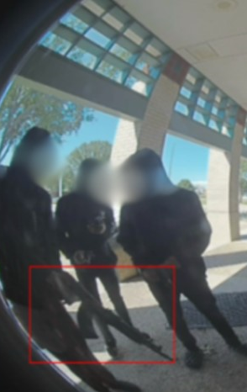
Police Notified in Seconds
  Perpetrator:
Juvenile Males
Texas School District
Brought weapons to hide on a Saturday
The district would have had NO idea this event occurred without the ZeroEyes notification.
© 2025 Premier Wireless. All rights reserved.

Slide 17

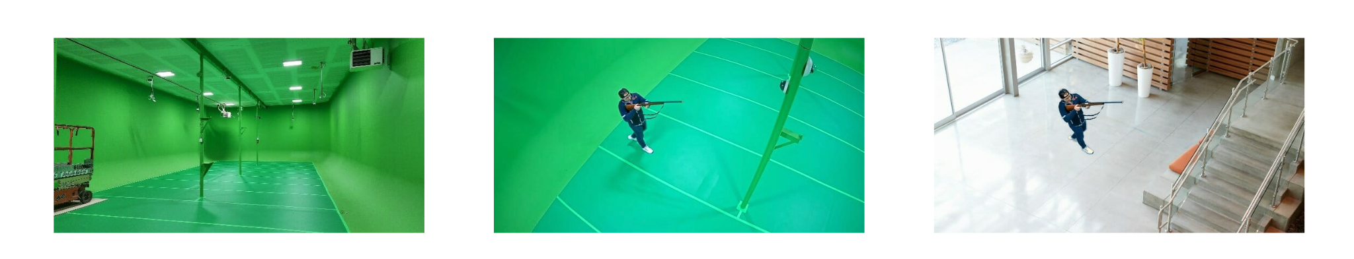
ZeroEyes Technology Creates Proprietary
Reality-Based Dataset
© 2025 Premier Wireless. All rights reserved.​

Slide 18




Certifications & Strategic Partnerships
DHS Safety Act DT&E Designated Platform
".... claims may not be brought against the buyers, buyers’ contractors, or downstream users...“
ZeroEyes is the ONLY video analytic gun detection
platform to achieve Safety Act Designation.
SOC 2 suitability of design & effectiveness of its controls relevant to security
ISO 27001 Certiﬁed, Integrity of Information Security Management System (ISMS)
RapidSoS link critical data directly to emergency services: Dispatched emergency services get to the right location for better outcomes
© 2025 Premier Wireless. All rights reserved.

Slide 19

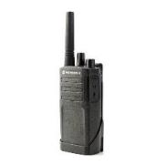
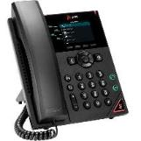

Voice & Data Communication
  Desk Phones – Smart Phones – Basic Phones & Radios
UCaaS
Desk Phones & Cell Phones
Laptops & Tablets
  Right Devices For The Right Person
District Administrators
School Resource Officers
Principals/Assistant Principals
School Nurse & Counselors
Teachers
Facilities - Technology – Warehouse
Food & Nutrition – Landscaping
Transportation
© 2025 Premier Wireless. All rights reserved.​

Slide 20
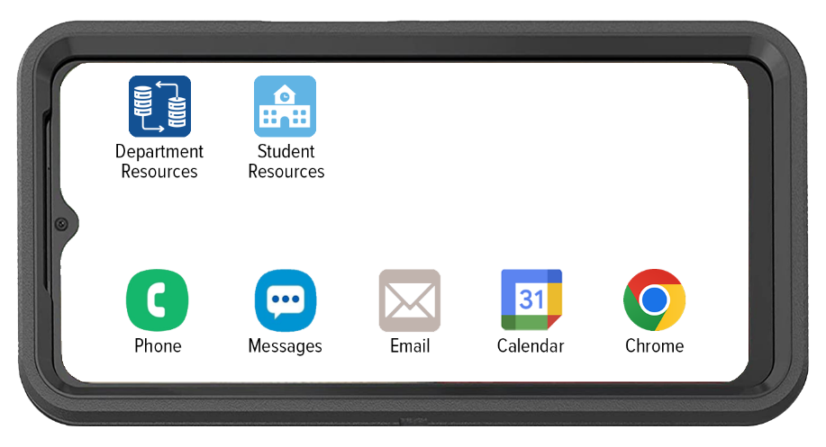

CPR³ – SmartPhones
Connecting People To Resources
Customized with resources for each department
Principals
Facilities
Landscaping
Food & Nutrition
Technology
School Resource Officers
© 2025 Premier Wireless. All rights reserved.​

Slide 21
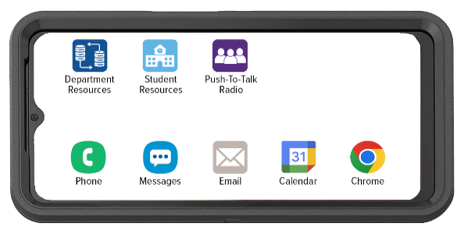




T-Mobile Direct Connect PTT
Provides messaging between individuals or groups with support for images, videos, audio, and location sharing
Provides location sharing and tracking capabilities for precise coordination
Supports devices with Push-to-Talk button hardware to help reduce call origination time with One-Touch calling
Gives ability to augment your Land Mobile Radio (LMR) network with T-Mobile devices
Offers broad device support from rugged PTT devices to conventional smartphones and tablets (iOS and Android)
Allows supervisors to centrally manage contacts, Talk groups, and settings with the Corporate Administration Tool (CAT)
© 2025 Premier Wireless. All rights reserved.​

Slide 22
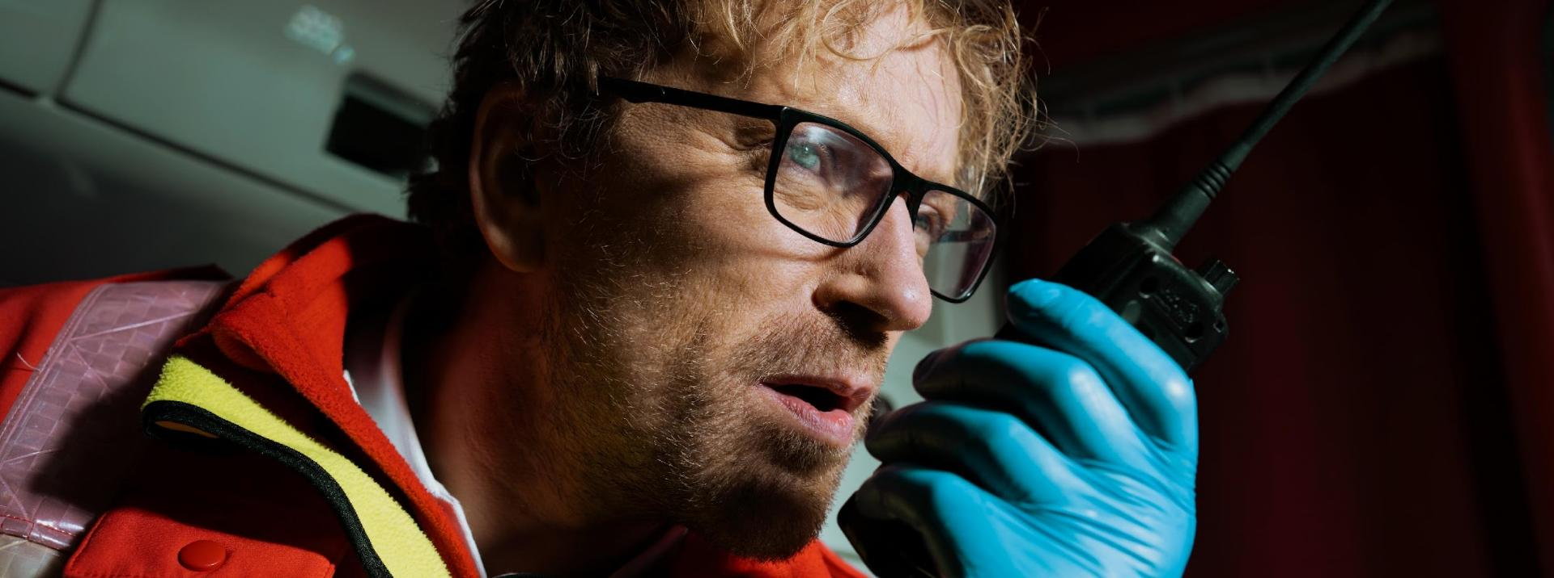
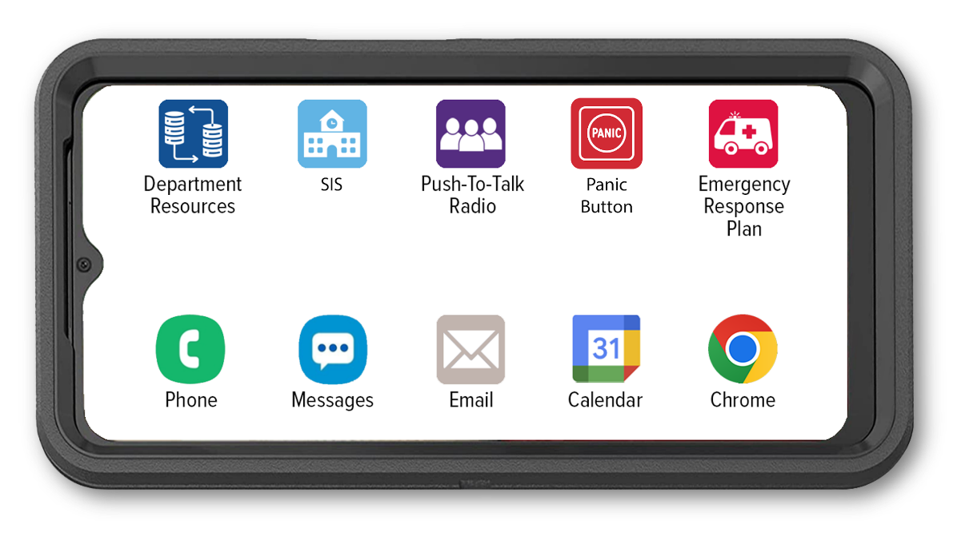
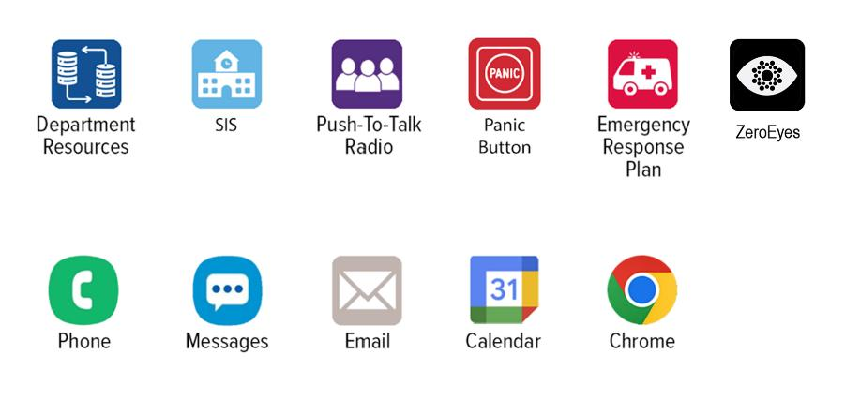
Purpose Driven & Poised for Emergency Response
© 2025 Premier Wireless. All rights reserved.​

Slide 23

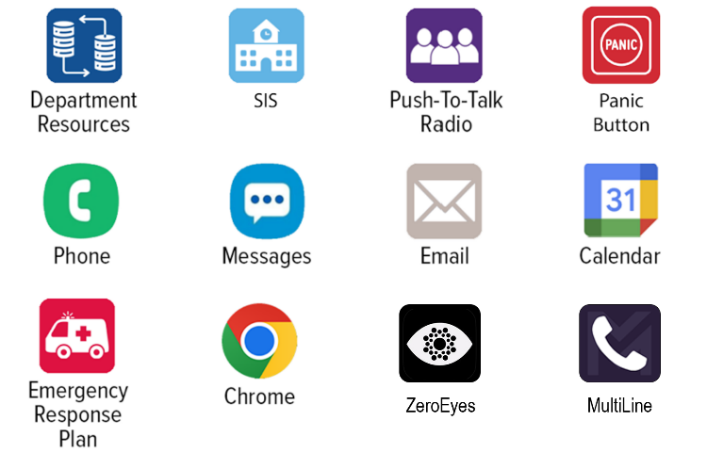
Enhancing Communication, Compliance,
& Emergency Response
Enables secure, recorded communication
Provides instant, reliable contact
Supports audit trails and documentation
Enables coordinated response and mass messaging
Supports audit trails and documentation
© 2025 Premier Wireless. All rights reserved.​

Slide 24


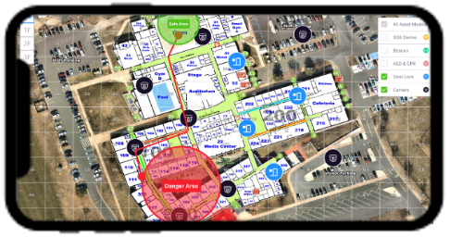
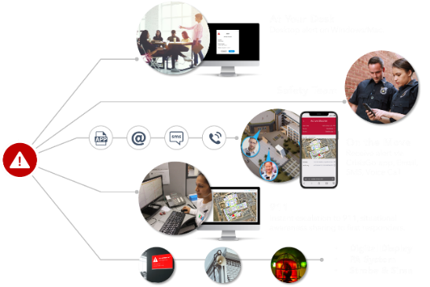

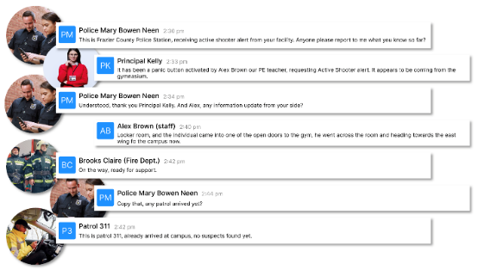
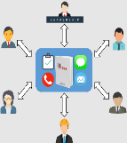

Emergency Response Plan
Awareness
MASS NOTIFICATION
PARENTS
GUARDIANS
COMMUNITY
Emergency Response ACTIVATION
Coordination
TEACHERS
STAFF
POLICE
FIRE
ISD ADMINS
INCIDENT RESPONSE
SYSTEM
© 2025 Premier Wireless. All rights reserved.​

Slide 25

Cellular-Based Panic Buttons
  Reliable Alerts When and Where They’re Needed
Multiple alert options: 1 click notifies the front office; multiple clicks reach 911 instantly.
Precise indoors: BLE beacons identify exact rooms or hallways.
Outdoors & off-campus coverage: Extends protection to playgrounds, buses, and field trips with GPS location.
Dependable connectivity: Cellular ensures alerts send even if WiFi is down.
  WiFi + SIM + BLE = Complete Safety
Indoors, outdoors, on and off-campus: Coverage follows staff and students everywhere.
WiFi alone isn’t enough: Outages and range limitations can delay help.
Peace of mind in every touch: Simple, reliable alerts instil staff confidence.
  Supports Alyssa’s Law compliance by enabling direct, location-enabled alerts to local 911.
  1.
  2.
  3.
Push Button
Distress Call Located
Incident Report Generated
© 2025 Premier Wireless. All rights reserved.​

Slide 26
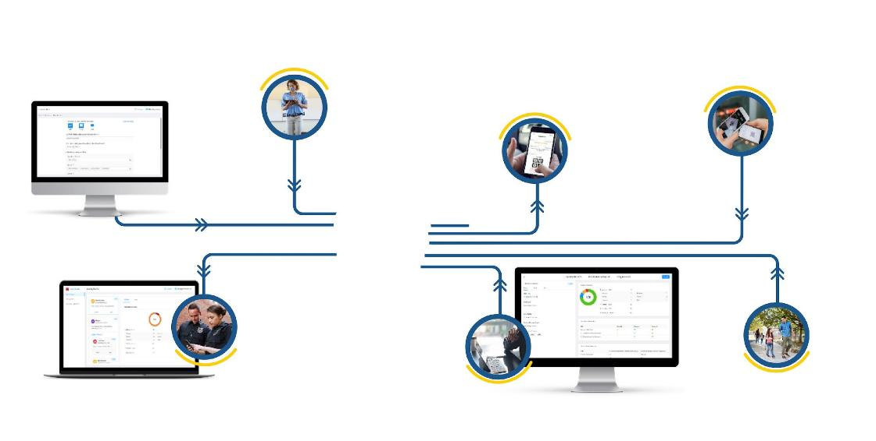
Simplify Student Reunification
Step 2: Account for Students
Step 3: Notify Parents
Students at the reunification site are accounted for by staff via the mobile tool or can self-scan into the kidhold.
Starting with parent communication.
Parents receive guidance and a digital QR Code to pick up students at the designated reunification site.
Step 4: Greet Parents
Step 1: Initiate Reunification Event
At the reunification site, greeters scan the parent's digital ID and know which kid(s) to pick up via mobile phones, verifying the parent's identity.
Reunification Hub
(Optional) Sharing Event Data with First Responders
Step 5: Reunify Parent & Kids
After confirmation with the student, the parent signs a digital signature in the app, and then they will be free to leave.
School Admin Monitor Event Progress
Administrators oversee event progress with real-time data, guide the team or communicate with parents.
© 2025 Premier Wireless. All rights reserved.​

Slide 27
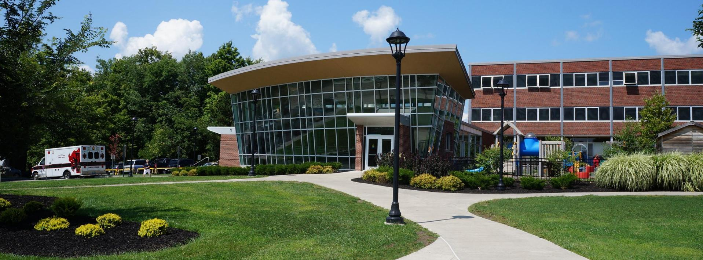








Seamless Communication
Uniting All Stakeholders for Student Safety
SCHOOL STAFF
SUPERINTENDENT, PRINCIPAL
TEACHER
911, FIRST RESPONDER
SAFETY TEAM
PARENT
STUDENT
COMMUNITY
© 2025 Premier Wireless. All rights reserved.​

Slide 28
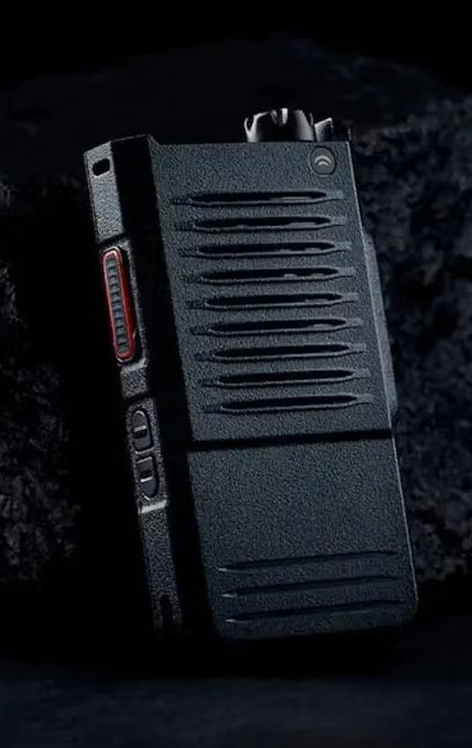

Cellular-Based Radios
  SD7: Cellular-based radio
Nationwide coverage – operates on LTE networks, no range limits
Push-to-talk simplicity
One-to-one & group calls
No dead zones
Rugged & school-ready
Secure & encrypted
Instant communication when seconds count.
  Ideal for:
School resource officers
Campus security
Facilities & transportation team
© 2025 Premier Wireless. All rights reserved.​

Slide 29


School Bus Radios
  Siyata School Bus Radios
Nationwide coverage using cellular networks, eliminating range limitations of traditional radios
Amplified external speaker ensures clear communication in noisy conditions
Rugged, durable design built to withstand daily school bus environments
Seamless slide-in/slide-out operation for instant in-vehicle and portable use
Dedicated SOS emergency button for rapid alerting and response during incidents
One-to-one or group conversation
© 2025 Premier Wireless. All rights reserved.​

Slide 30
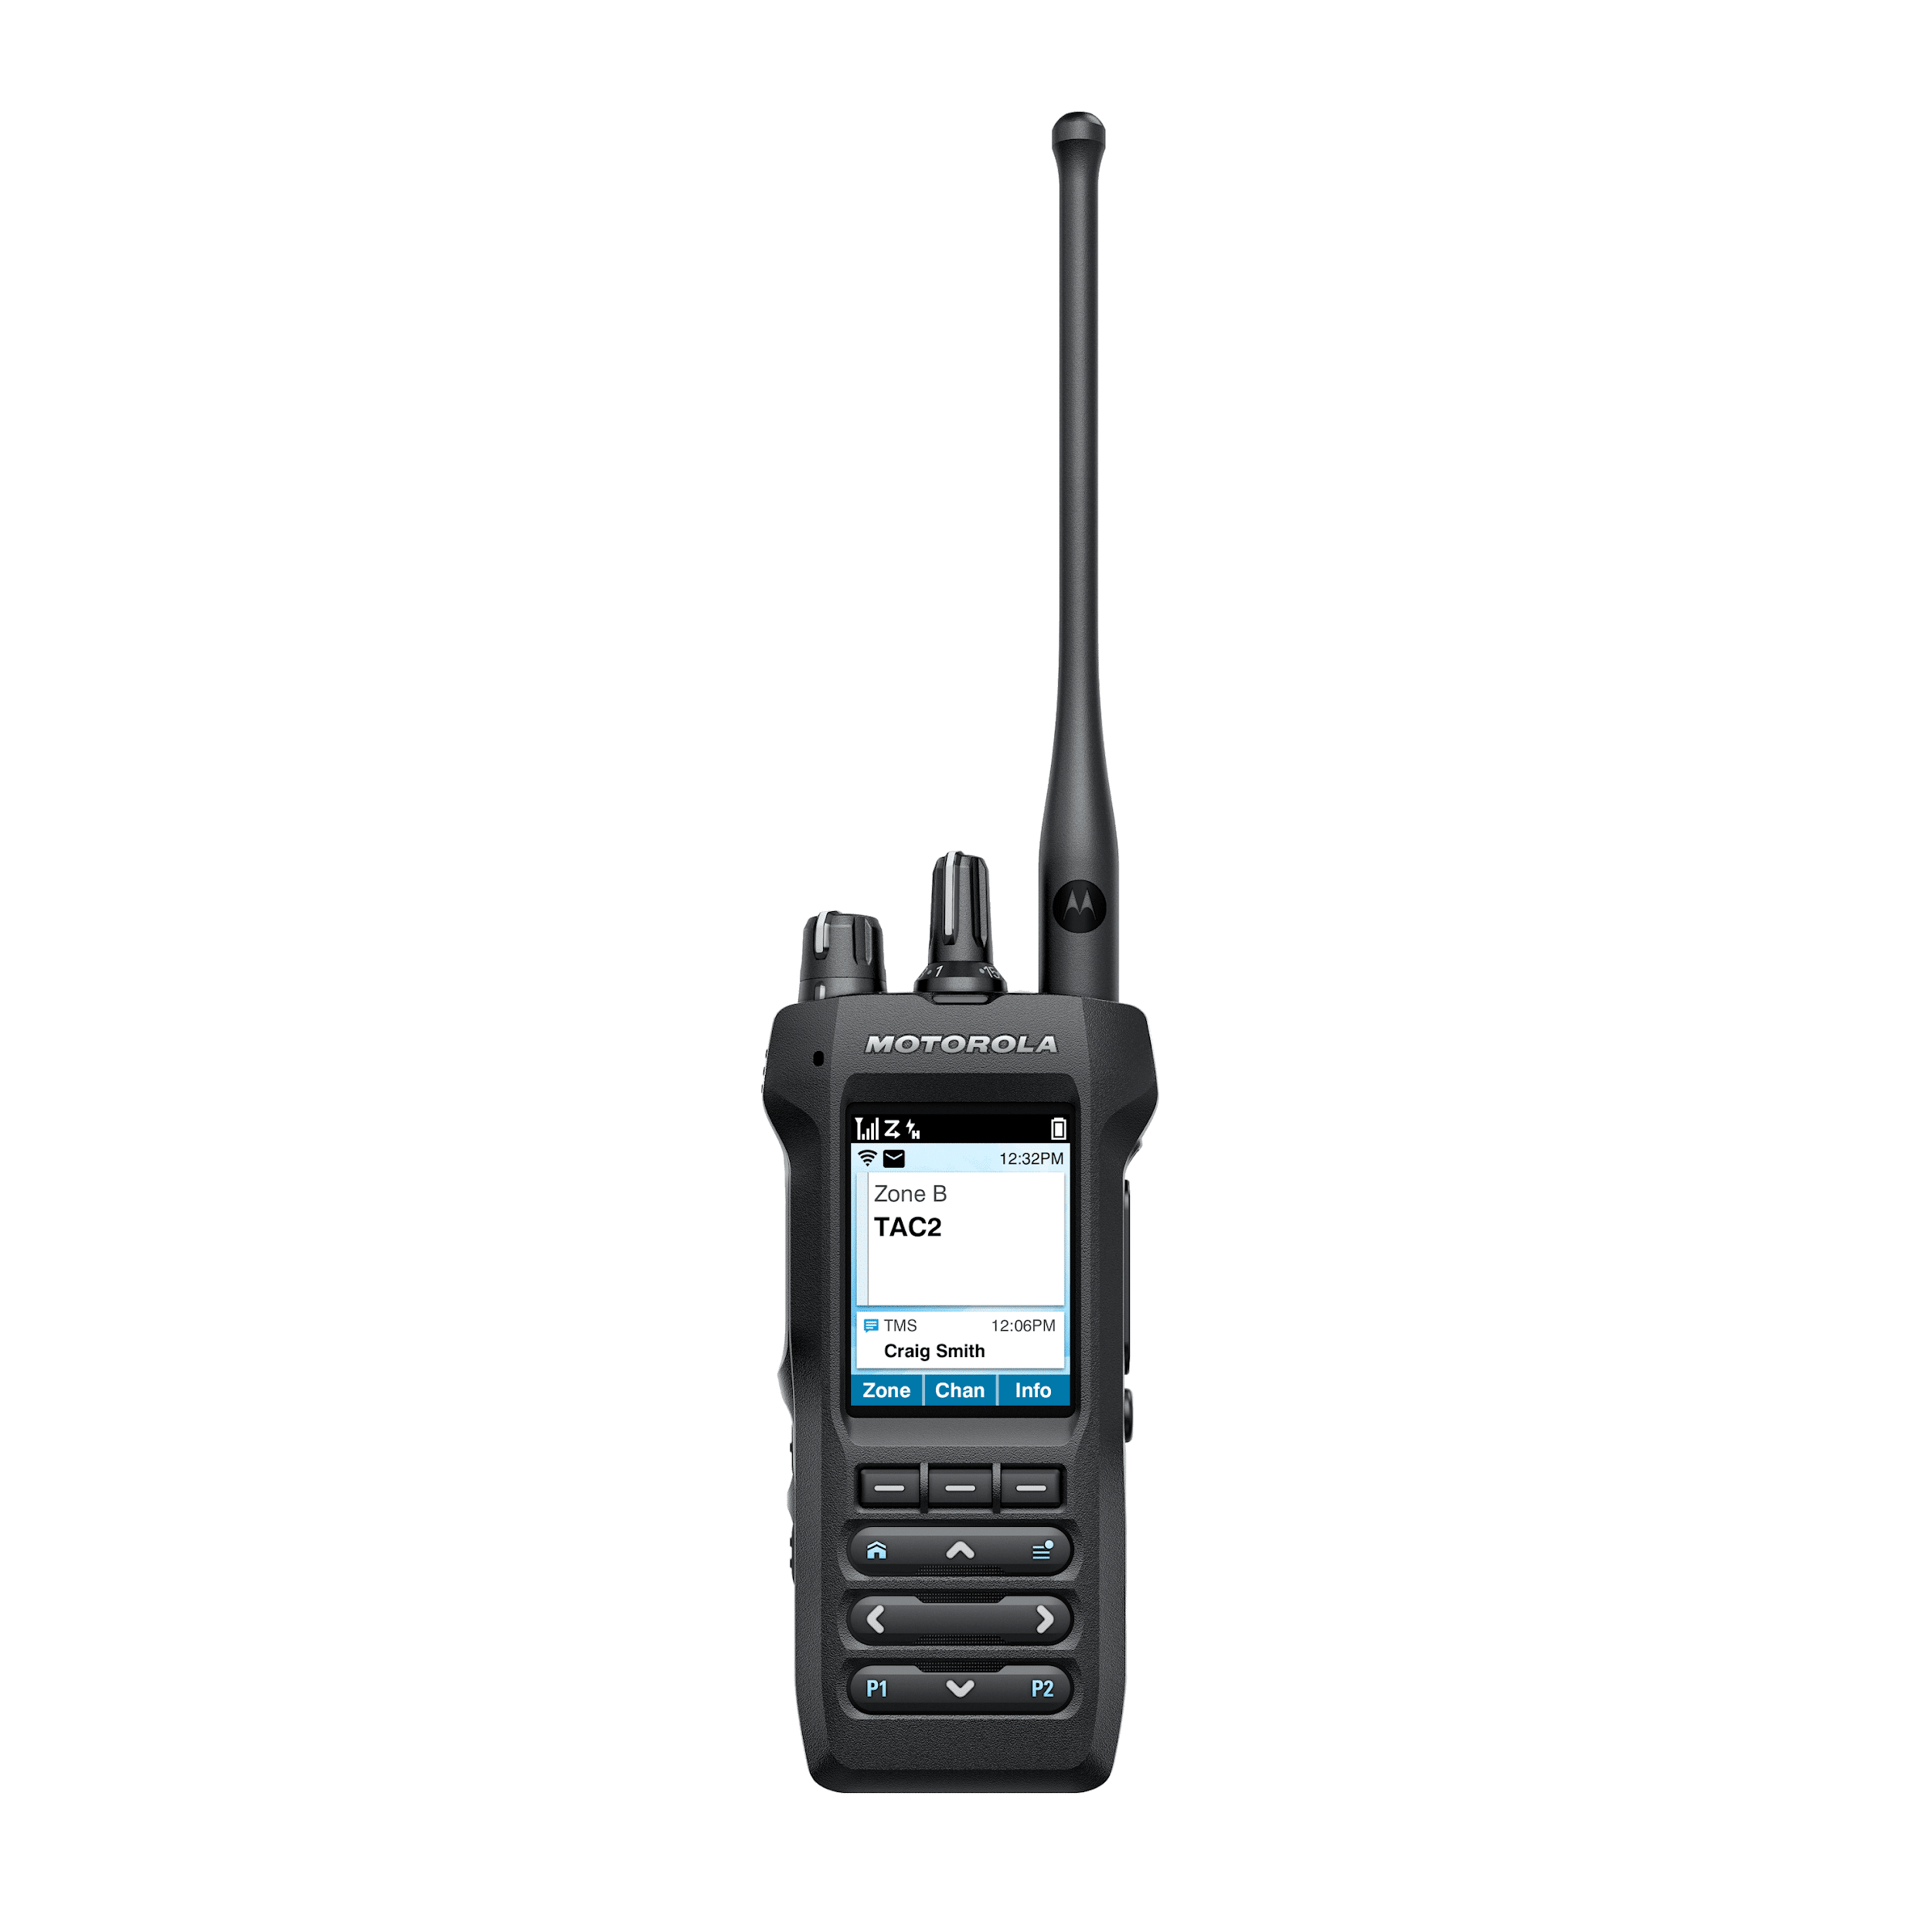


Interoperability
Donor Radio
ROIP Box
© 2025 Premier Wireless. All rights reserved.​

Slide 31

5G School Bus Cameras
  SafeSight cameras – Hardware & connectivity
AI-powered dual cameras
8-camera 360° school bus system
Secure cloud video storage
Onboard panic button
Built-in mic & loudspeaker
Unified command dashboard
Embedded 5G & LTE connectivity
GPS tracking
  Benefits of 5G cameras for school safety
Real-time monitoring & live alerts
Immediate response in emergencies
  Advanced features
Stop-arm violation capture
Driver rear view camera
Cloud storage & remote video access
Driver coaching alerts
Integrated GPS and route tracking
Rugged, school bus-ready design
© 2025 Premier Wireless. All rights reserved.​

Slide 32






ConnectED Bus WiFi
REAL-TIME
CAMERA ACCESS
WIFI ON
THE BUS
GPS
TRACKING
STUDENT
SIGN ON
CLOUD
MANAGEMENT
© 2025 Premier Wireless. All rights reserved.​

Slide 33







Crosswalk Student Ridership
STUDENT TRACKING & PARENT APP
GPS &
ROUTING
TURN-BY-TURN
DIRECTIONS
FIELD TRIP
MANAGEMENT
PRE & POST
TRIP INSPECTIONS
SCHOOL INFORMATION SYSTEM INTEGRATION
© 2025 Premier Wireless. All rights reserved.​

Slide 34

Automatic Vehicle Location (AVL)
Crosswalk Student Safety Solution
  FEATURES: Powerful, real-time tracking & student accountability
5-second GPS updates for real-time tracking
Smart ridership: RFID, barcode or touch screen
Real-time reports for administrators
Supports commutes, trips, and events
  FUNCTIONALITY: Tools for drivers, admins, parents, and students
Turn-by-turn directions
Route planning & optimization
Parent & student app
Field trip manager
Pre & post trip inspections
SIS integration
  BENEFITS: Smart technology for smarter, safer transportation
Improves safety for students & drivers
Prevents missed pickups & drop-off errors
Reduces route errors, fuel use & labor
Builds parent trust with parent app
Streamlines inspections & safety checks
Simplifies daily & event coordination
© 2025 Premier Wireless. All rights reserved.​

Slide 35
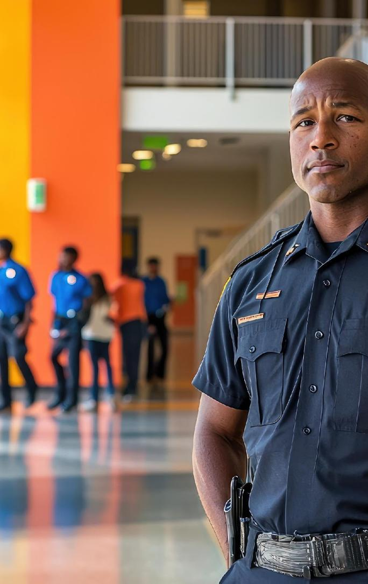
Technology Tools for
School Resource Officers
Empower school-based officers with mobile tools for faster response, real-time coordination & student protection.
  Rugged Laptops (MDTs)
In-vehicle access to dispatch, reports & maps
  5G In-Vehicle Routers
Secure, always-on connection for real-time school communication
  Body Worn Cameras
Live, GPS-tagged video for transparency & rapid response
© 2025 Premier Wireless. All rights reserved.​

Slide 36

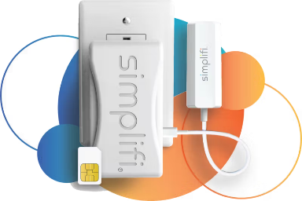
POTS Line Replacement
Modern connectivity in minutes—no rewiring,
no downtime.
  Modernize Critical Communications
  Replace aging copper lines with reliable connectivity
Reliable cellular connectivity
Easy deployment & cost-effective
24/7 monitoring & battery backup
Compliance-ready
E911
  Support Essential Systems
  Enhanced 911
Fire & alarm panels
Elevators
Fax machines
Gate entry
Emergency phones
Blue light boxes
Precise location data when 911 is dialed
Faster emergency response
Direct routing to the nearest PSAP
Automatic location identification
Supports Kari’s Law and Ray Baum’s Act
© 2025 Premier Wireless. All rights reserved.​

Slide 37
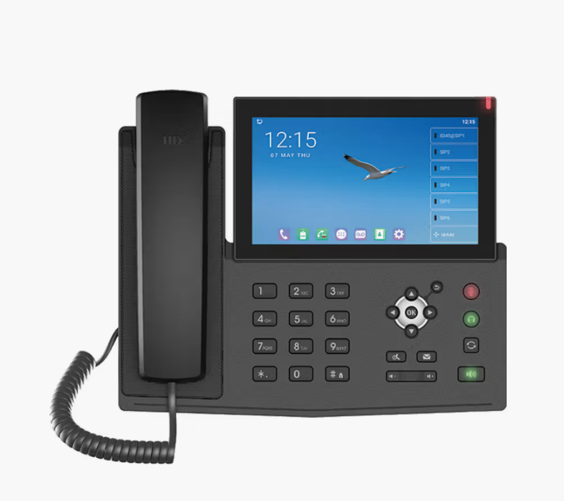
Modern Emergency Phones:
Reliable POTS Replacement for Schools
  Key Features & Benefits
Native E911 support – Provides precise location data for compliance and faster emergency response.
Built-in battery backup – Maintains phone operation during power outages, ensuring critical access.
Reliable connectivity (Cellular, Wi-Fi & Ethernet) – Dual network options keep lines active even if one fails.
Touchscreen interface – Simplifies quick dialing and call handling in urgent situations.
HD audio clarity – Crystal-clear calls ensure effective communication when every second counts.
Email and text integration - Manage calls, texts, and emails from one device to streamline communication and response times.
Integrated contact directory with sync - Access and update shared contacts instantly across all connected devices.
© 2025 Premier Wireless. All rights reserved.​

Slide 38

Door, Vape & Smart Sensors
  Door & Window Sensors
Monitors open & close status
  Vape Detection
Instantly identifies vaping in restrooms & restricted areas
  Gunshot Detection
Sends immediate alerts to security teams for rapid response
  Bullying & Aggression Monitoring
Detects loud noises, shouting, or altercations
  Occupancy Monitoring
Tracks restroom crowding & unusual activity
  Connected sensors = faster response, safer campuses
© 2025 Premier Wireless. All rights reserved.​

Slide 39


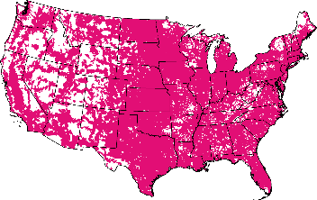
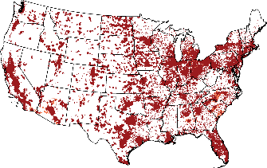
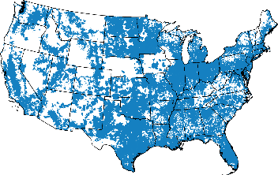
We have a clear and demonstrable lead in 5G.
Low-band | Extended Range 5G: 2.2M sq. miles 333M people covered | 5G Nationwide 0.85M sq. miles 293M people covered | 5G Nationwide 1.67M sq. miles 321M people covered
Mid-band & mmWave | Ultra Capacity 5G: 310M people covered | Ultra Wideband: 291M people covered | 5G Plus: 290M people covered
© 2025 Premier Wireless. All rights reserved.

Slide 40

Wireless Priority Service (WPS)
In an emergency, the wireless network may become severely congested and reach 100% of capacity. Priority Access and preemption help ensure users with WPS still get through.
End-to-end prioritization
Using WPS by dialing *272 or the
PTS Dialer app ensures end-to-end prioritization, regardless of which
carrier is at the other end.
Priority access
T-Mobile subscribers with WPS get moved to the front of the communication line.
Preemption
If necessary, a customer without WPS will be dropped to make room for one with WPS.
WPS functionality (including priority access and preemption) may not be available while roaming. Completion of calls not guaranteed.
© 2025 Premier Wireless. All rights reserved.

Slide 41
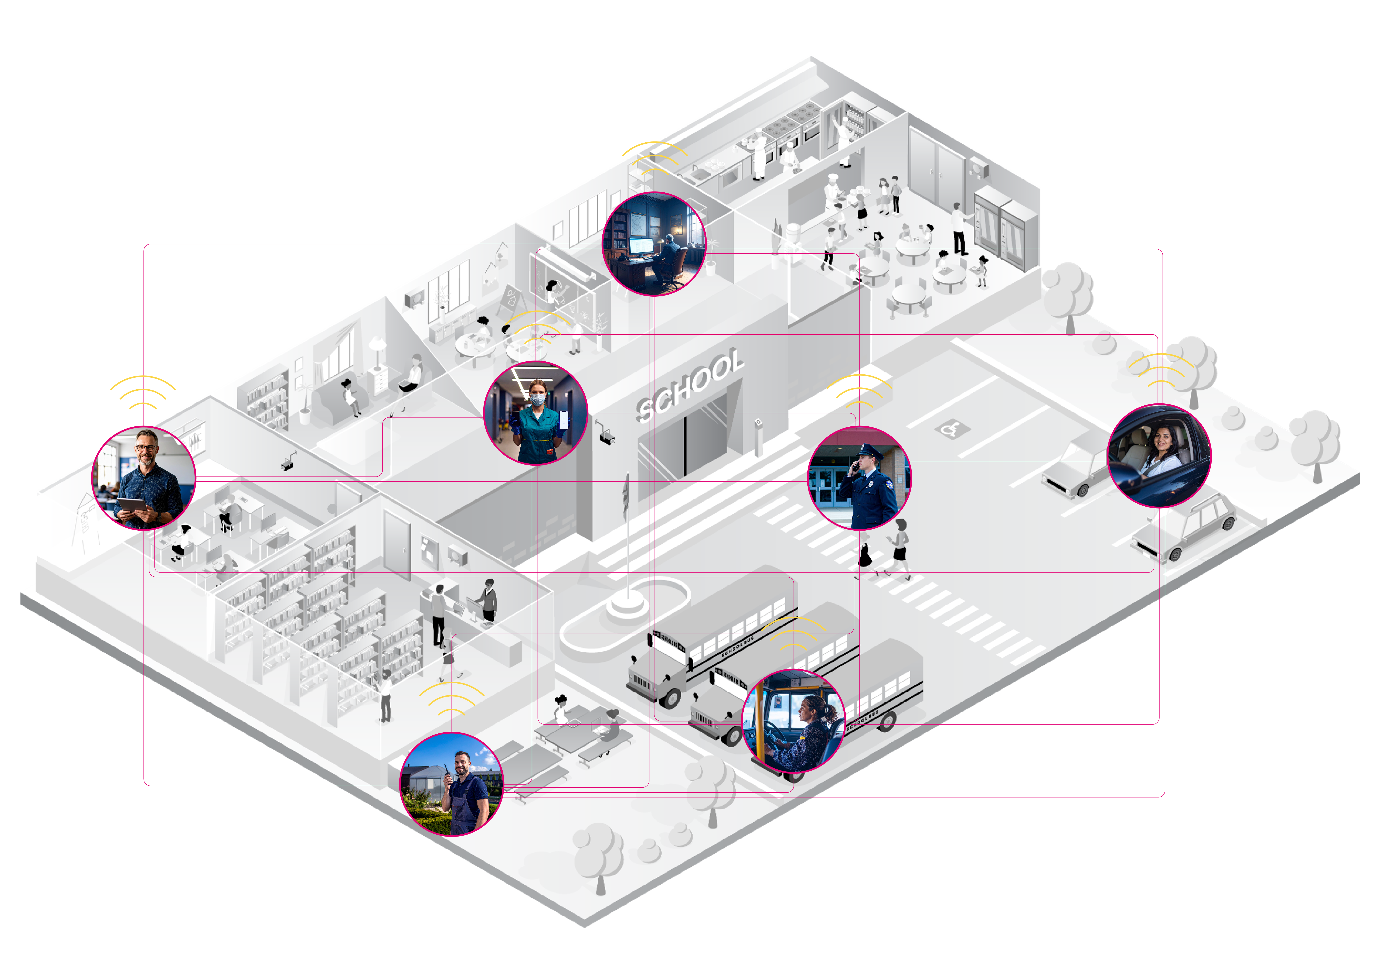
One district. One network. Unified through T-Mobile’s 5G.
Campus
    Principal
Asst Principal
Front Office
Nurse
Counsellors
Custodian
Food Service
SRO
Teachers
Coaches
Administration
Facilities & Maintenance
Technology
Warehouse
Landscape
Transportation

Slide 42

Questions?
What’s the top priority for your campus?
What’s the best way to move forward from here?
Who else would you like to bring to our next conversation?
(281) 667-0404
© 2025 Premier Wireless. All rights reserved.

