Slide 1



CPR³
Connecting People to Resources

Slide 2
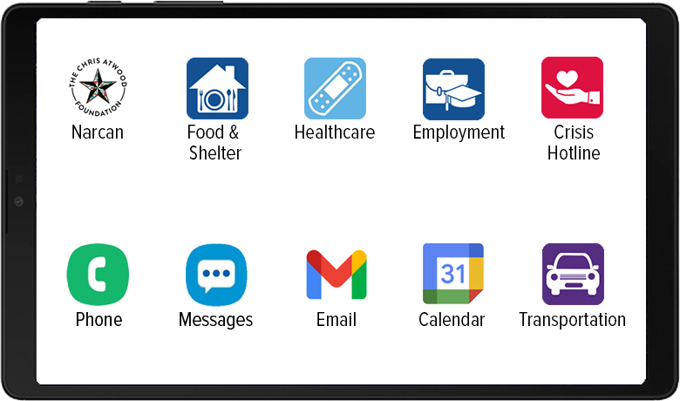

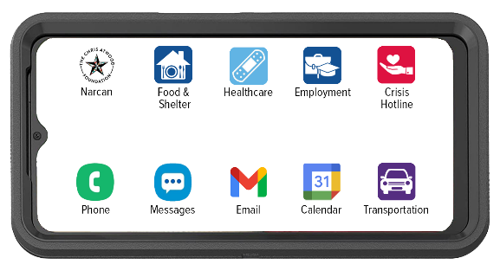

Our mission
Premier Wireless enables innovation, communication, safety, and transformation through technology.
CPR³ Tablet
CPR³ Smartphone

Slide 3







CPR³: Customizing your device
The CPR³ device is custom-built to provide access to many different resources.
It’s this simple, tap the icon & get a list of available resources.
Food & Shelter
WIC
Snap
Food Bank Southern Va.
Oxford House
Healthcare
Medicaid
Medicare
MyTherapy
SAMHSA Treatment Locator
Employment
GED Program
Goodwill
Indeed Job Ready
Virginia Career Works
Crisis Hotline
Veterans Crisis Line
Virginia Opioid Help
Suicide Crisis Hotline
NA Meeting Search
Icons can be an individual app, a link to a webpage,
or a folder containing multiple apps and webpage links.

Slide 4
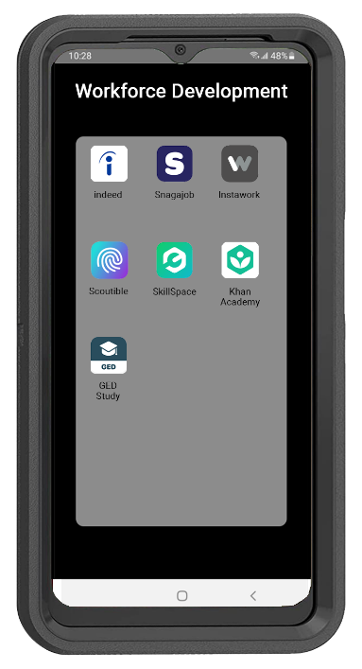

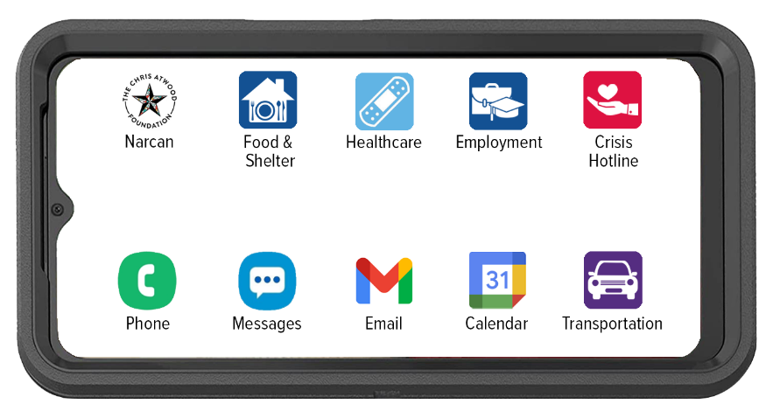



CPR³: Workforce Development & Careers
Training and/or jobs icons provide access to a folder
with basic education, skills training, and job resources.

Slide 5

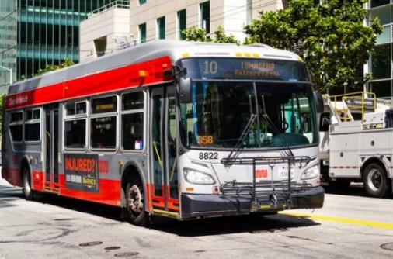


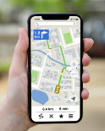


CPR³: Access to Maps & Transportation
Map and transportation icons provide the ability to plan public transit usage and routes.​
Google Maps and Access to other Transportation Options
Simplify Mobility Needs

Slide 6

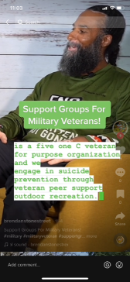
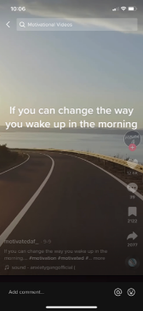
CPR³: Teach, Reach & Motivate with Videos
Workforce Development
Virtual Support Groups
Music & Meditation

Slide 7
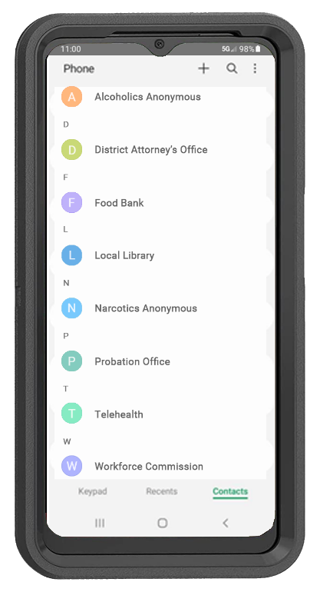


CPR³: Unlimited Communication
+
Provides the ability to call 911 in an emergency
Provides the ability to communicate with a stable
and consistent phone.
Provides people in recovery with a pre-programmed resource phone directory; easily updated at any time.

Slide 8
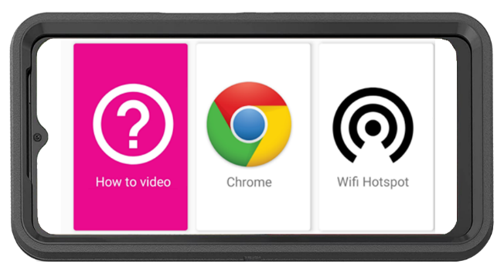
CPR³: Equity & Access
How-To Video with Step-by-Step Instructions to Connect Other Devices to the Hotspot
Unlimited On-Screen Data
11GB Hotspot Internet Access
Powered by T-Mobile, America’s Largest & Fastest 5G Network

Slide 9

CPR³: the impact
Facilitate Life-Saving Connections: Ensure individuals can easily connect with healthcare providers, mental health counselors, and addiction recovery support groups for immediate and ongoing assistance.
Rebuild Family Bonds: Enable better communication with loved ones and access to critical family services, fostering stability and emotional support during recovery.
Empower Individuals to Seek Help: Equip those in recovery with the tools and resources they need to confidently seek assistance, breaking down barriers to care.
Advance Education and Job Readiness: Provide access to literacy programs, job training resources, and digital skills development to increase employability and self-sufficiency.

Slide 10

Getting started
Identify:
Your goals
Your gaps
Your challenges
Your desired outcomes

Slide 11

WE’RE HERE TO HELP.
(281) 667-0404
premierwireless.com

