Slide 1
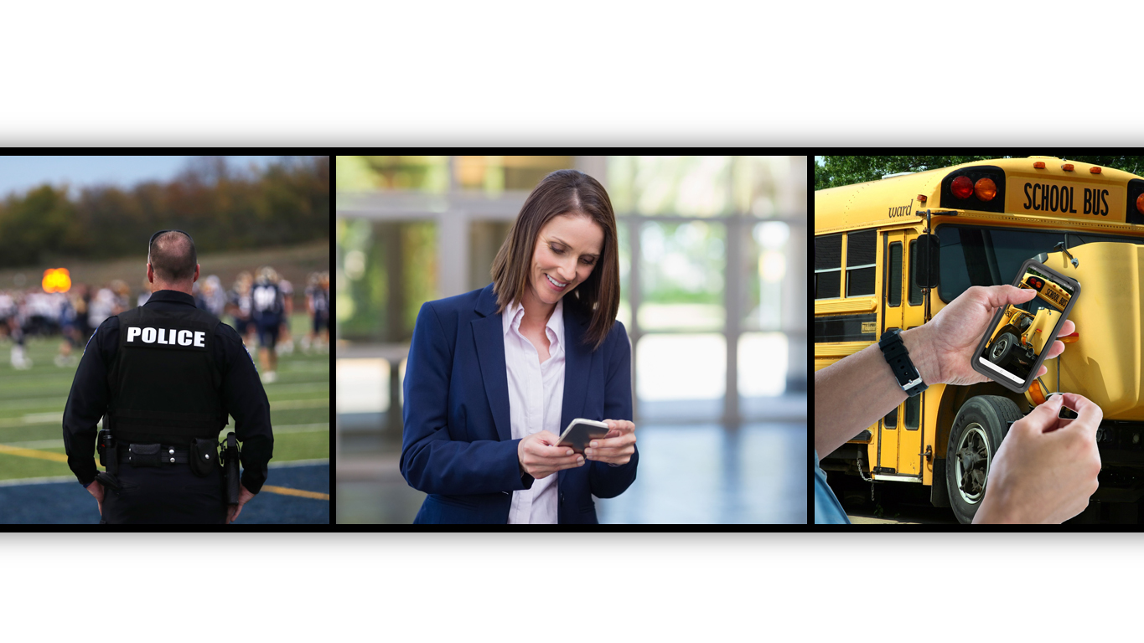


CPR³ - Connecting People to Resources

Slide 2





Day in the Life: Administrator
Building Coverage
Instruction
Student Discipline
Communication
Meetings

Slide 3
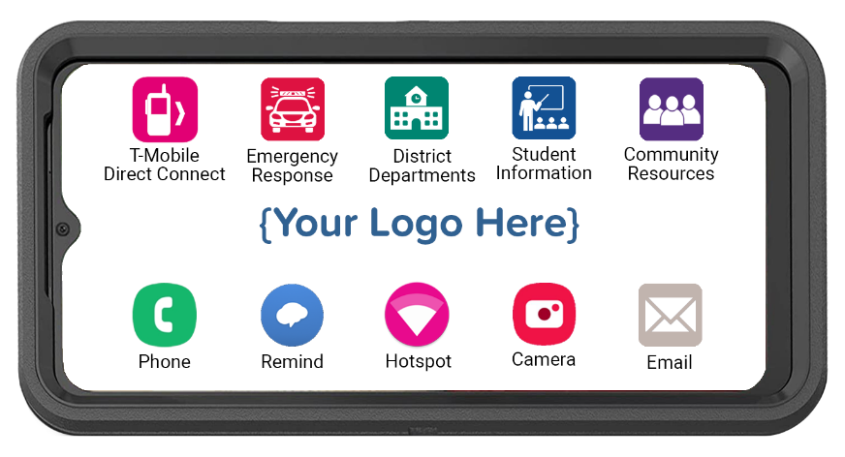
CPR³ Connecting People to Resources
Powered by T-Mobile
All-in-one device providing:
  Hand-held, body-worn computer
  Unlimited communication
  Instant access to resources
Plus, unlimited wi-fi hotspot, connecting up to 10 additional devices to the internet simultaneously
Cost-effective, robust solution for helping administrators and staff connect to critical resources anytime, anywhere

Slide 4
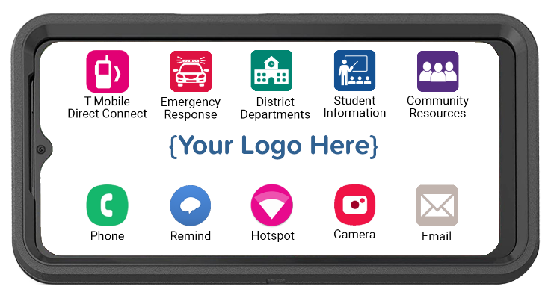




Customizing Your CPR³ Device
PTT
The CPR³ solution is custom-built to provide
access to many different resources.
Employees simply tap the icon and get your
list of available resources.
Emergency Response
District
Resources
Student
Resources
Community Resources
Emergency Contacts
District Policies
Reunification Procedures
Emergency Response Plan
Maintenance
Technology
Food Services
Social Services
Transportation
SIS
Activities & Events
Academic Plans
Class Schedules
Student Policies
CPS
Libraries
Icons can be an individual app, a link to a webpage or a folder containing multiple apps and webpage links.

Slide 5

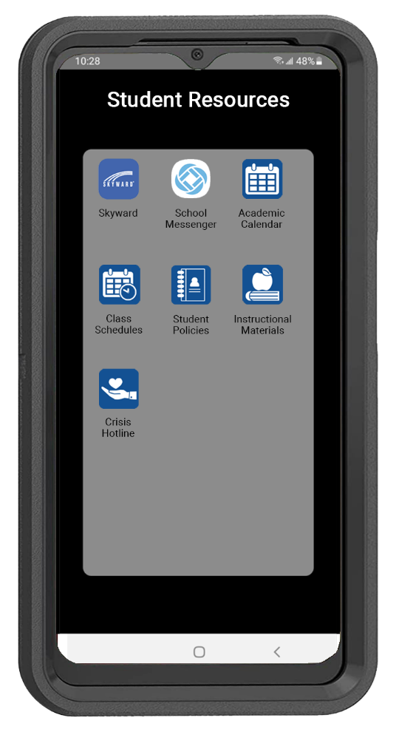


Student Resources
Enables administrators and staff to access resources anywhere, anytime from the
palm of their hand

Slide 6

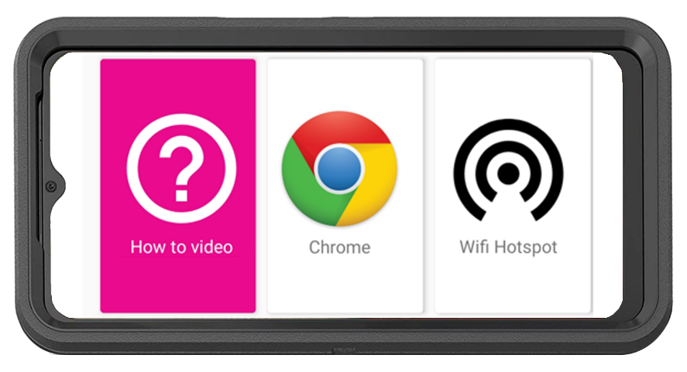
CPR³ Unlimited Internet Access
How-To Video with Step-by-Step Instructions to Connect Other Devices to the Hotspot
  English
  Spanish
  Pashto
  Farsi
Unlimited On-Screen Data
Plus, Unlimited Hotspot Data to Use
for Connecting Other Devices
Powered by T-Mobile – America’s Largest & Fastest 5G Network

Slide 7

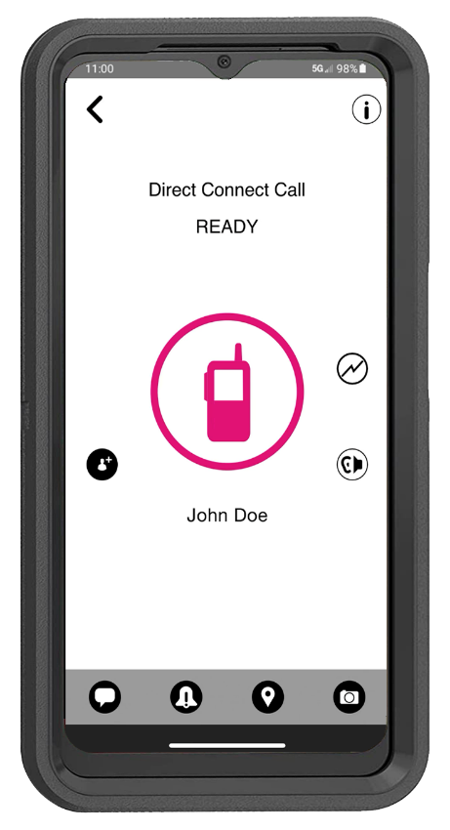
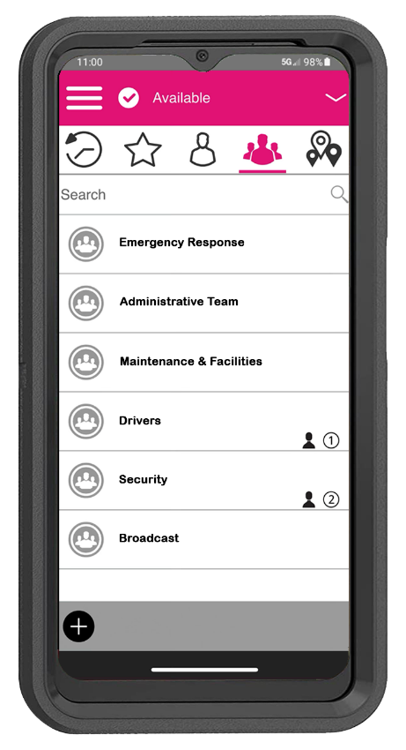
T-Mobile Direct Connect - PTT
Talk or send secure text and media to a group or an individual person
Easily create custom groups based on roles & responsibilities
View history of message and media from group & private calls

Slide 8
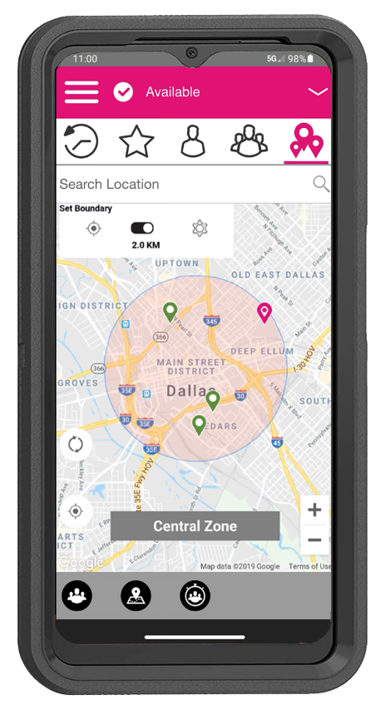
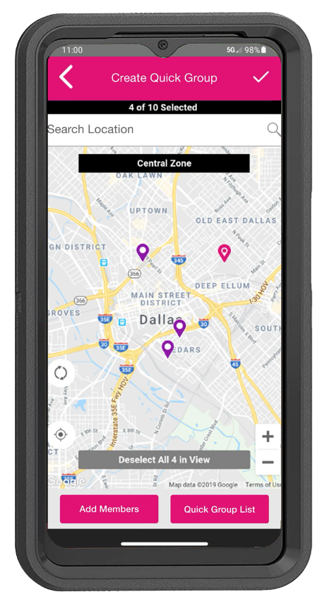
T-Mobile Direct Connect - PTT
Easily share your location with map view
Make a group call based on selected area

Slide 9
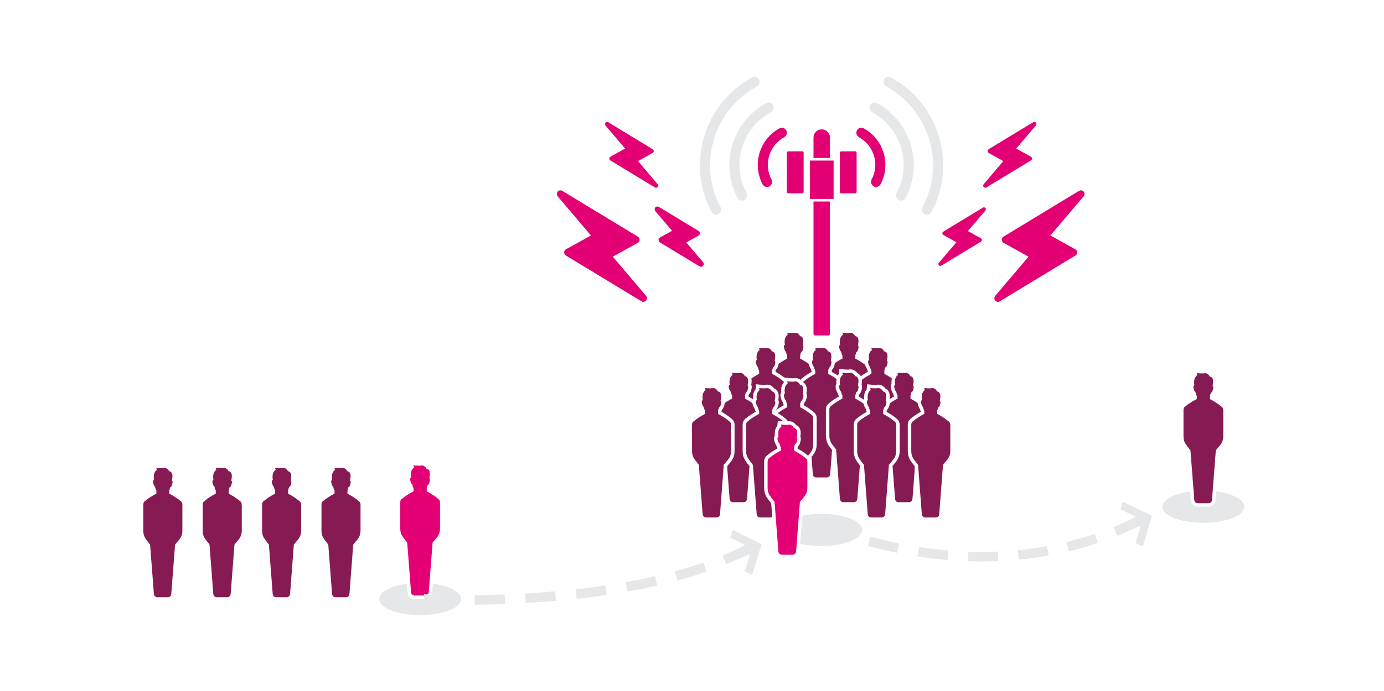
Wireless Priority Service (WPS)
In an emergency, the wireless network may become severely congested and reach 100% of capacity. Priority Access and Preemption helps ensure users with WPS still get through.
End-to-end prioritization
Using WPS by dialing *272 or the PTS Dialer app ensures end-to-end prioritization, regardless of which carrier is at the other end.
Priority access
T-Mobile subscribers with WPS get moved to the front of the communication line.
Preemption
If necessary, a customer without WPS will be dropped to make room for one with WPS.
WPS functionality (including priority access and preemption) may not be available while roaming. Completion of calls not guaranteed.

Slide 10

WPS – How it Works
WPS enhances call completion when cellular networks are overloaded or impaired.
WPS is an add-on feature to existing cellular service
WPS provides priority on the connection between the user’s device and the tower
Carrier agnostic–available on
all nationwide
and some regional cellular carriers
Provides 95% call completion rate
There are more than 594,000 WPS users
* Source: CISA About Priority Telecommunications Services https://www.cisa.gov/wireless-priority-service-wps

Slide 11
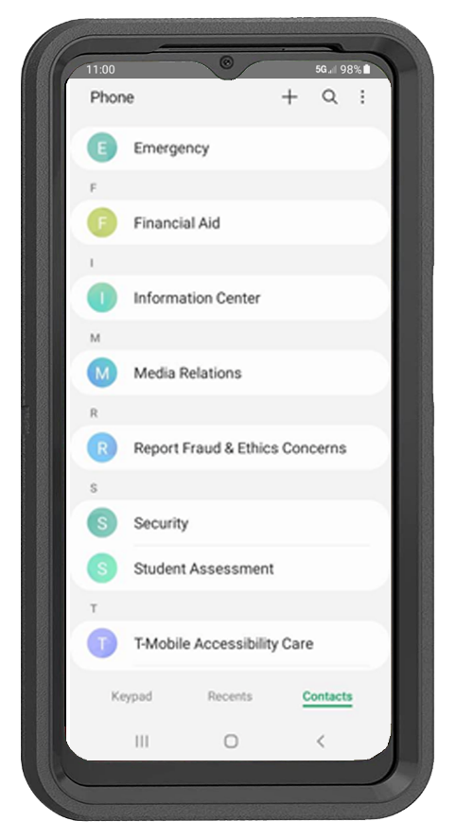



CPR³ Unlimited Communication
Unlimited Nationwide Calling
Unlimited Texting
Easily deploy a resource phone directory to all devices
  Easily update phone directory anytime

Slide 12
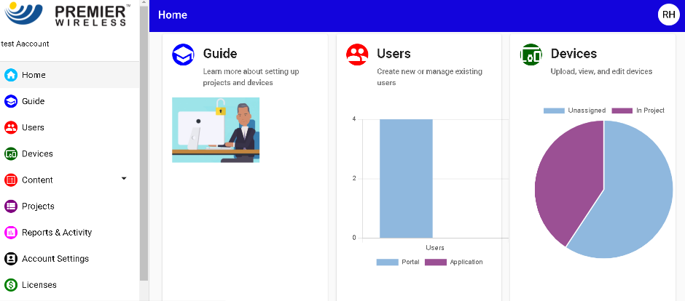
CPR³ Turn-Key 5G Solution with White Glove Support
Smart Device
Rugged Case, Screen Protector
& Charger
Initial Device Enrollment
2-Year CPR³ Software License
2-Year CPR³ Portal Admin Support
White Glove Project Management
& Post-Sales Support
Completely customizable to provide your local resources in the desired language
Remotely add, update or remove apps for educational programs, facilities management, district schedules & other resources

Slide 13
CPR³ Software Additional Benefits
Easily add or remove apps & links
Customize the look & feel
Personalize with your logo
Manage usage by time & day
Monitor usage per device
Optional CIPA filter for web traffic
Locate devices with GPS (optional)
Restrict user’s ability to download additional apps
Lockdown & restrict lost or stolen devices
Control device settings - brightness, screen time out, font size & color, etc.

Slide 14

Let the CPR³ help bring success to your administrators and staff.
www.pwbts.net 281-667-0404

