Slide 1
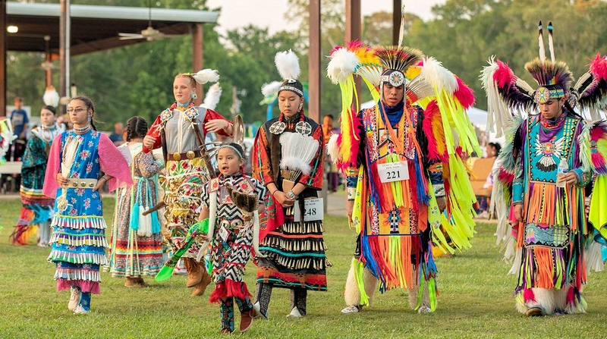


Tribal
Solutions

Slide 2


DIGITAL EQUITY & STATS
Native Americans have one of the highest poverty rates among racial and ethnic groups in the U.S. They often experience income disparities compared to the general population, with a median household income lower than the national average.
Rural
Tribal

Slide 3
Cellular Technology as a Bridge to Prosperity
In Native American communities, mainly rural areas, reliable cellular technology and broadband internet access are challenges. Many rely on cell phones as their primary online connection, but unreliable cell coverage often forces them to depend on local institutions like libraries, tribal offices, or schools for internet access.
Rural
Tribal

Slide 4
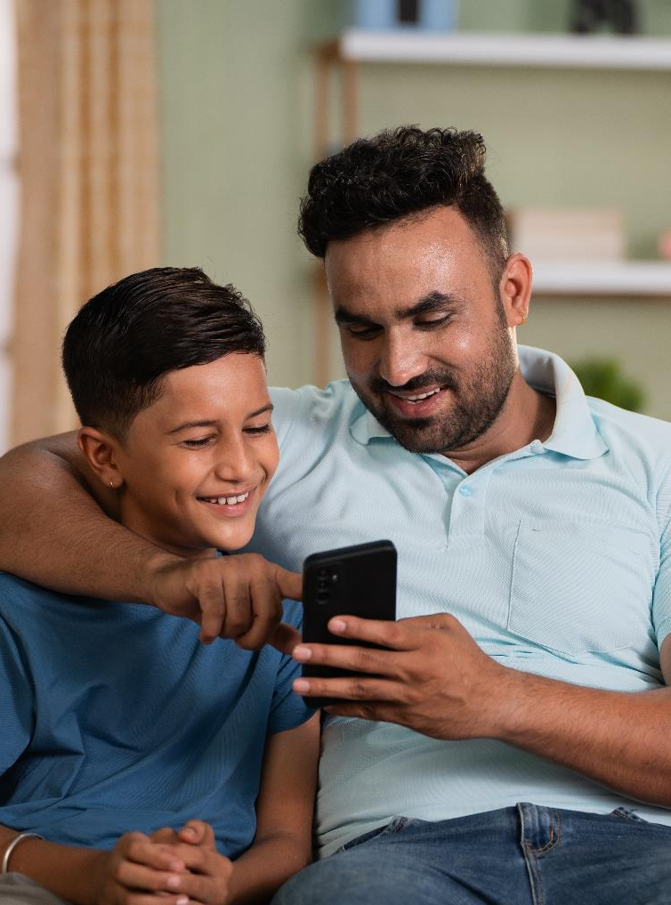

education
Bridging the Digital Divide with Access to Education

Slide 5

healthcare
Access to Telehealth,
Remote Monitoring &
Office Administration

Slide 6
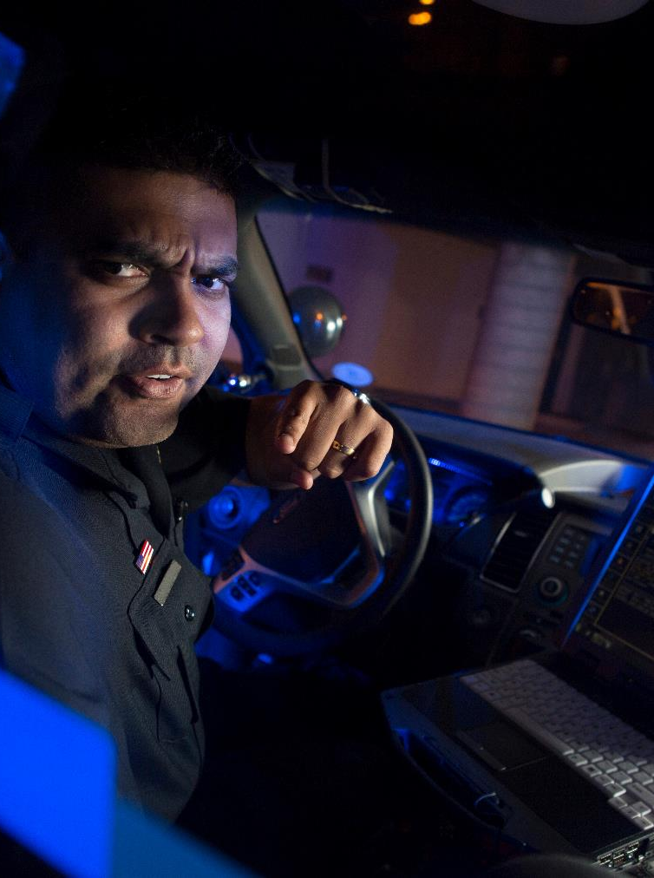
Public safety
Access to Emergency Response Systems & Community
Watch Platforms

Slide 7

agriculture
Access to Smart Agricultural Techniques & Sustainable Practices

Slide 8
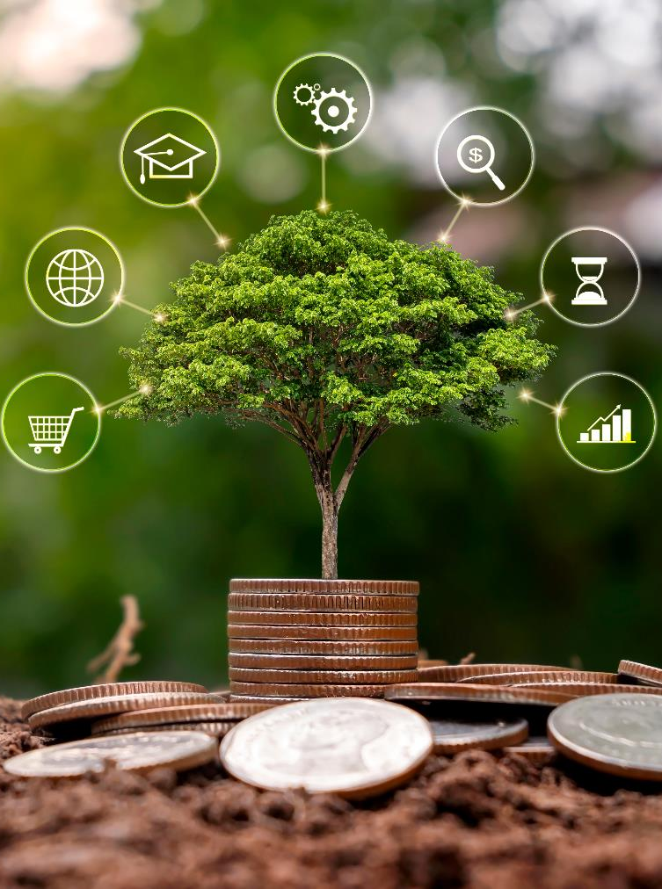
Economic
development
Support for Small Business &
Job Creation Through
Digital Platforms

Slide 9
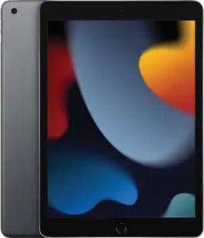
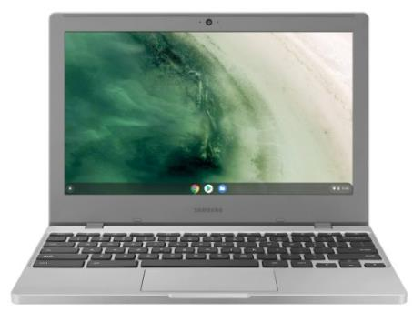

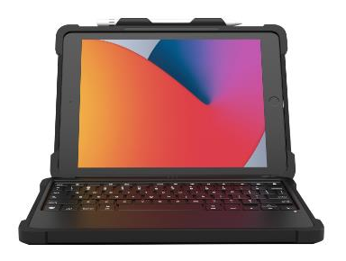

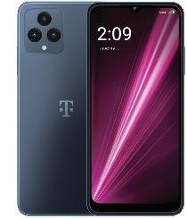


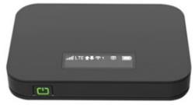
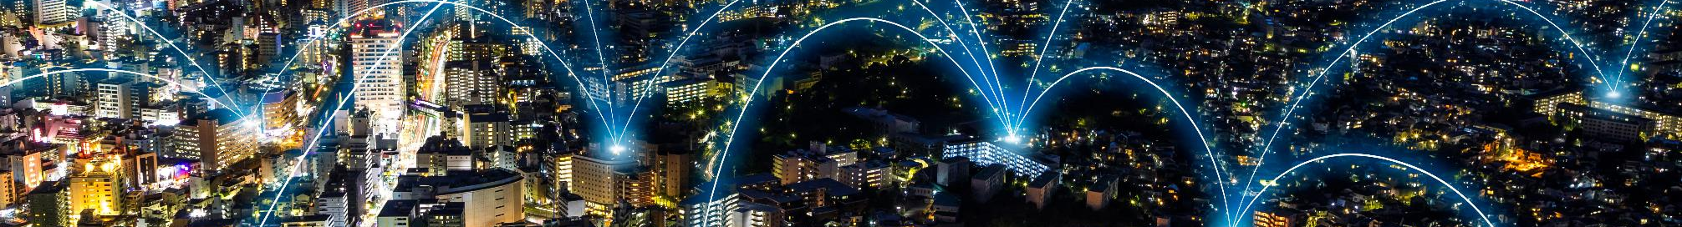
CPR³ DEVICES
All-In-One
Small Compact & Portable
‘Low Computer Skill’ Knowledge Needed
2:22
Tue, Jul 25

Slide 10
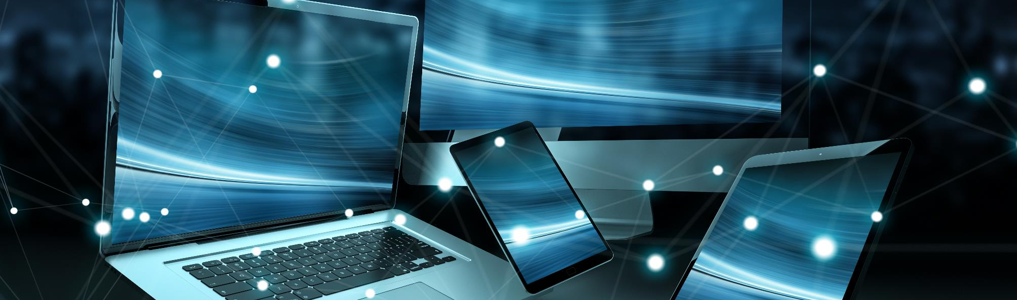
OUR MISSION
Premier Wireless enables innovation, communication, safety, and transformation through technology.

Slide 11



HOW CAN WE HELP?

Slide 12
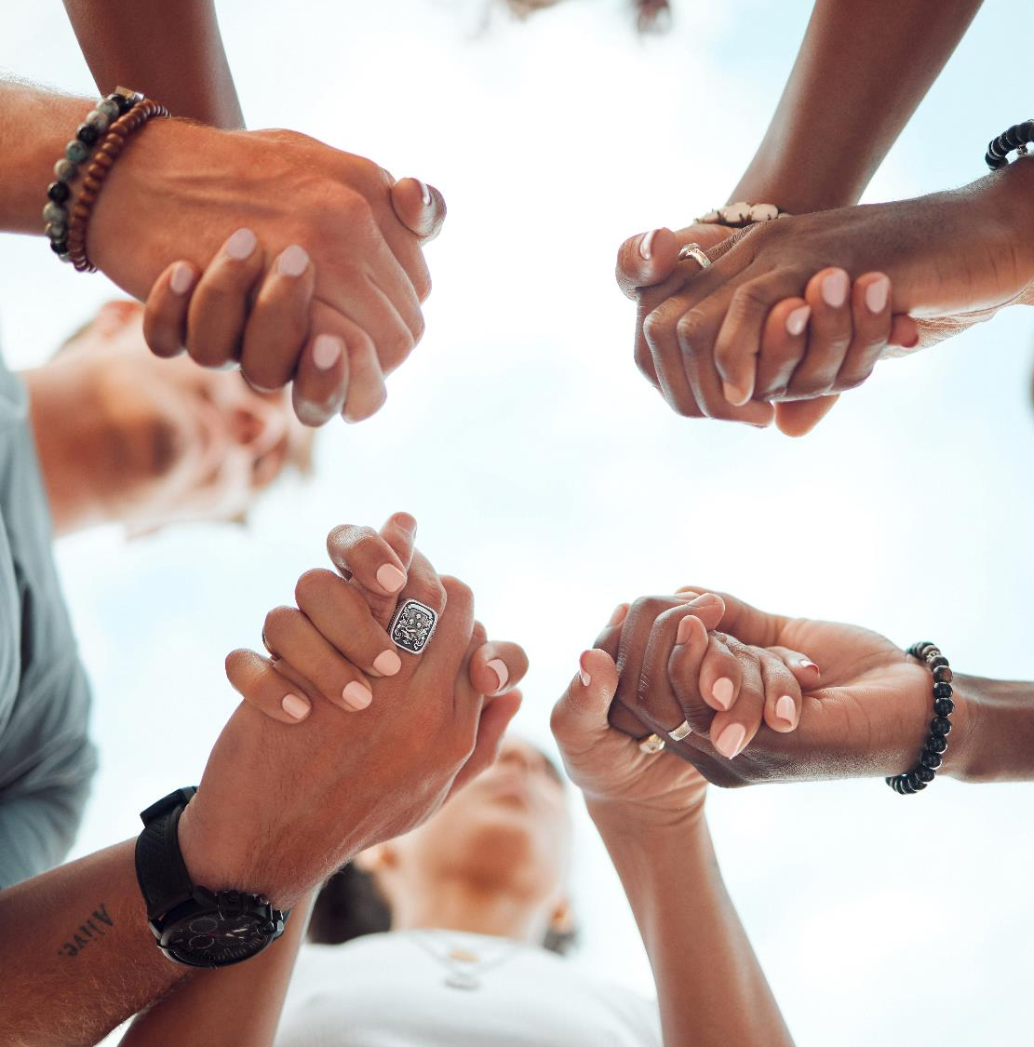
WE’RE HERE TO HELP.
(281) 667-0404
premierwireless.com

