Slide 1



Library
Solutions

Slide 2

Our mission
Premier Wireless enables innovation, communication, safety, and transformation through technology.

Slide 3

Who do you serve? What do they need?
Community Poverty Levels
Local Infrastructure Limitations
Homelessness
Workforce Development Needs
Seniors
Other Targeted Populations
Census Data

Slide 4
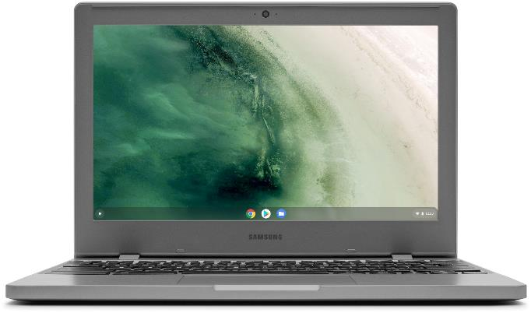
Chromebooks & Laptops
Laptop & Chromebook Checkout Program
Chromebooks
Easily Manage Content
  Google Chrome Licenses
  MDM
  Remote Lockdown
  Install only web apps
  Lower Cost of device
Laptops
Easily Manage Content
  MDM
  Remote Lockdown
  Install Apps
Your Choice: Wi-Fi Only or 5G Enabled

Slide 5

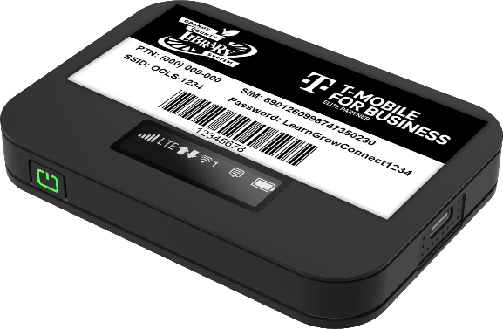
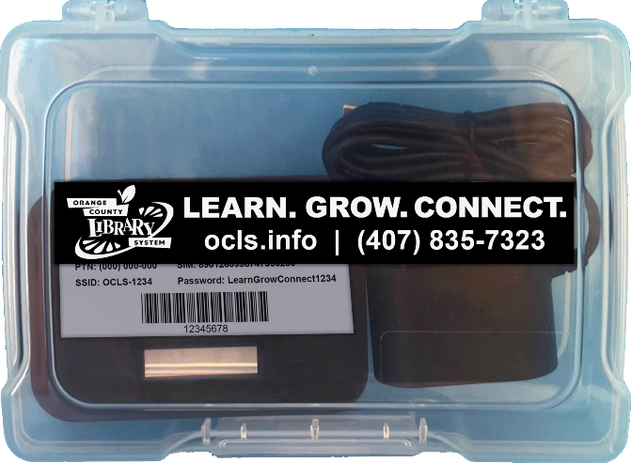
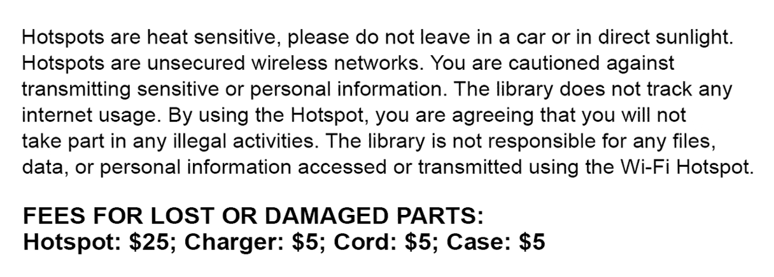
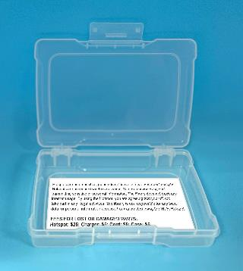
Library HOTSPOT CHECKOUT Program
Every hotspot is pre-configured and Includes:
    Hotspot
    Mobile Device Management (MDM)
    Protective Cases
    Custom Labels
      Your Branding
      How to Connect Instructions
      Library Policies
      Asset Tags
    T-Mobile Unlimited 5G Data

Slide 6

Introducing Premier’s CPR³ Program

Slide 7
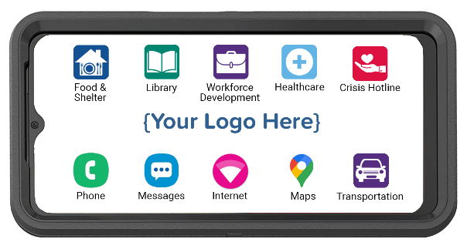

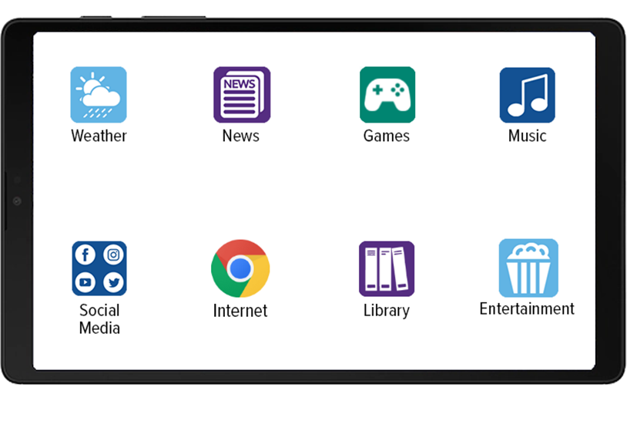


CPR³ profile customization
Fully Customizable to your location and patrons’ needs
Tap an icon to view available resources
Library Core Solutions
E-Books
Audio Books
Card Games
Trivia
Library
Online Book Club
Games
Entertainment
Social Media
…

Slide 8






CPR³ Supporting Communities
The CPR³ solution is custom-built to provide access to the resources your patrons need.
Clients tap the icon to view available resources.
Healthcare
Mental Health
Telehealth
Local Clinics
Medicaid/CHIP
Prescription Help
Food & Shelter
Local food banks
SNAP/WIC
Local shelters
Housing assistance
Utility bill assistance
Transportation
Bus Schedules
Medicare Travel
Uber/Lyft
Taxi
Crisis Hotline
Suicide Prevention
Sexual Abuse
LGBTQ Support
Domestic Violence
Substance Abuse

Slide 9

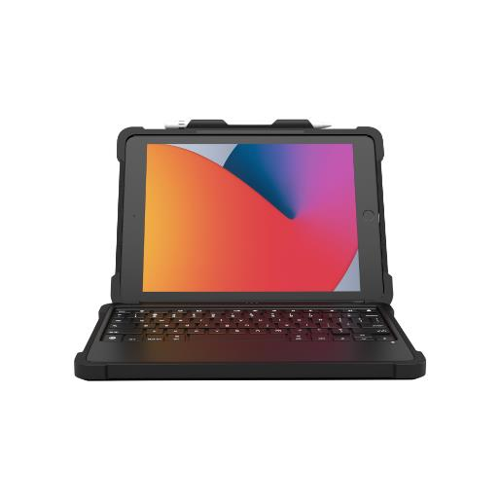
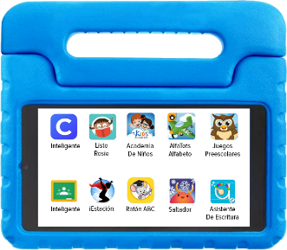
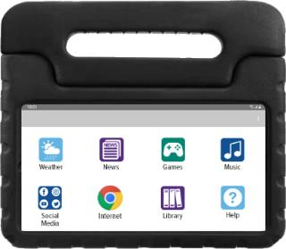




CPR³ Custom Tablets
Tablets can be “just” a tablet or easily customized
To meet the specific needs of each community
TotSpot
SilverSpot
SmartBook

Slide 10

silverspoT: THE CPR³ SOLUTION for Seniors
Every SilverSpot includes unlimited data, making it easy for seniors to connect with family and friends and access online games, social media, the internet, and more.
Additionally:
Handle converts to stand for hands-free use
Large icons for easier viewing
Tablet layout helps clients with minimal technical skills
Pre-configured with your desired apps and resources
Unlimited T-Mobile Data: $20 Month

Slide 11
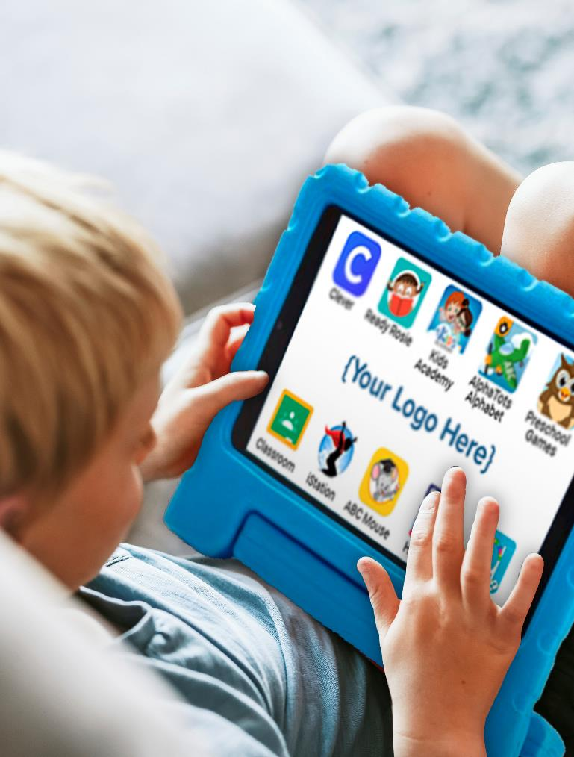
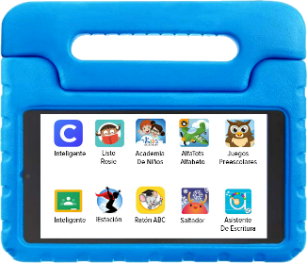
TotSpot: the CPR³ solution for Tots
Perfect all-in-one solution for early learners
  Pre-loaded apps help to build digital skills
  Touch screen allows students to trace numbers and letters
  Handle makes it easy for small children to carry
Rugged carrying case protects your investment
Hotspot functionality provides internet connectivity for the entire family
Sets the stage for a lifetime of learning
Unlimited T-Mobile Data: $20 Month

Slide 12
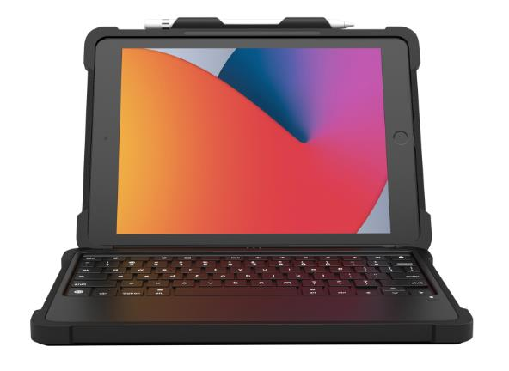


SMARTBOOK: The CPR3 Laptop replacement
Device & Accessories
Tablet or iPad
Protective Case & Keyboard
Screen protector
Wall charger
Optional Pencil
Set-Up & Service
One-Time Device Enrollment
Implementation Project Manager
Full support for design & set-up
CPR3 software license
CPR3 portal admin support
Unlimited T-Mobile Data: $20 Month

Slide 13

Devices for library Personnel
What does your staff need?
We can help!
Smartphones
Tablets
2-way based Radios
Laptops
Desktops

Slide 14

Internet backup & failover
How do internet outages impact you?
A robust internet connection is critical for securing, protecting, and ensuring constant accessibility across all your sites.
Our backup and failover technology creates an unbreakable VPN connection.
Why Premier’s Powered by T-Mobile Unlimited 5G Data:
  Resilient VPNs and VoIP
  System Availability
  Reduced Data Loss
  Simplified Disaster Recovery

Slide 15

Digital Literacy Training & support

Slide 16

funding
What are you already using?
State Funds/Governor's Funds
Library Service & Technology (LSTA) Grants
Digital Equity Act: NTIA
WHAT ELSE IS THERE?
  Partnerships
  Foundations
  Other Federal, State, County, and City Grants

Slide 17

WE’RE HERE TO HELP
(281) 667-0404
www.premierwireless.com

