Slide 1
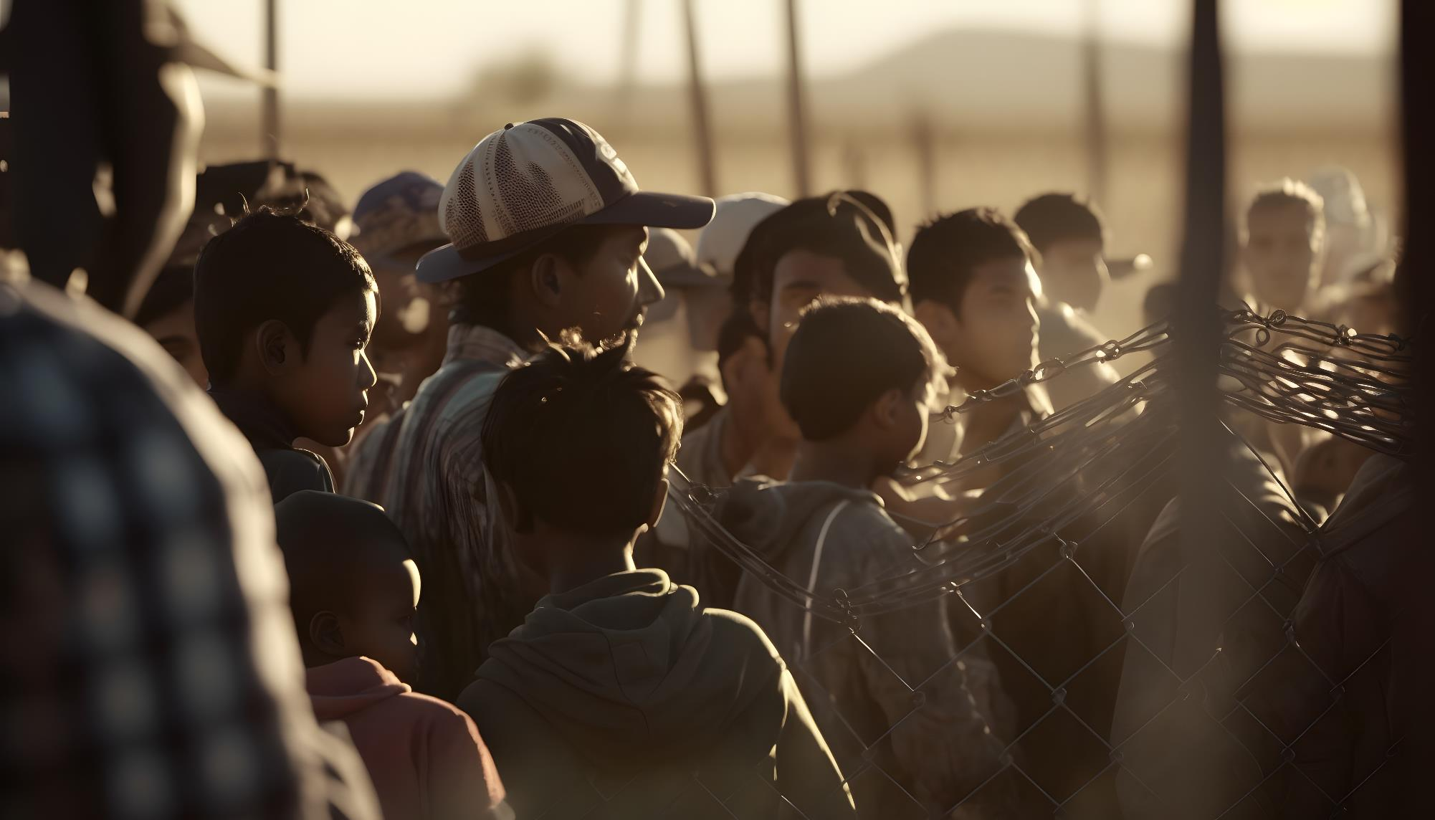


CPR³ FOR
newcomers

Slide 2


Our mission
Premier Wireless enables innovation, communication, safety, and transformation through technology.

Slide 3

CPR³: Connecting People to Resources
Support agencies provide newcomers with essential resources to navigate their new environments, such as:
      Temporary shelter or housing solutions
      Job placement and skill training
      Guidance on local customs and regulations
      Access to essential services
      Language and cultural orientation
      Mental and physical health resources
      Advocacy and rights awareness
      Assistance with family reunification
      Community integration programs
      Legal aid and advice on immigration processes
      Transportation assistance
      And more, ensuring their safety, dignity, and
      well-being in their new settings.

Slide 4
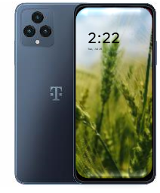
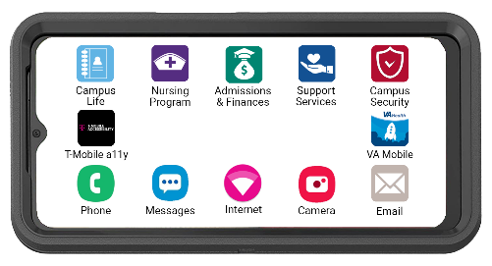
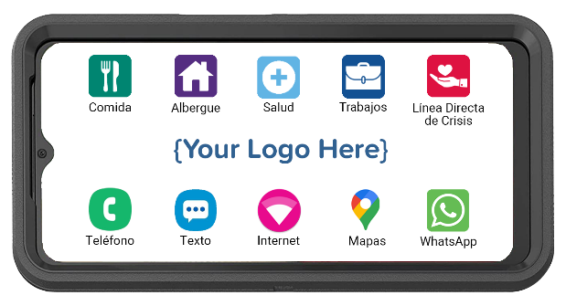


CPR³: All-in-one Device
All-in-One Device Providing:
Hand-Held Device
Unlimited Communication (Talk, Text, Data)
Plus, an Extra 11GB of HotSpot Data
Immediate Access to Resources
CPR³ is a cost-effective, robust solution powered by T-Mobile for helping newcomers connect to critical resources anytime, anywhere!

Slide 5
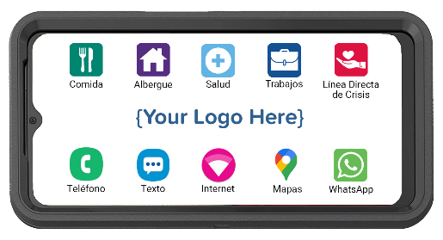





CPR³: customizing your CPR³ device
The CPR³ solution is custom-built, in the preferred language, to provide access to many different resources.
Families, tap the icon and get a list of available resources.
Transportation
Bus schedules
Taxi
Uber
Lyft
Education
Learning English
Head Start
K-12
Higher Ed
Adult Education
Health
Telehealth
Mental Health
Local Clinics
Prescription Help
Employment
Job Search
Skills Development
Worker Rights
Employment Resources

Slide 6
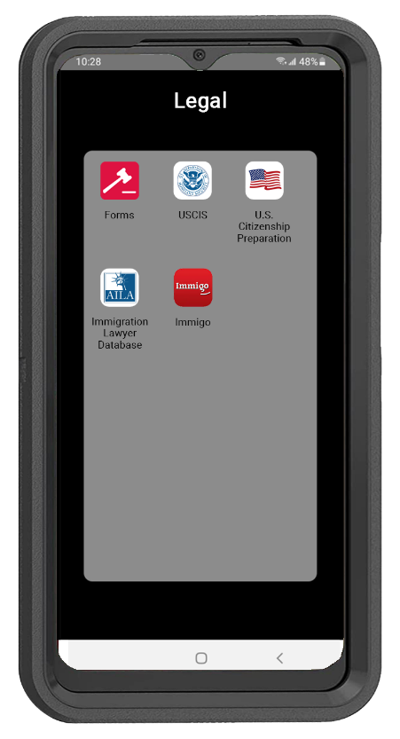
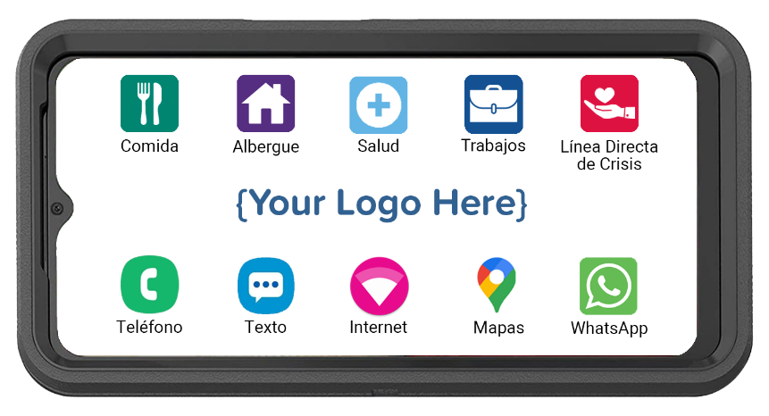
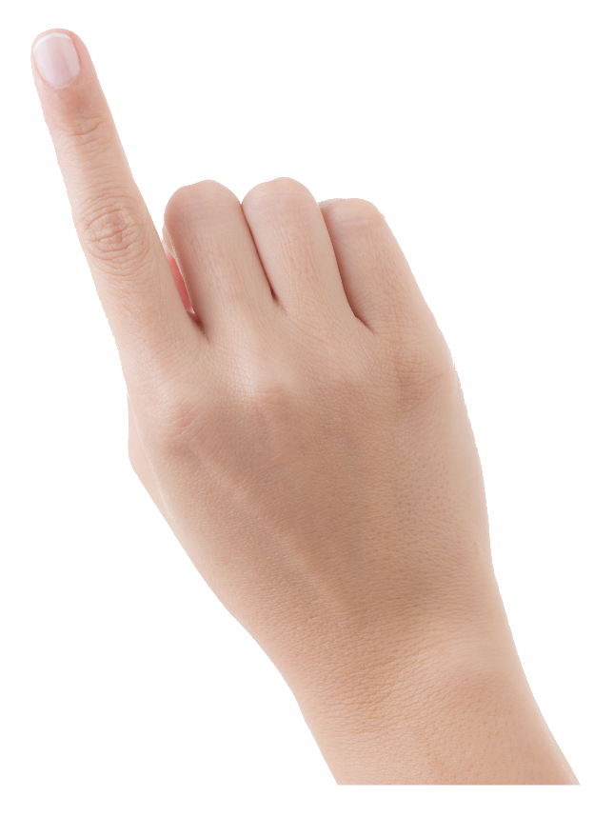
CPR³ : resource folders expanditions
Enables families to access resources
anywhere, anytime, from the palm of their hand.

Slide 7
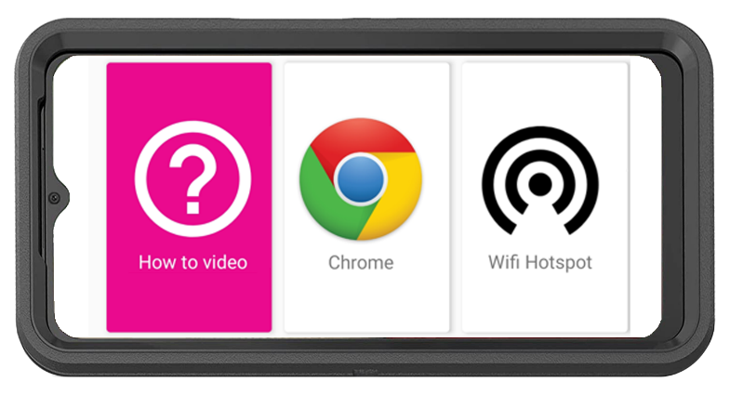
CPR³: unlimited internet access
How-To Video with Step-by-Step Instructions
to Connect Other Devices to the Hotspot
  English
  Spanish
Unlimited On-Screen Data
Unlimited Hotspot Internet Access
Powered by T-Mobile: America’s Largest & Fastest 5G Network

Slide 8
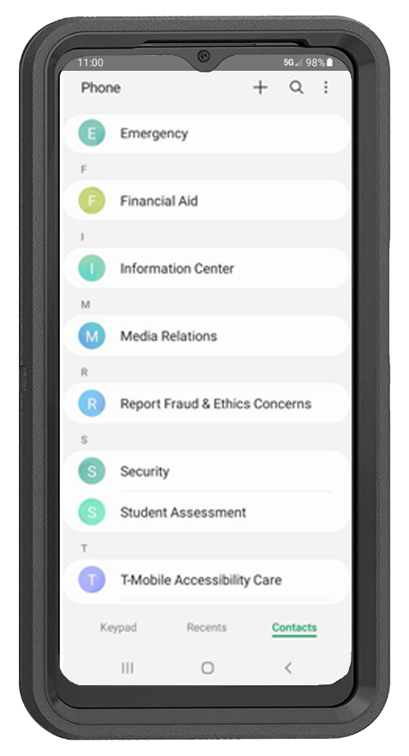


CPR³: unlimited Communication
Unlimited Calling
  Calling to/from US, Mexico, or Canada
Easily deploy a resource directory with complete contact information, including phone numbers, addresses, email addresses, and agency names.
  Easily update phone directory anytime
  Ability to restrict calling to/from numbers included in the pre-programmed phone directory

Slide 9
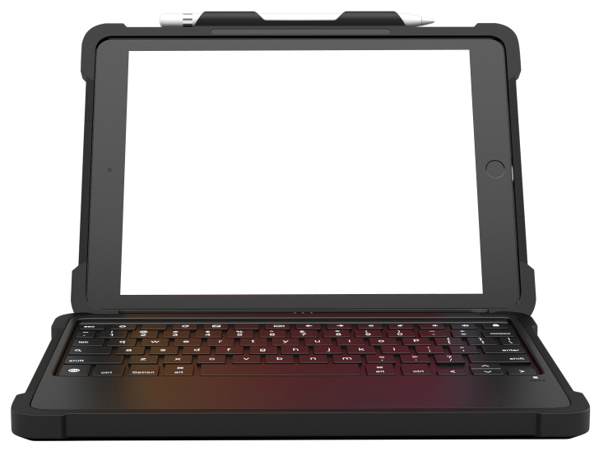
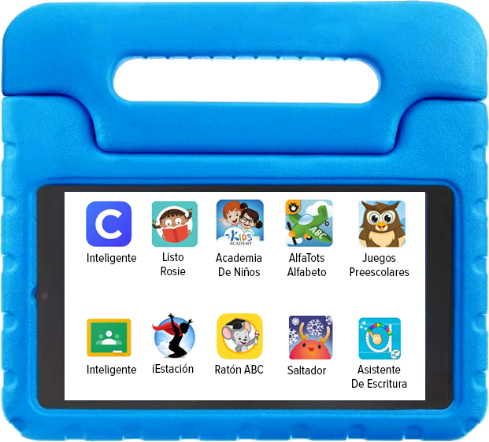
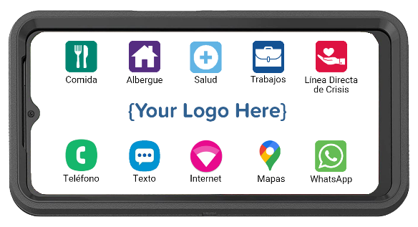
CPR³: unlimited Communication
CPR³ is also available on tablets! Perfect for caseworkers who need a keyboard option or TotSpot preschoolers.

Slide 10
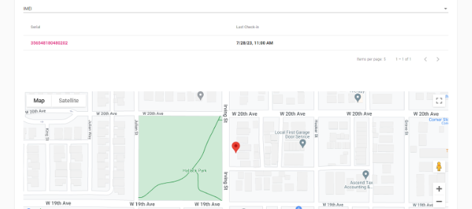
CPR³: GPS to Identify Where Migrants are located
Note: Upon deployment, individuals can be located on a one-on-one basis; within 90 days of deployment, it will be possible to see clusters on a map showing communities.

Slide 11
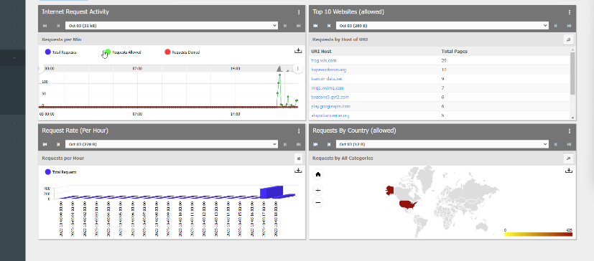
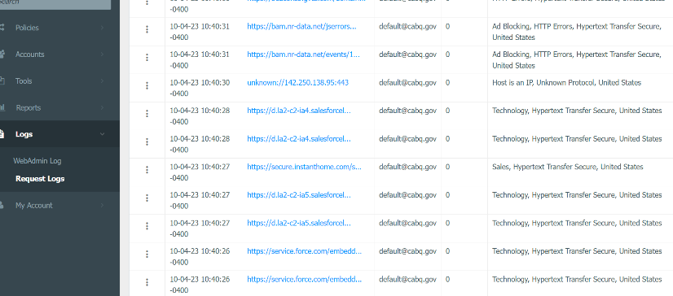
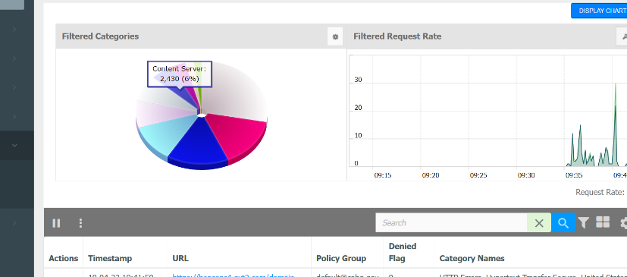
CPR³: Custom Reporting
Custom reporting to show general usage will also be available within 90 days of deployment.

Slide 12
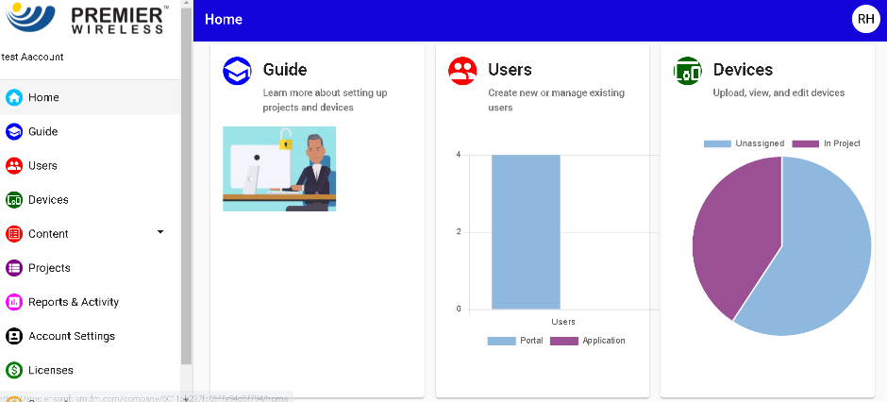
CPR³: 5G Turn-Key Solution & White glove Service
Device Provided by T-Mobile
Rugged Case & Charger
Implementation Project Manager
White Glove
Staging/Kitting
Programming
Ongoing Support
CPR³ Software License
CPR³ Portal Admin Support

Slide 13
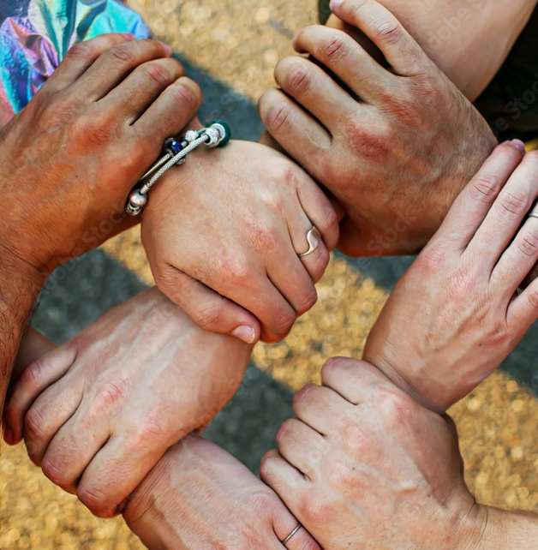
WE’RE HERE TO HELP.
(281) 667-0404
premierwireless.com

