Slide 1



SilverSpots

Slide 2

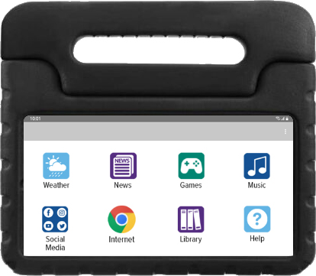
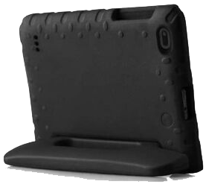
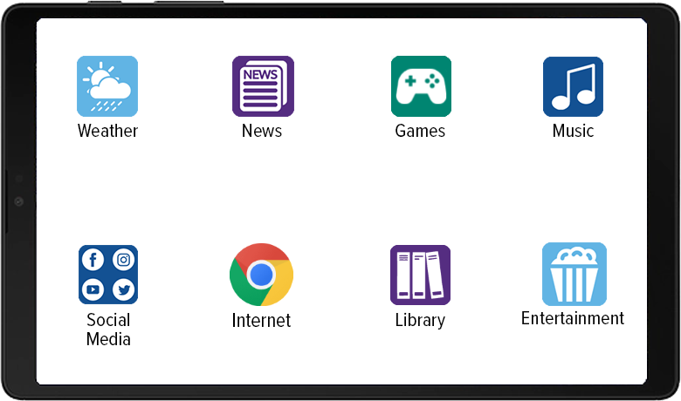
Introducing silverspot for seniors
Every SilverSpot includes unlimited data making
it easy for seniors to connect with their family and friends; and access online games, social media,
the internet, and more.

Slide 3

Benefits of a Silverspot
Provides entertainment with access to both e-books and audiobooks, music, movies, recipes, games, and more
Increases engagement with family and friends to combat isolation
Enhances cognitive function by stimulating memory, attention, and problem-solving skills
Enables access to healthcare and wellness resources, including telemedicine appointments, medication reminders, and health-tracking apps to monitor and improve the overall health
Includes easy customization for access to virtually any app or resource

Slide 4

SILVERSPOTs INCLUDE:
SilverSpot
Samsung A7 Lite Tablet
Soft, Easy-to-Grip Carry Case
Wall Charger
SilverSpot Set-Up & Design
Implementation Project Manager
Full Support to Design & Set-up Each SilverSpot
2-Year Ongoing Library Support
2-Year SilverSpot Software License
1-Year Manufacturer’s Warranty
Extended Warranties Available

Slide 5



WE’RE HERE TO HELP.
(281) 667-0404
premierwireless.com

