Slide 1





Improving the Student Experience & Student Success Outcomes
Exploring how reliable access to technology can reduce barriers, improve student experience, and support stronger outcomes from enrollment to completion.

Slide 2




The Current Challenge for Higher Education
Declining enrollment. Lower completion rates. Increased pressure to show measurable value.
Enrollment Trends:
Graduation & Completion:
Financial Impact:
Enrollment down 14.6% since 2010 (2.6 million fewer students).
[Source: NSCRC]
Only 64% of students complete a bachelor’s degree within six years; 36% leave without a credential.
[Source: NCES]
Only 32% of associate degree students graduate within three years.
[Source: NCES]
Attrition costs U.S. higher education an estimated $16.5B annually.
[Source: Raisman, Education Policy Institute, 2013]

Slide 3

Addressing Higher Ed’s Biggest Challenges
For many low-income and underrepresented students, lack of access to reliable technology and connectivity compounds these outcomes.
Higher Ed Challenge | Our Aim (Closing Technology & Connectivity Gaps) | Expected Impact
Declining enrollment | Ensure reliable access to technology so that all students — especially low-income and underrepresented — can fully participate from day one. | Improves recruitment appeal and reduces early attrition due to access barriers.
Lower completion rates | Reduce barriers that contribute to drop-outs by providing reliable devices and connectivity. | Supports persistence, course completion, and on-time graduation.
Increased pressure to show measurable value | Strengthen student success outcomes (retention, completion) by addressing access inequities. | Mitigates institutional revenue loss tied to attrition; demonstrates ROI in student success.

Slide 4


Why Closing Access Gaps Matter to Universities
Retention & Revenue Stability: Unreliable or no internet access creates substantial participation barriers—especially for lower-income and rural students—hindering academic engagement and course completion. [Source: EdTech Magazine]
Alumni Engagement & Giving: Graduates are 35% more likely to donate than non-completers
[Source: Oberlin College Longitudinal Alumni Study].
Completion, Rankings & Reputation: Access to devices and broadband helps first-gen and Pell-eligible students stay on track, improving graduation metrics used in rankings.
Recruitment & Competitiveness: 95% of students say reliable technology is essential to their college success and choice of institution. [Source: EDUCAUSE Student Technology Report]

Slide 5

Why Completion Matters to Universities
Higher education transforms not only students’ lives, but the strength and reputation of the institutions they attend. Graduating on time directly affects lifetime earnings, employability, and alumni contributions — all of which fuel a university’s success.
 | Median Annual Earnings | Unemployed | Increase over Prev. Category/No HS Diploma |  | Median Lifetime Earnings
No High School Diploma | $30,784 | 5.4% | - | - | $ < 1 M
High School Diploma/GED | $38,792 | 3.7% | 25% | - | $ 1.3 M
Some College | $43,316 | 3.3% | 11% | 40% | $ 1.5 M
Associate Degree/2-year | $46,124 | 2.7% | 6% | 50% | $ 1.7 M
Bachelor's Degree/4-year | $64,896 | 2.2% | 40% | 100% | $ 2.2 M
Master’s Degree | $77,844 | 2.0% | 20% | 150% | $ 2.7 M
Doctoral Degree | $97,916 | 1.1% | 25% | 218% | $ 3.3 M
Our Role in Enabling These Outcomes:
We don’t claim to directly change lifetime earnings. What we address is the access gap: students without reliable connectivity are more likely to drop out. By removing these barriers, we help institutions improve persistence and completion.

Slide 6

Empowering Completion Through Connectivity
Students leave college for many reasons — academic, social, financial, and personal. But digital access is a compounding barrier that institutions can directly address.
Academic Performance
Students without reliable internet/devices report lower GPAs and greater difficulty completing assignments. [Source: EDUCAUSE Student Technology Report]
Digital Skills & Readiness
Limited access correlates with weaker digital literacy, affecting course participation and employability. [Source: Pew Research Center]
Persistence & Retention
Students lacking connectivity are more likely to stop out, particularly in hybrid/online programs. [Source: Digital Equity Act Report to Congress]
Our Role
By ensuring students have consistent access, we remove one critical, solvable barrier — enabling institutions to better support persistence alongside their academic, social, and financial strategies.

Slide 7

Introducing CPR³ for Higher Education
A student-success–aligned access strategy to reduce barriers from day one.
Reliable Access
Persistence Support
Ensures every student (or targeted at-risk cohorts) receives reliable devices and connectivity, aligning with opportunity pillars in Achieving the Dream.
Continuous access to coursework, professors, and digital resources strengthens engagement and persistence, supporting Complete College America’s focus on momentum.
Institutional Integration
Sustainability & Flexibility
Kits are configurable to align with existing IT, library, or student success programs — designed to complement, not replace, institutional strategies.
Warranty and refresh options ensure access remains dependable throughout a student’s academic journey.

Slide 8

Library Checkout Program: Scalable, Integrated Access
Many institutions already operate device loan programs — CPR³ strengthens and scales these efforts.
Scalable at Any Size
Designed to serve cohorts from a small pilot to 10,000+ students with centralized logistics, support, and device management.
Institution-Branded & Student-Centered
Custom labelling and easy check-in/check-out streamline the student experience while reinforcing institutional identity.
Integrated Device Management
Remote management can be institution-owned or jointly managed with our support team — flexible to IT governance models.
End-to-End Support
White-glove service covers deployment, maintenance, warranty, and replacement — reducing IT/library burden and eliminating tech as a barrier for students.

Slide 9




Available Tech Lending Options
Extend learning beyond the library with laptops, iPads, and hotspots designed for easy campus lending.
Every device is custom-labeled, trackable, and protected in a clear case—ensuring fast circulation and reliable access for every student.

Slide 10


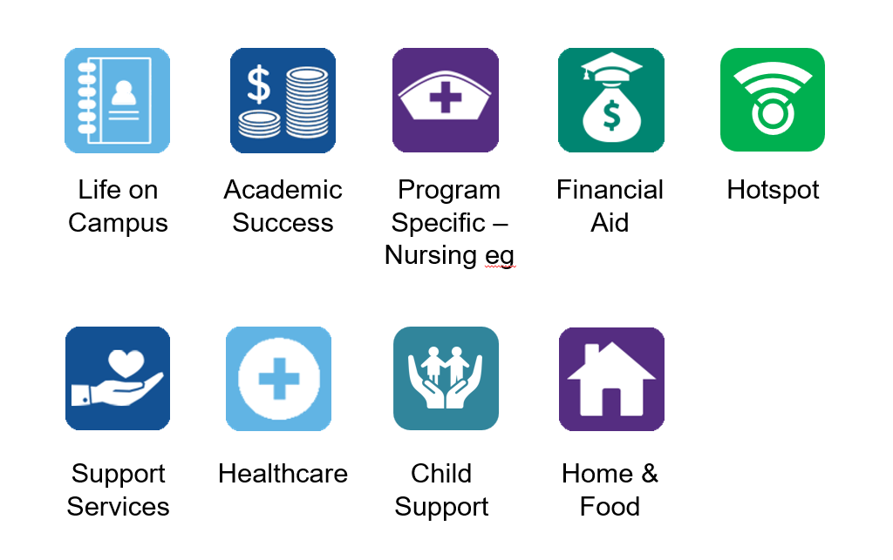

Introducing CPR³ for Higher Education
More than a laptop + hotspot — CPR³ is designed as a student-success strategy, not just a procurement option.
Student-Success Aligned
Configurable kits support all students or at-risk cohorts, aligning with digital empowerment and retention frameworks (e.g., Achieving the Dream, Complete College America).
Transparent Cost — No Hidden Vendor Add-ons.
Flat per-student, per-semester pricing — device, connectivity, support, replacement included.
Reliable Connectivity
Unlimited nationwide 5G service powered by T-Mobile to ensure consistent access even in rural/urban areas
True Partnership
CPR³ includes end-to-end support, remote management, and deployment that scale — reducing IT & library burden.

Slide 11










CPR3: Student Success Resources
Life on Campus
Academic Success
Program Specific – Nursing eg
Financial Aid
Hotspot
  Icons can be a stand-alone app, a link to a webpage or a folder containing multiple apps and webpage links.
Support Services
Healthcare
Child Support
Home & Food
Life on Campus
Academic Success
Program Specific – Nursing Example
Financial Aid
Maps
Calendars
Bookstore
Athletics
Events
Student portal
Tutoring
Internship
Meetups
Study Groups
Grants & Scholarships
Veterans & Military
Student Loans
Paid Internships
Work Programs
Medical Dictionary
Reference Lab Norms
Pharmacology Resource
Clinical Internship Sites
Program Scholarships

Slide 12
CPR3: Student Support Services
Life on Campus
Academic Success
Program Specific – Nursing eg
Financial Aid
Hotspot
  Icons can be an individual app, a link to a webpage or a folder containing multiple apps and webpage links.
Support Services
Healthcare
Child Support
Home & Food
Support Services
Healthcare
Child Support
Home & Food
Accessibility & Disability Accommodations
Safety & Emergency (Campus Police, Title IX, 911/988)
Library, Tutoring & Writing Center
Admissions, Registration & Records
Academic Advising & Success Coaching
Mental Health & Crisis Support (24/7)
Telehealth & After-Hours Nurse Line
Student Health Clinic & Immunizations
Pharmacy & Prescription Savings
Insurance Help (student plans, Medicaid/CHIP)
Childcare Finder (licensed centers)
Babysitters & Nannies
After-School & Summer Programs
Parenting Resources & Playgroups
Childcare Subsidies & Vouchers
On-Campus Housing & Dining
Affordable Housing & Roommates
Food Pantry & Local Food Banks
Rent & Utility Assistance
Local Restaurants & Student Discounts

Slide 13

Institutional ROI with CPR³
Removing access barriers supports the outcomes that matter most to institutions.
Retention & Revenue Stability
By ensuring reliable connectivity, CPR³ helps remove one of the major barriers to persistence, supporting stable enrollment and tuition revenue.
Completion & Performance Metrics
Improved persistence contributes to stronger graduation outcomes — metrics that influence rankings and accreditation.
Alumni Engagement & Reputation
Graduates are more likely to donate, mentor, and advocate; CPR³ helps institutions support more students in reaching graduation.
Funding & Grant Opportunities
Demonstrated commitment to digital enablement and student success strengthens eligibility for competitive grants and external funding.

Slide 14

Funding Options
Title III/V & MSI programs
TRIO SSS / McNair
USDA DLT
State Higher-Ed
Innovation/Completion grant
Perkins V
NTIA Digital Equity

Slide 15

Extended Warranty Programs: New or Old Devices
Two Flexible Warranty Options:
University-Paid Program: The university covers the cost to protect every device.
  Budget Relief for IT
  $0 Deductible, Low Cost
  Flexible Enrollment
  Covers the Gaps
Student Opt-In Program: Students can purchase coverage individually for their own devices.
  Coverage for up to 3 devices
  $0 deductible & unlimited claims
  Flexible pricing: monthly or annual options to fit student budgets
  Institution pays $0 — opt-in only for students who want added protection
Digital Enablement Lens
Optional, not required — no impact on baseline access provided through CPR³.
Institutions can choose to subsidize for Pell-eligible or at-risk cohorts to ensure affordability.

Slide 16

Next Steps
Next Step: Identify your pilot cohort.
Pilot
Assess
Scale
Start small: launch with a defined cohort
Measure impact: share KPIs on persistence, GPA, satisfaction.
Assess & refine: review results after first term/year, adjust accordingly.
Scale: expand to larger populations based on data.
  Let’s Build Your Student’s Success Story
  Invest in your students today to strengthen your institution’s future.

