Slide 1
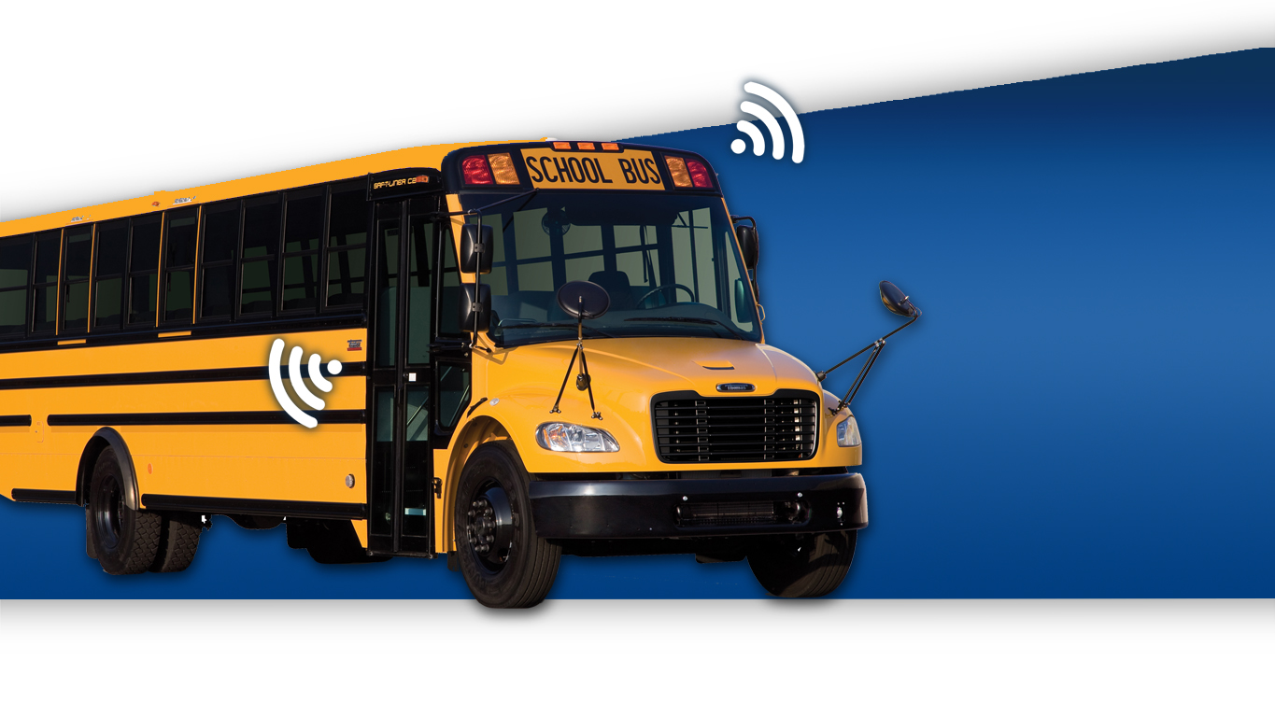



ConnectED Bus
Crosswalk
K-12

Slide 2
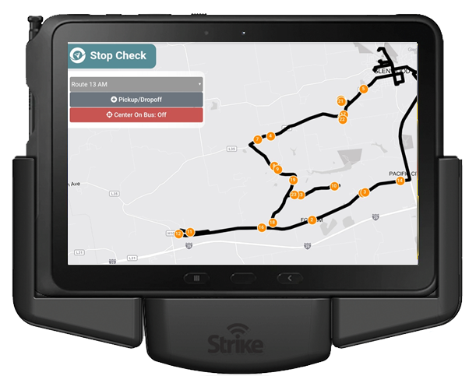
Directions & Student Assignments
Provide drivers real-time directions, stop location and names of students assigned to each stop.
Provide drivers knowledge of the route so that students are picked up and dropped off in the right locations.

Slide 3
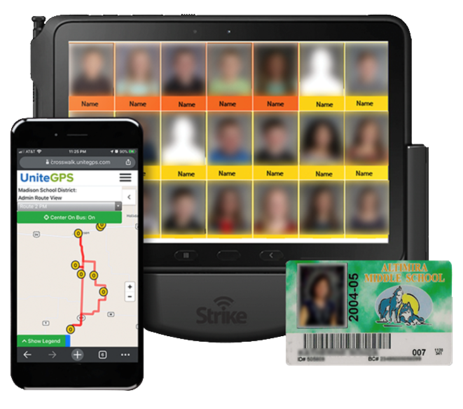
Student Tracking
Track students as they board and disembark your vehicles. Help drivers understand schedule changes and who is supposed to get on and off at each bus stop.
Help prevent students from boarding the wrong bus or
being left at the wrong bus stop

Slide 4
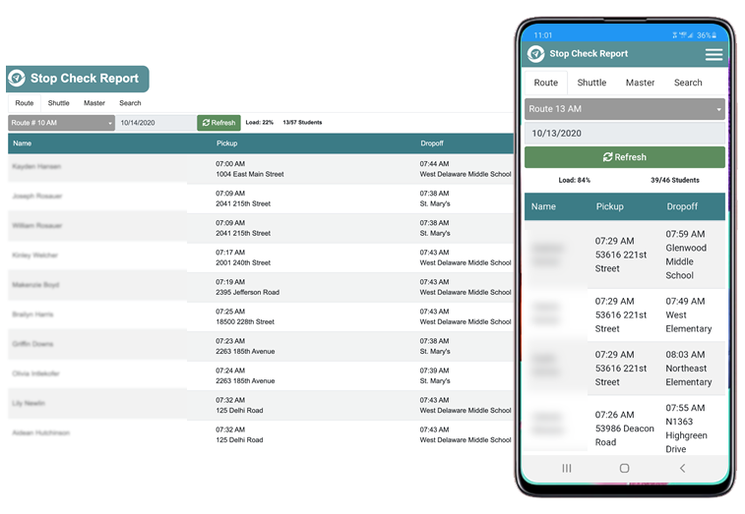
Student Tracking Reporting
Who, when and where students board and disembark your vehicles. Prevent students from boarding the wrong bus.
Share student status with your administrative team via mobile devices

Slide 5
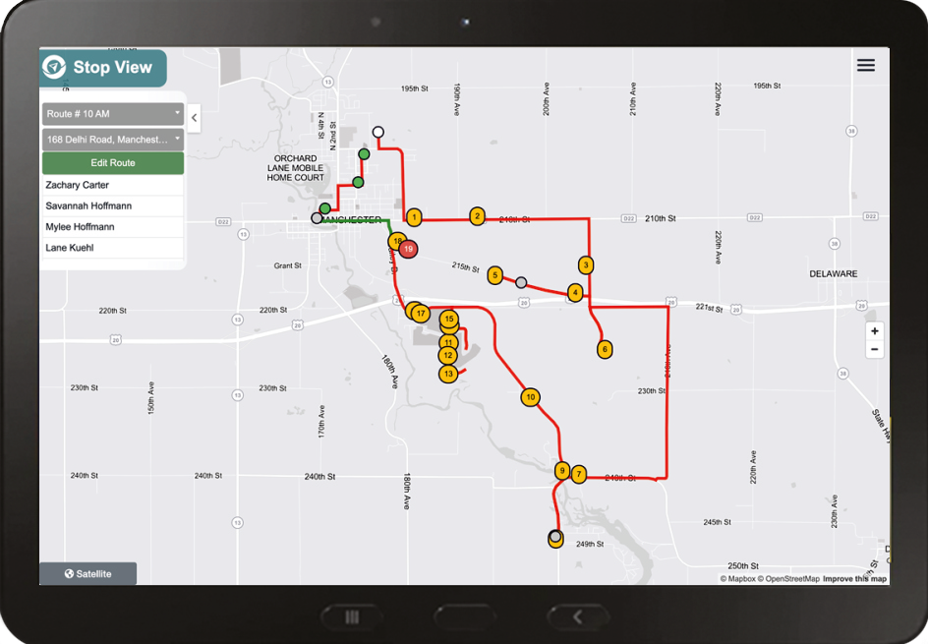
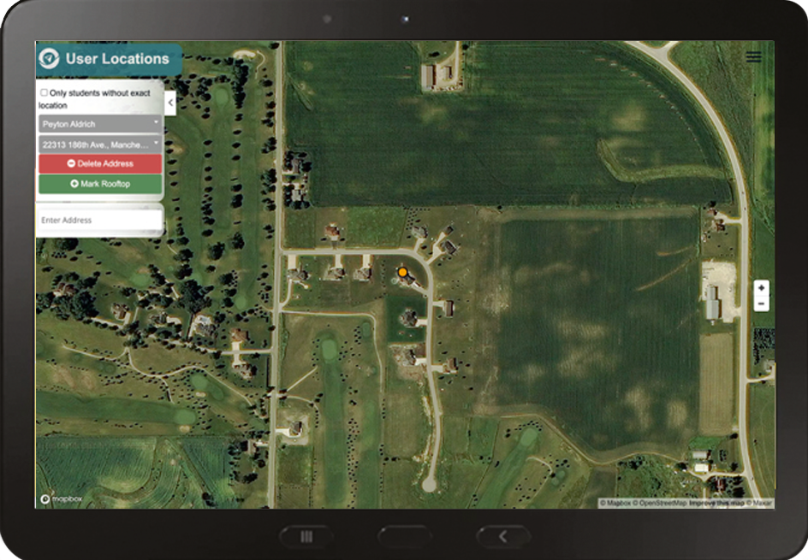
Routing & Routing Support
Identify all students by location using our rooftop mapping tool that identified 95% of student locations based upon address. Determine eligibility for transportation service.
Save thousands on vehicles, maintenance, fuel and labor by optimizing routes

Slide 6
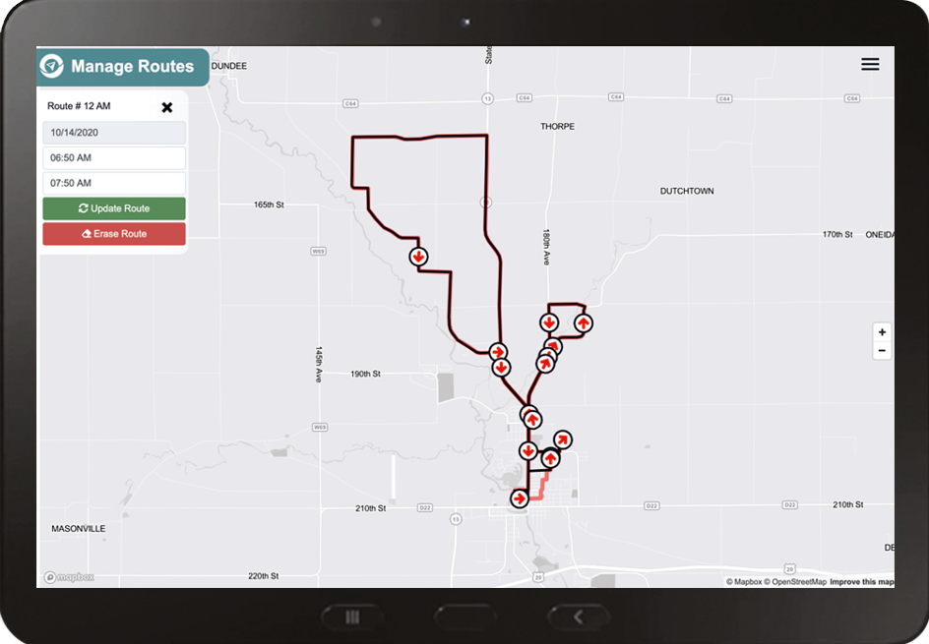
Manage Route Lines
Create or update routes in seconds using data from where the bus traveled.
Save time by creating routes using data rather than a time-consuming manual process

Slide 7
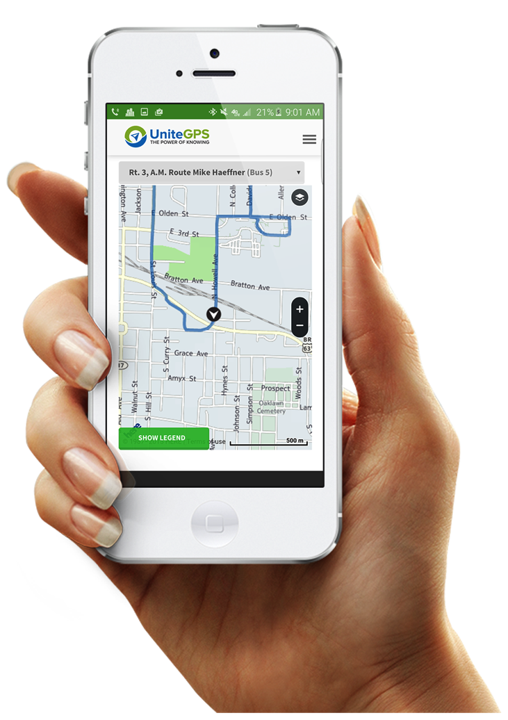
Mobile Web App for Parents
Gain the vote of confidence from your parental constituency by providing free, real-time access to their children’s whereabouts during the daily school bus commutes.
Just imagine the benefits, both from a cost as well as goodwill perspective, of becoming fully transparent to the parental community

Slide 8
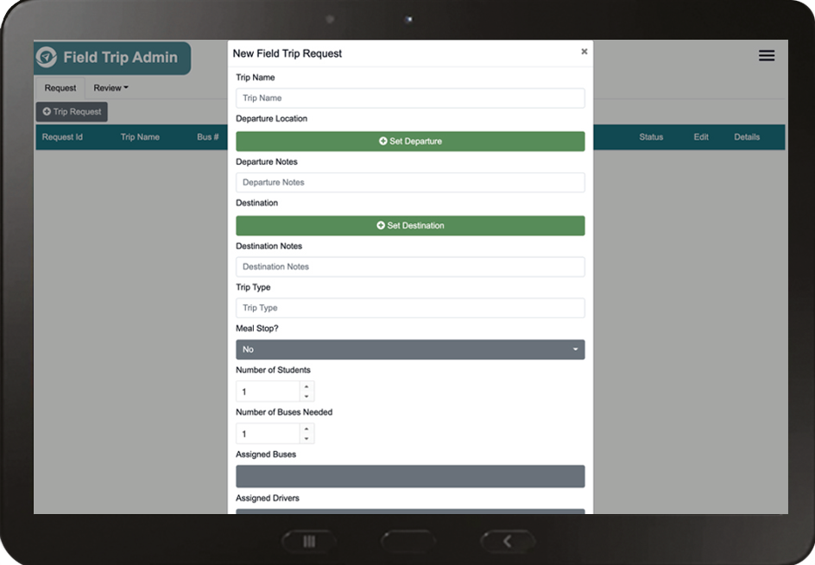
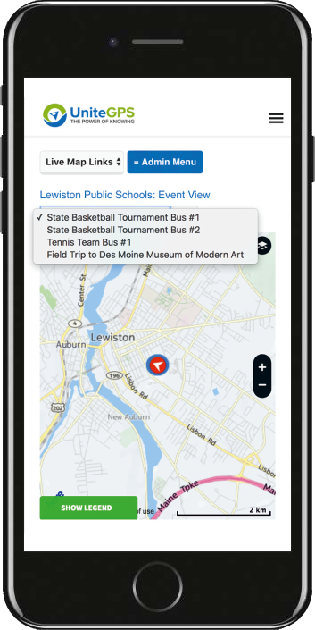
Event View & Field Trip Manager
Parents, students and school staff may easily coordinate around field trips, athletic events and other activities using our event view tool.
Protect students by allowing their family to better coordinate pick up times

Slide 9

Data Integration with School Information System
Synchronize with your school information system to improve productivity and performance.
Skyward
PowerSchool
Infinite Campus
Aeries
Others

Slide 10
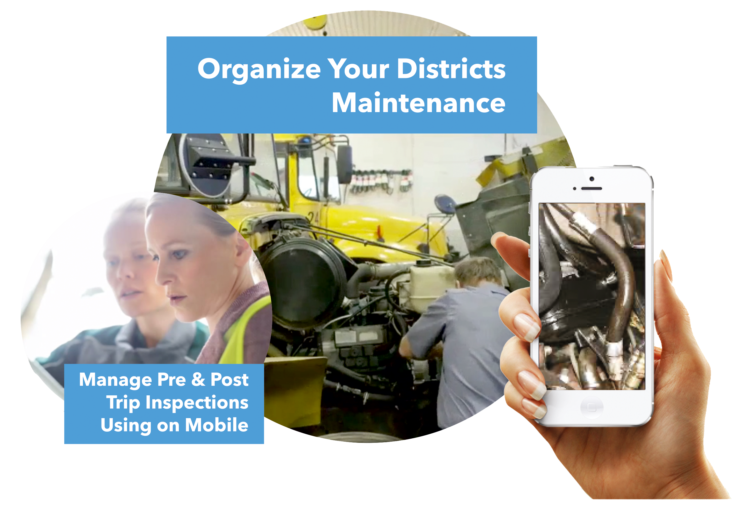
Photo Verified Trip Inspections
Drivers use tablets to identify repairs that need to be made on the vehicles.
This information flows to maintenance for resolution.

Slide 11
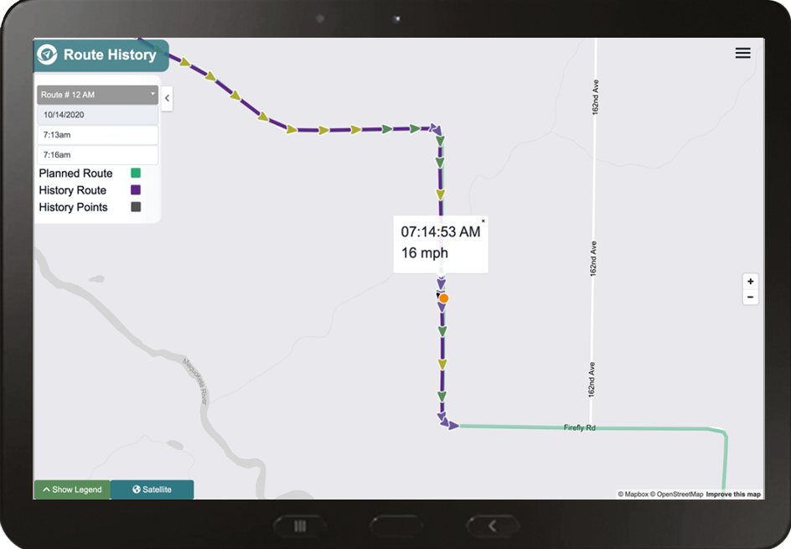
Route History Look-Up
Select route and time range to reveal a map showing where the bus traveled and speed.
Protect students and drivers by knowing where your buses were, when and how fast they were traveling

Slide 12
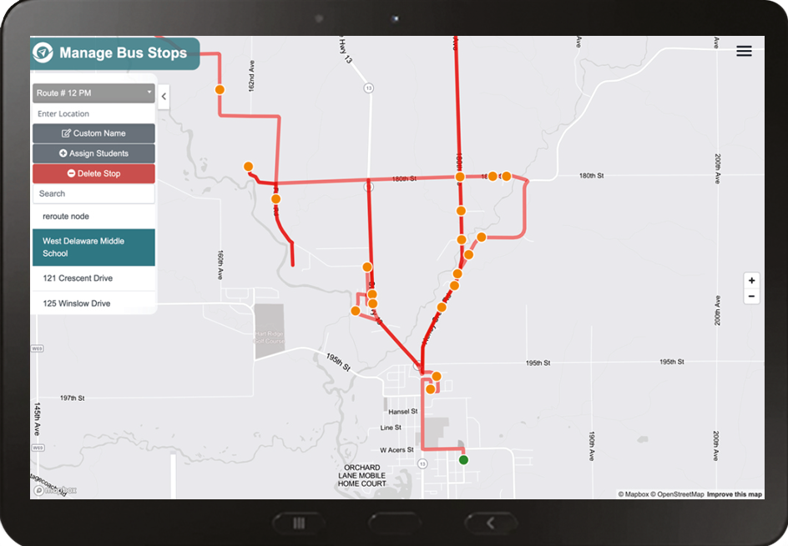
Manage Bus Stops
Create bus stops in seconds with a click, address or GPS coordinate.
Save time by using our user-friendly bus stop creation tool that takes seconds to make changes to your stops

Slide 13
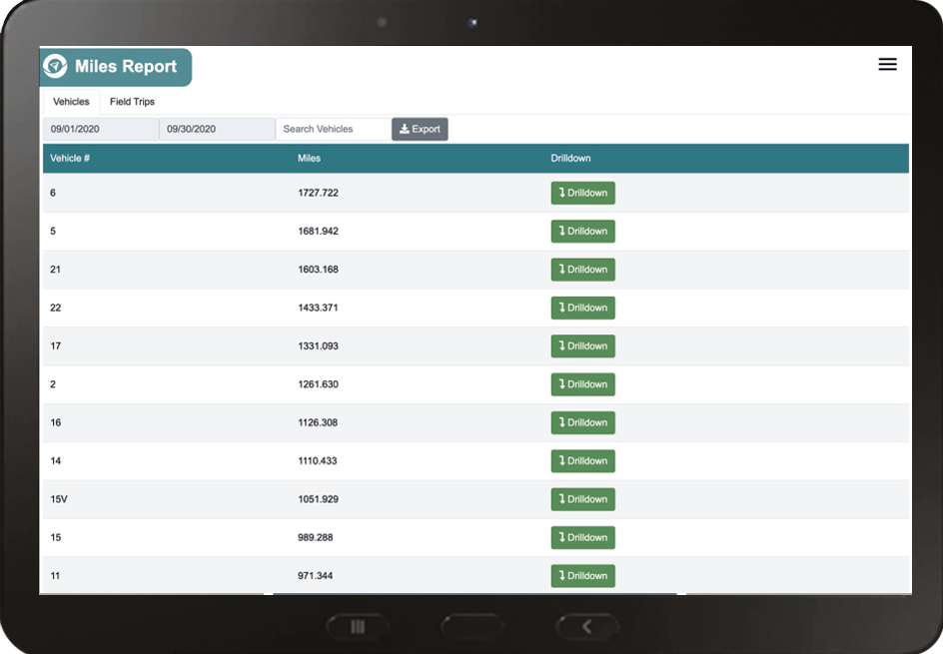
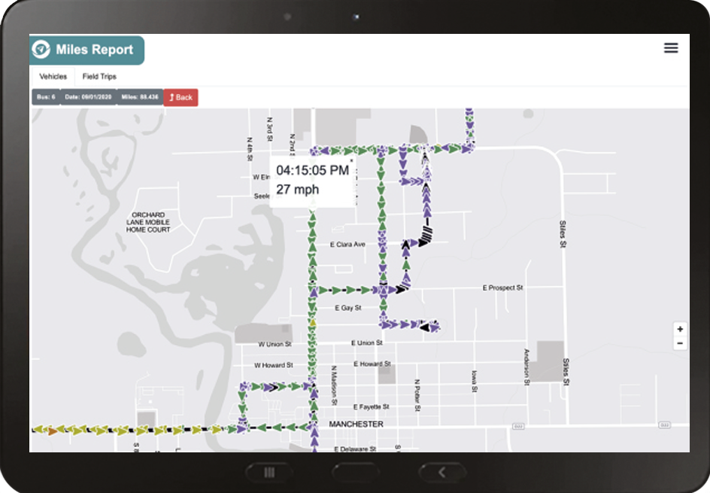
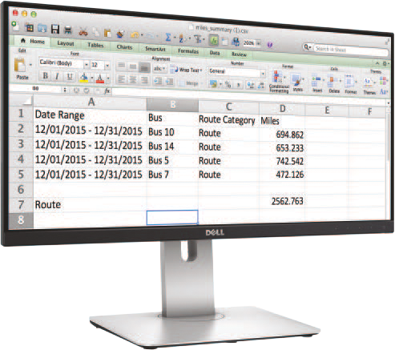
Mileage Report
Mileage reports are automatically generated by category.
Select a date range and drill down to the year, month day and moment level.
Save money by automating your mileage reimbursement reporting

Slide 14
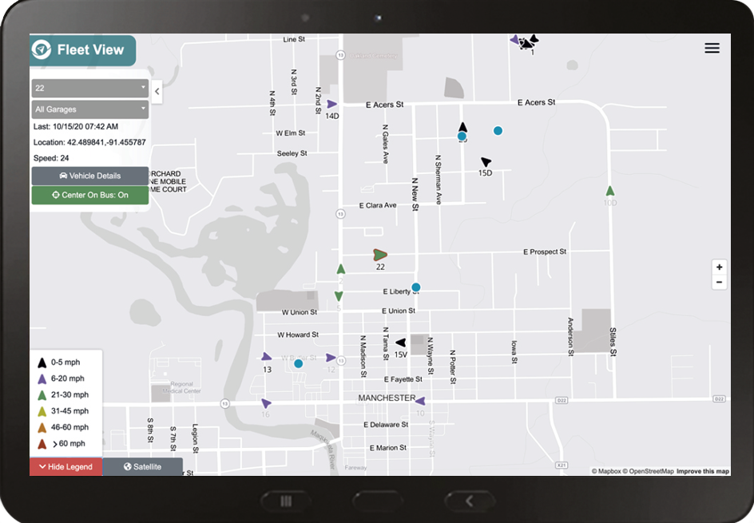
Fleet View
View all vehicles in your fleet on a single map, all in motion with updates streaming every five seconds.
Protect students and respond to emerging needs by being able to monitor your entire fleet from a single map

Slide 15
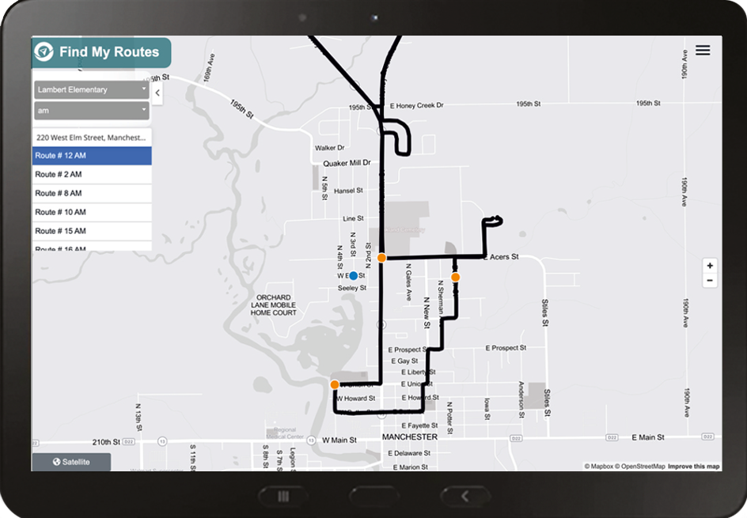
Find My Route
Provide parents their child’s route, bus stop and ETA information in seconds.
Save time & improve service by providing route, stop and ETA based upon the family address and student’s school

Slide 16
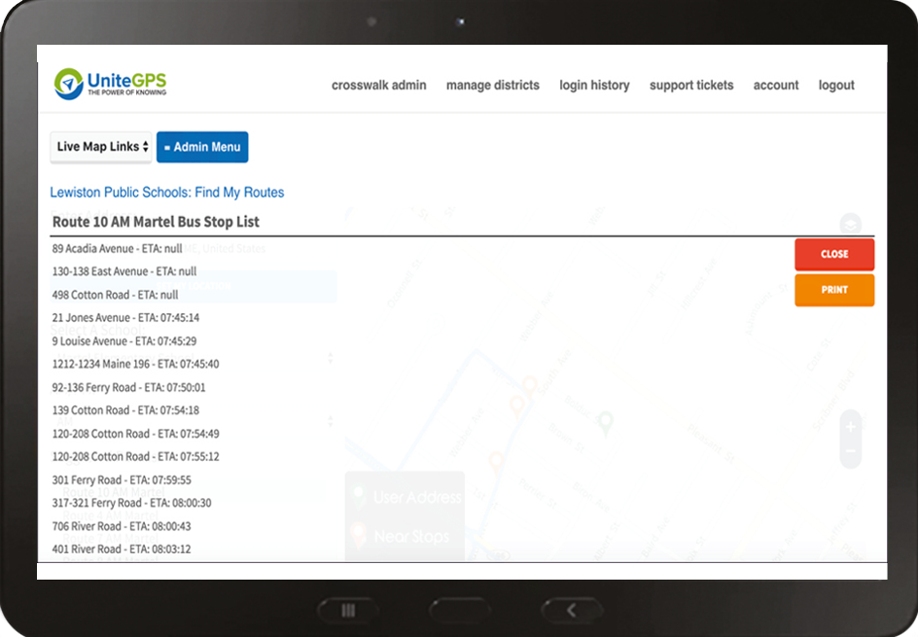
Route Report with Automatic ETA
Track the ETA of every stop.
Print reports showing the ETA at each stop and reveal which stops are not being used.
Lower cost by monitoring effectiveness of each stop on each route

