Slide 1



CPR³ - Connecting People to Resources

Slide 2
Introduction
Our Mission
To Enable Innovation, Communication, Safety, and Transformation through Technology
Our Goal
To provide reliable access to critical resources, improving quality of life and helping people reach their full potential.

Slide 3

Empowering Workforce Success
Workforce Development program administrators need a reliable method to connect clients to available resources including:
Educational tools and resources
Childcare
Workforce development
Employment opportunities
Healthcare
Mental health services

Slide 4
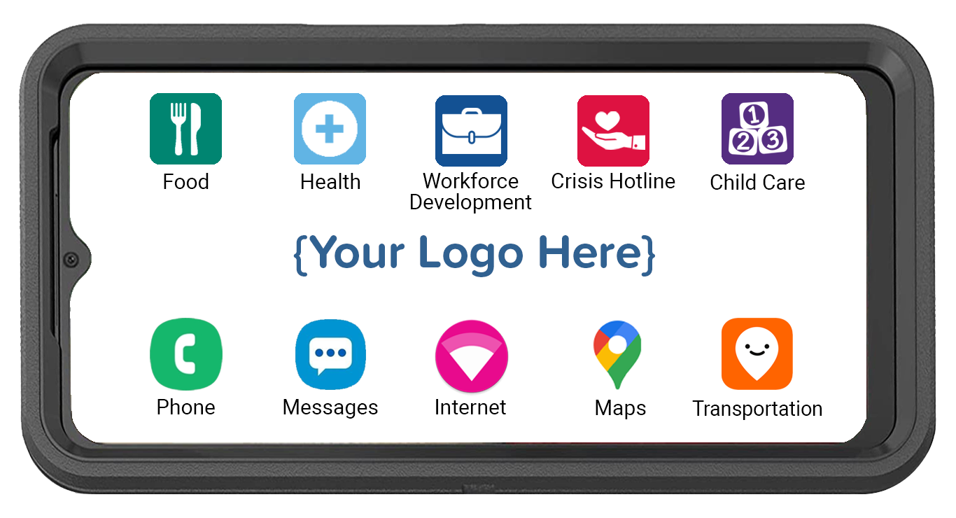
CPR³ Connecting People to Resources
Powered by T-Mobile
All-in-one device providing:
  Hand-held, body-worn computer
  Unlimited communication
  (voice, text, data & hotspot)
  Instant access to resources
An innovative & effective solution connecting clients to Employment and Life-Changing Opportunities

Slide 5




Customizing Your CPR³ Device
The CPR³ solution is custom-built to provide
access to many different resources.
Clients simply tap the icon to access your
list of available resources.
Workforce Development
Food
Health
Crisis Hotline
Local food banks
Local churches
Holiday Food Drives
SNAP (food stamps)
WIC
Telehealth
Mental Health
Local Clinics
Prescription Help
Medicaid/CHIP
GED Programs
Vocational Schools
Higher Education
Job Readiness Training
Job Search Platforms
Drug & Alcohol
Domestic Violence​
Sexual Abuse​​
Suicide Prevention
Veterans Hotline​
Icons can be an individual app, a link to a webpage or a folder containing multiple apps and webpage links.

Slide 6
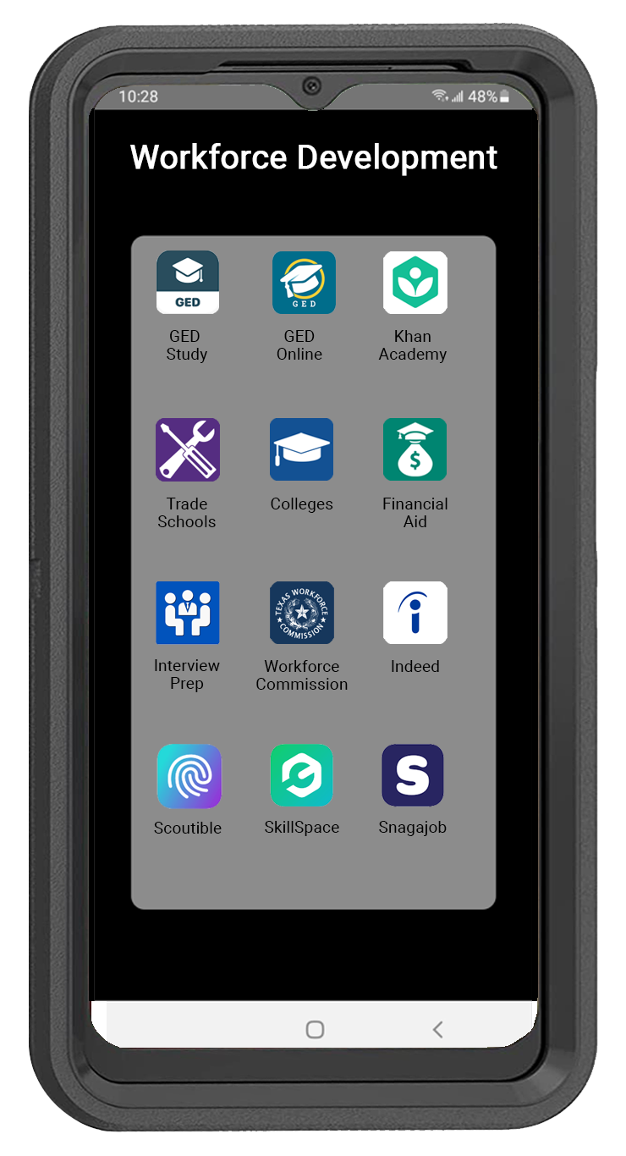

Workforce Development
Clients can easily access the resources they need to build their skills & find employment opportunities
Turn On the Hotspot to Provide Internet Access for Additional Devices

Slide 7

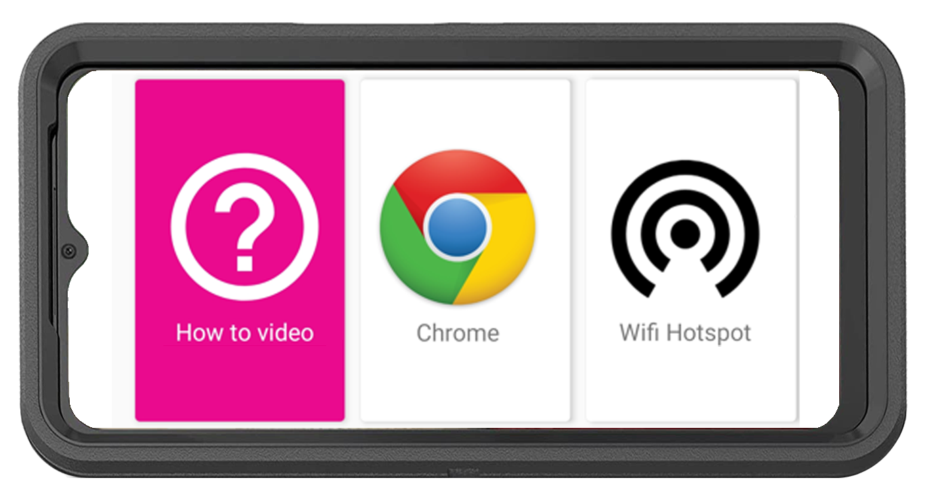
CPR³ Expanding Access & Opportunity
How-To Video Step-by-step instructions for hotspot connection
Bilingual Support:
  English
  Spanish
Unlimited On-Screen Data
11 GB Hotspot Internet Access
Powered by T-Mobile –
America’s Largest & Fastest 5G Network

Slide 8
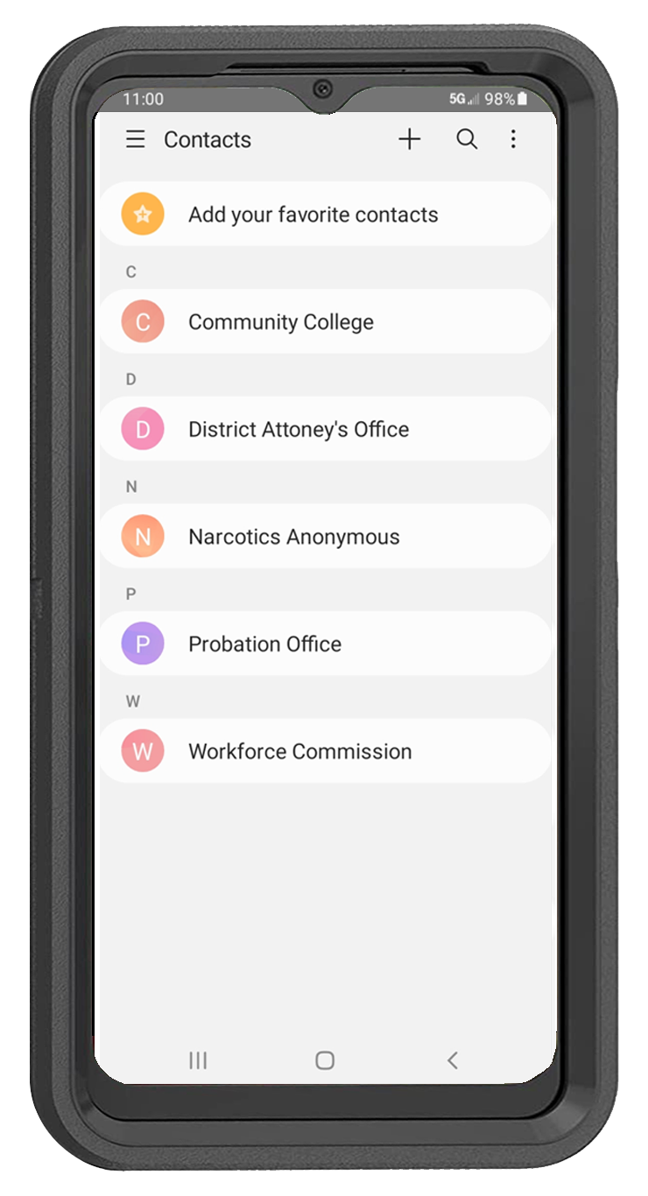


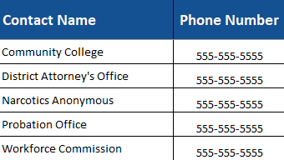

CPR³ Unlimited Communication
Ensure consistent communication between clients, employers, and support networks to reduce barriers to employment and enhance job readiness.
Unlimited Calling: Seamlessly connect with employers, workforce programs, and support services
  Unlimited Texting: Maintain instant communication with job coordinators, mentors, and family support systems
Resource Phone Directory: Provide quick access to employment services, job training programs, and critical resources

Slide 9
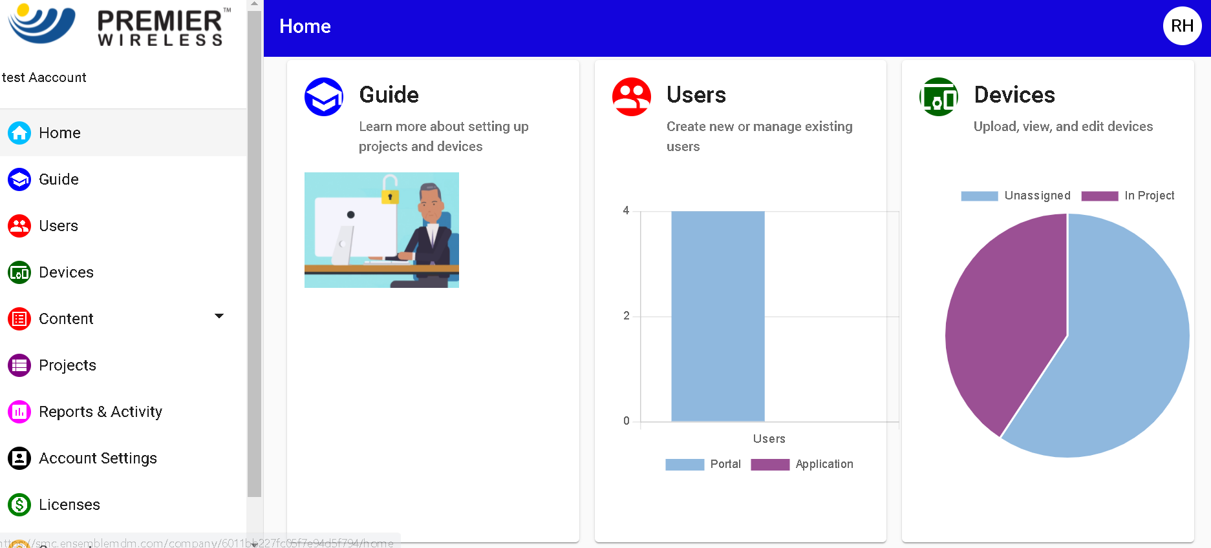
CPR³ Turn-Key 5G Solution with White Glove Support
Smartphone
Rugged Case, Screen Protector
& Charger
Initial Device Enrollment
2-Year CPR³ Software License
2-Year CPR³ Portal Admin Support
White Glove Project Management
& Post Sales Support
Completely customizable to provide your local resources
Remotely add, update or remove apps for food, housing, health, legal & other resources

Slide 10
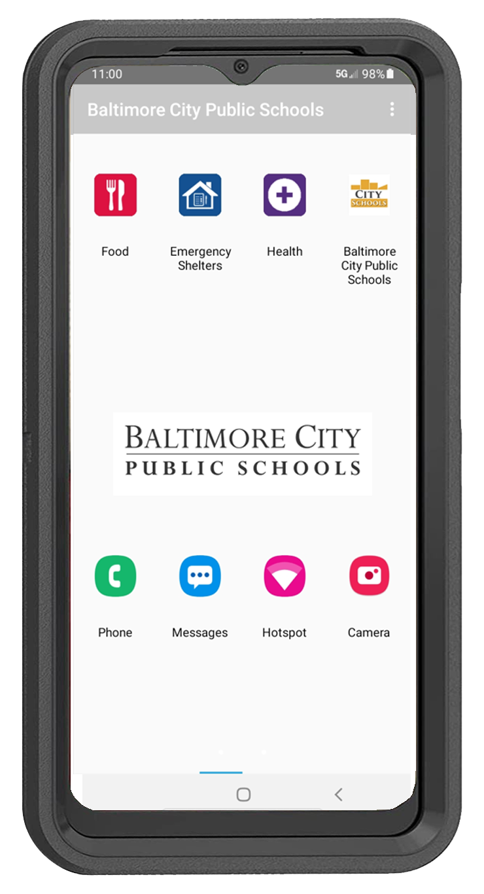
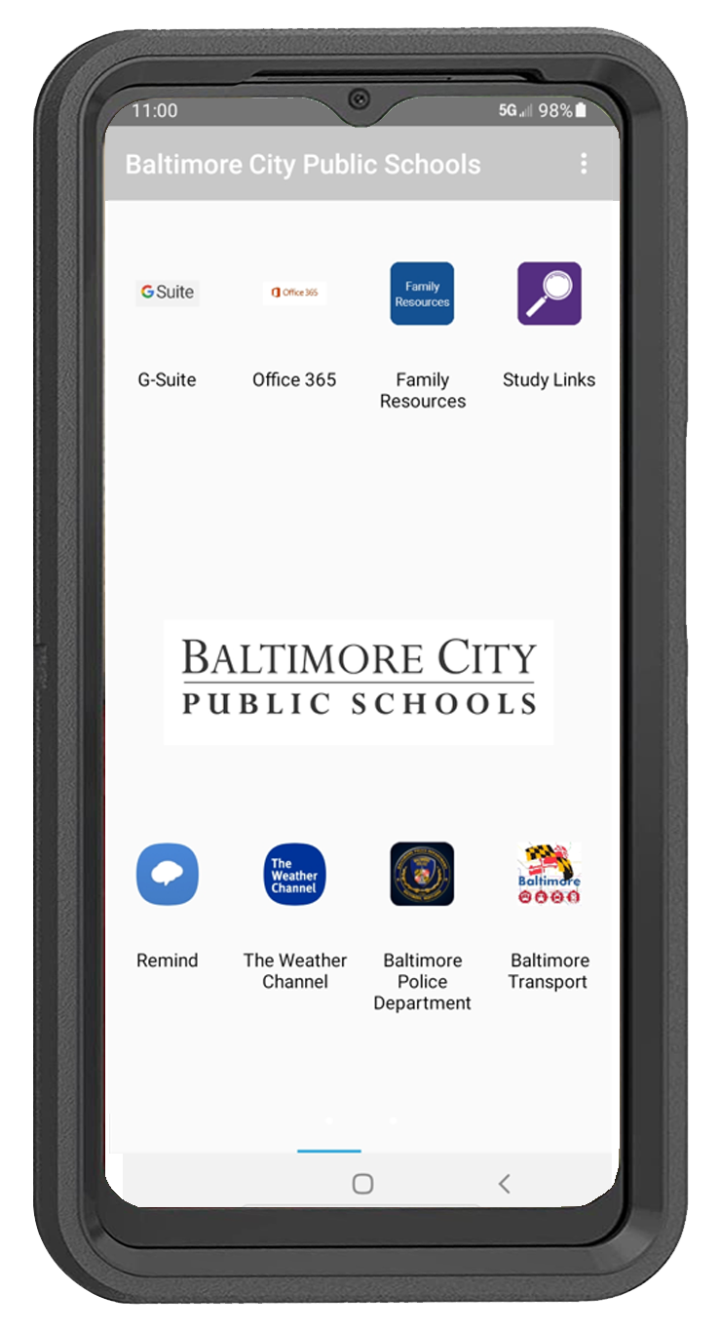
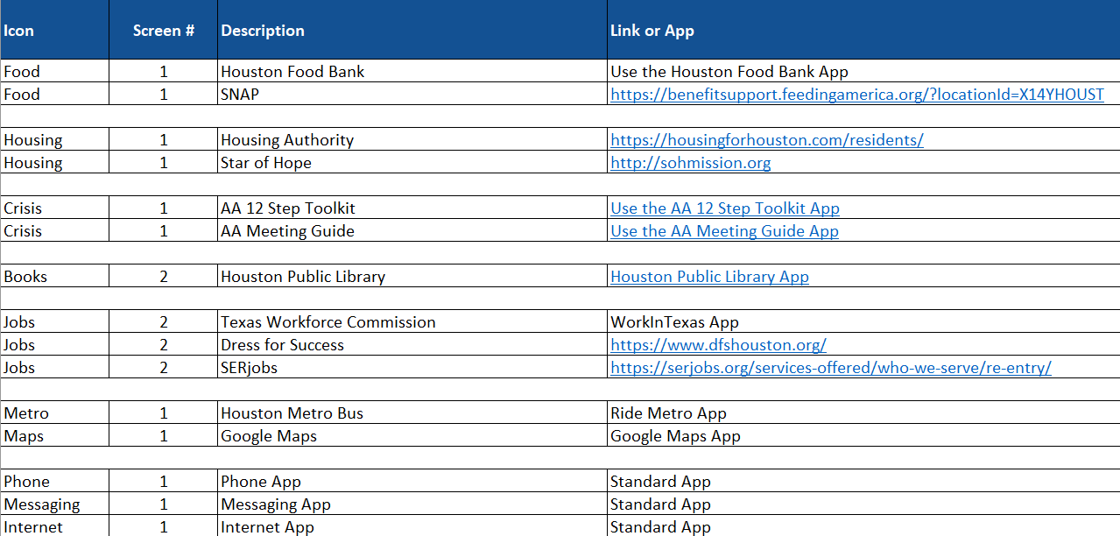
Getting Started
Home Screen
Screens 2, 3, 4, etc.
Provide Premier with a PNG image of your Logo
List the names of the stand-alone apps that will be included in a folder on the master spreadsheet
List the screen number you want each folder or Icon to appear
Add the web links and the apps that correlate to the folder that you want included on your Excel template
Remember, you can add or delete Icons, Apps and Folders at any time

Slide 11

Impact of the CPR³ Program
Improve access to critical resources and
job opportunities for greater career success
Empower clients with confidence through
improved job skills, technical training and
educational growth
Maintain communication with family and
support networks to boost stability
Drive positive outcomes that build stability
and support long-term employment

Slide 12

Let the CPR³ Program help your clients reach their full potential.
PremierWireless.com

