Slide 1



Technology for higher ed
Premier Wireless enables innovation, communication, safety, and transformation through technology.

Slide 2



ACCESS & EQUITY
enables better Outcomes for all students
Students with poor or no internet access:
have lower overall GPAs,
have fewer digital skills,
are less likely to enroll in postsecondary education, and
are more likely to drop-out, if enrolled.
In 2021, 2.6M fewer students were enrolled than in 2010. If this decline continues, it will negatively impact the US' economic growth, innovation, and global competitiveness.

Slide 3

College drop-out: the hidden costs
Economic losses due to students dropping out
According to the National Center for Education Statistics:
64% of students graduate with a bachelor's degree within six years (36% drop out)
32% of students graduate with an associate degree within three years (68% drop out)
US-based HEIs lose $16.5 billion every year due to drop-outs.
Drop-outs/year | 600
Title IV funds (Pell grants) | $5,000
Total losses | $3,000,000

Slide 4

Educational Attainment: impact on Lifetime Earnings
economic projections
 | Median Annual Earnings | Unemployed | Increase over Prev. Category/No HS Diploma
No High School Diploma | $30,784 | 5.4% | - | -
High School Diploma/GED | $38,792 | 3.7% | 25% | -
Median Lifetime Earnings
$ < 1 M
$ 1.3 M
$ 1.5 M
$ 1.7 M
$ 2.2 M
$ 2.7 M
$ 3.3 M
Some College | $43,316 | 3.3% | 11% | 40%
Associate Degree/2-year | $46,124 | 2.7% | 6% | 50%
Bachelor's Degree/4-year | $64,896 | 2.2% | 40% | 100%
Master’s Degree | $77,844 | 2.0% | 20% | 150%
Doctoral Degree | $97,916 | 1.1% | 25% | 218%
Source: Indeed.com

Slide 5

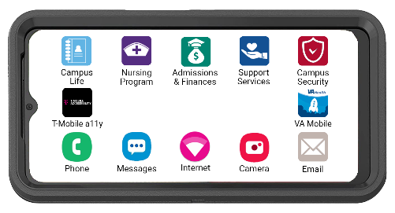





CPR³: connecting people to resources
A device
Unlimited connectivity, plus a hotspot
Access to resources
Food
Campus Options
Local Restaurants
Local food banks
SNAP (food stamps)
WIC
House & Home
On Campus Options
Affordable Housing
Roommate Connect
Utility Assistance
Rental Assistance
Healthcare
Mental Health Services
TeleHealth Access
Student Health Clinic
Prescription Services
Medicaid/CHIP
Productivity
Email
Microsoft Word
Microsoft Excel
Microsoft PPT
EndNote

Slide 6

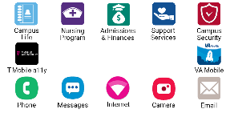




CPR³: connecting people to resources
Consistent & Reliable Access
Creates Equity for all Students
Increases Completion Rates & Lifetime Earning Potential
Medical Dictionary
Reference Lab Norms
Pharmacology Resource
Clinical Internship Sites
Program Scholarships
Campus Life
Campus Maps
Academic Calendar
Sports & Athletics
Book Store
Student Handbook
Admission &
Financial Aid
Grants & Scholarships
Veterans & Military
Student Loans
Paid Internships
Work Programs
Support Services
Diversity & Inclusion
Disability Resources
Emergency Info
Library & Tutoring
Admission Services

Slide 7



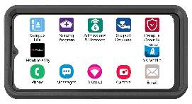
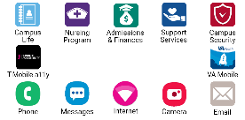
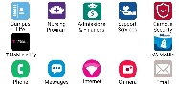
CPR³ Devices provide Access & Equity
Connected technology bridges economic disparity,
helps keep students enrolled,
and increases completion rates.

Slide 8

The Possibilities are Endless.
WE’RE HERE TO HELP.
(281) 667-0404
premierwireless.com

