Slide 1

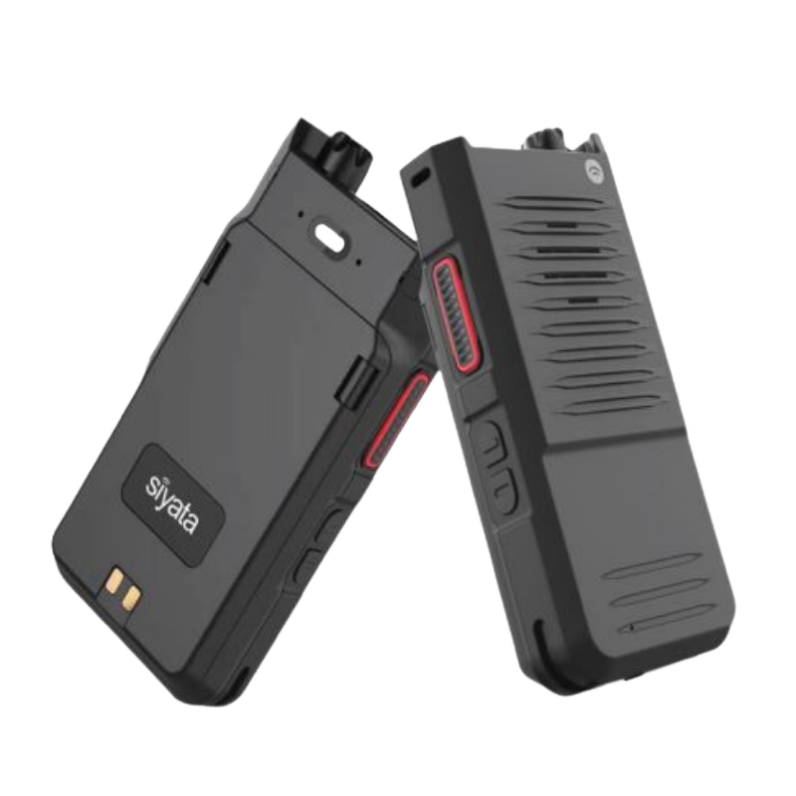

Siyata SD7 Push-to-Talk
From Premier Wireless & T-Mobile
Contents
Industry Context & Solution Overview | 2
Value Pillars | 2
Segments and Verticals | 2
Buyer Concerns | 2
Why Premier and T-Mobile | 2
Competitive Environment | 3
Elevator Pitch | 3
How Our Solution Helps | 3
Conversation Starters | 4
Discovery Checklist | 4
Objection Handling | 4
Advice From Sales Specialist | 4
Phone & Voicemail Script | 5
Email Script | 6-7
1

Slide 2



Overview
Industry Context
Value Pillars
Buyer Personas and Concerns
Organizations with field-based teams rely on instant, reliable communication across:
Job sites and facilities
Vehicles and mobile teams
Remote or high-risk environments
However, communication breaks down due to:
Limited range of traditional radios
Dead zones and inconsistent coverage
Over-reliance on smartphones (distractions, durability issues)
Lack of interoperability across teams and agencies
When communication fails, safety, coordination, and response time are immediately impacted.
Instant, Always-On Communication
One-touch PTT with crystal-clear voice keeps teams connected in real time.
Operations Leaders
“I need my teams connected at all times.”
Communication gaps across job sites
Delays in coordination
Lack of real-time visibility
Safety / Risk Leaders
“I need fast response when something goes wrong.”
Slow emergency communication
Worker safety concerns
Limited reach in critical moments
IT / Technology Leaders
“I need something simple and reliable.”
Managing multiple communication tools
Device complexity
Coverage limitations
Executives / Leadership
“Downtime and delays cost us money.”
Productivity loss
Safety liability
Inefficient operations
Beyond Traditional Radios
Unlimited range over T-Mobile’s nationwide network with cross-agency interoperability.
Built for Tough Environments
Military-grade durability (MIL-STD-810H, IP68) resists water, dust, and drops.
Simple & Easy to Adopt
Familiar radio-style design with no training required.
Cost-Effective Communication
Lower total cost of ownership vs radios and smartphones with affordable PTT-only plans.
Segments & Verticals
Public Safety & First Responders
Utilities & Field Services
Construction & Manufacturing
Transportation & Logistics
Government & Municipal
The Siyata SD7 is a rugged Push-to-Talk over Cellular (PTT) device built for organizations that need instant, reliable communication without the complexity of smartphones or limitations of radios.
Running on T-Mobile’s nationwide network, it delivers crystal-clear voice, unlimited range, and dependable performance—built for the toughest environments.
Why T-Mobile
T-Mobile provides the connectivity foundation that makes SD7 more powerful than traditional radios:
Nationwide cellular coverage with unlimited range
Reliable performance across urban, rural, and remote environments
No dependency on radio towers or local infrastructure
Scalable across teams, locations, and agencies
Why Premier Wireless
Premier Wireless turns the SD7 into a complete, deployable solution:
Trusted T-Mobile Pinnacle Partner
Fast deployment — devices ready to go
PTT solution design + configuration
Ongoing support and account management

Slide 3
Competitive Environment
Customers are moving away from:
Traditional two-way radios (limited range)
Smartphone-based communication (distractions, durability issues)
Fragmented communication tools
They are adopting:
Push-to-Talk over Cellular (PTToC)
Dedicated communication devices
Nationwide, interoperable communication platforms
Elevator Pitch
Most teams rely on radios or smartphones—until they fail in the moments that matter most.
The Siyata SD7 replaces both with a rugged, dedicated Push-to-Talk device that delivers instant communication over T-Mobile’s nationwide network—without range limits, distractions, or complexity.
How Our Solution Helps
Instant Communication Anywhere
Connect teams across job sites, vehicles, and regions in real time.
Improved Safety & Response
Enable faster emergency communication and coordination.
Operational Efficiency
Reduce delays and miscommunication across teams.
Reliable Performance in Tough Environments
Built to withstand harsh conditions where smartphones fail.

Slide 4
Conversation Starters
Discovery Checklist
Do your teams rely on radios or smartphones today?
Do you experience communication gaps or dead zones?
Are your teams spread across multiple locations or regions?
Do you need communication during emergencies?
Are devices durable enough for your environment?
“What happens when your team is out of radio range?”
“How do your teams communicate across multiple job sites?”
“Are smartphones causing distractions or reliability issues?”
“What’s your backup when communication fails?”
“How quickly can your teams respond during an incident?”
“Are your current radios limiting your operations?”
Objection Handling
“We can just use smartphones”
→ “Smartphones aren’t built for instant PTT, durability, or distraction-free communication.”
“We already use radios”
→ “Radios are limited by range—this works anywhere with cellular coverage.”
“This seems expensive”
→ “It reduces total cost compared to maintaining radio systems and replacing damaged phones.”
“We don’t need nationwide coverage”
→ “Most teams don’t—until they do. This ensures you’re never out of range.”
Advice from Sales Specialist
Lead with:
Safety and response time
Communication gaps
Real-world scenarios
Avoid:
Leading with specs
Comparing features too early
Overcomplicating with technical details
Position as:
“A modern replacement for radios and smartphones—built for real-world communication.”

Slide 5
Phone & Voicemail Scripts
Cold Call Script
Hi [Name], this is [Your Name] with Premier Wireless and T-Mobile.
I’m reaching out because a lot of teams are running into communication gaps with radios or smartphones in the field.
Quick question—how far does your current communication system actually reach?
Pause
That’s exactly where we’re helping—giving teams instant push-to-talk communication anywhere using the cellular network.
Would it be worth 15 minutes to see where communication gaps could impact your team?
Voicemail Script
Hi [Name], this is [Your Name] with Premier Wireless and T-Mobile.
We’re helping organizations replace radios and smartphones with dedicated push-to-talk devices that work nationwide.
I’ll follow up by email—would love to connect.

Slide 6
Emails
Email #1
Subject Options:
What happens when your team is out of range?
Are your radios limiting your communication?
A better way to stay connected in the field
Hi [First Name],
Many organizations rely on radios or smartphones for team communication—until they run into range limitations, poor coverage, or reliability issues in the field.
The Siyata SD7 is a rugged push-to-talk device that works over T-Mobile’s nationwide network—giving your team instant communication with unlimited range and no distractions.
It’s simple, reliable, and built for environments where communication can’t fail.
Would it be worth a quick 15-minute conversation to see where your current setup might fall short?
Best,
[Signature]
Email #2
Subject Options:
Quick question about your team’s communication
Still using radios or smartphones?
Closing communication gaps in the field
Hi [First Name],
Quick question—how does your team stay connected when they’re outside of radio range or dealing with unreliable coverage?
We’re helping organizations replace radios and smartphones with dedicated push-to-talk devices that work anywhere there’s cellular coverage—improving response time, safety, and coordination.
The Siyata SD7 is built specifically for this—rugged, simple to use, and ready to deploy.
Let me know if it’s worth a quick conversation.
Best,
[Signature]

