Slide 1





Connected Retail
Keeping Stores Open, Secure, and Profitable
Connectivity • Continuity
• Customer Experience
Premier Wireless | Powered by T-Mobile

Slide 2

Agenda
The Modern Retail Reality
Planning for the Unexpected
When Systems Fail
Always-On Infrastructure
Protecting the Customer Experience
Loss Prevention & Visibility
Workforce Communication
Smart Store Intelligence
Unified Retail Command Center
Why Premier + T-Mobile
Next Steps

Slide 3
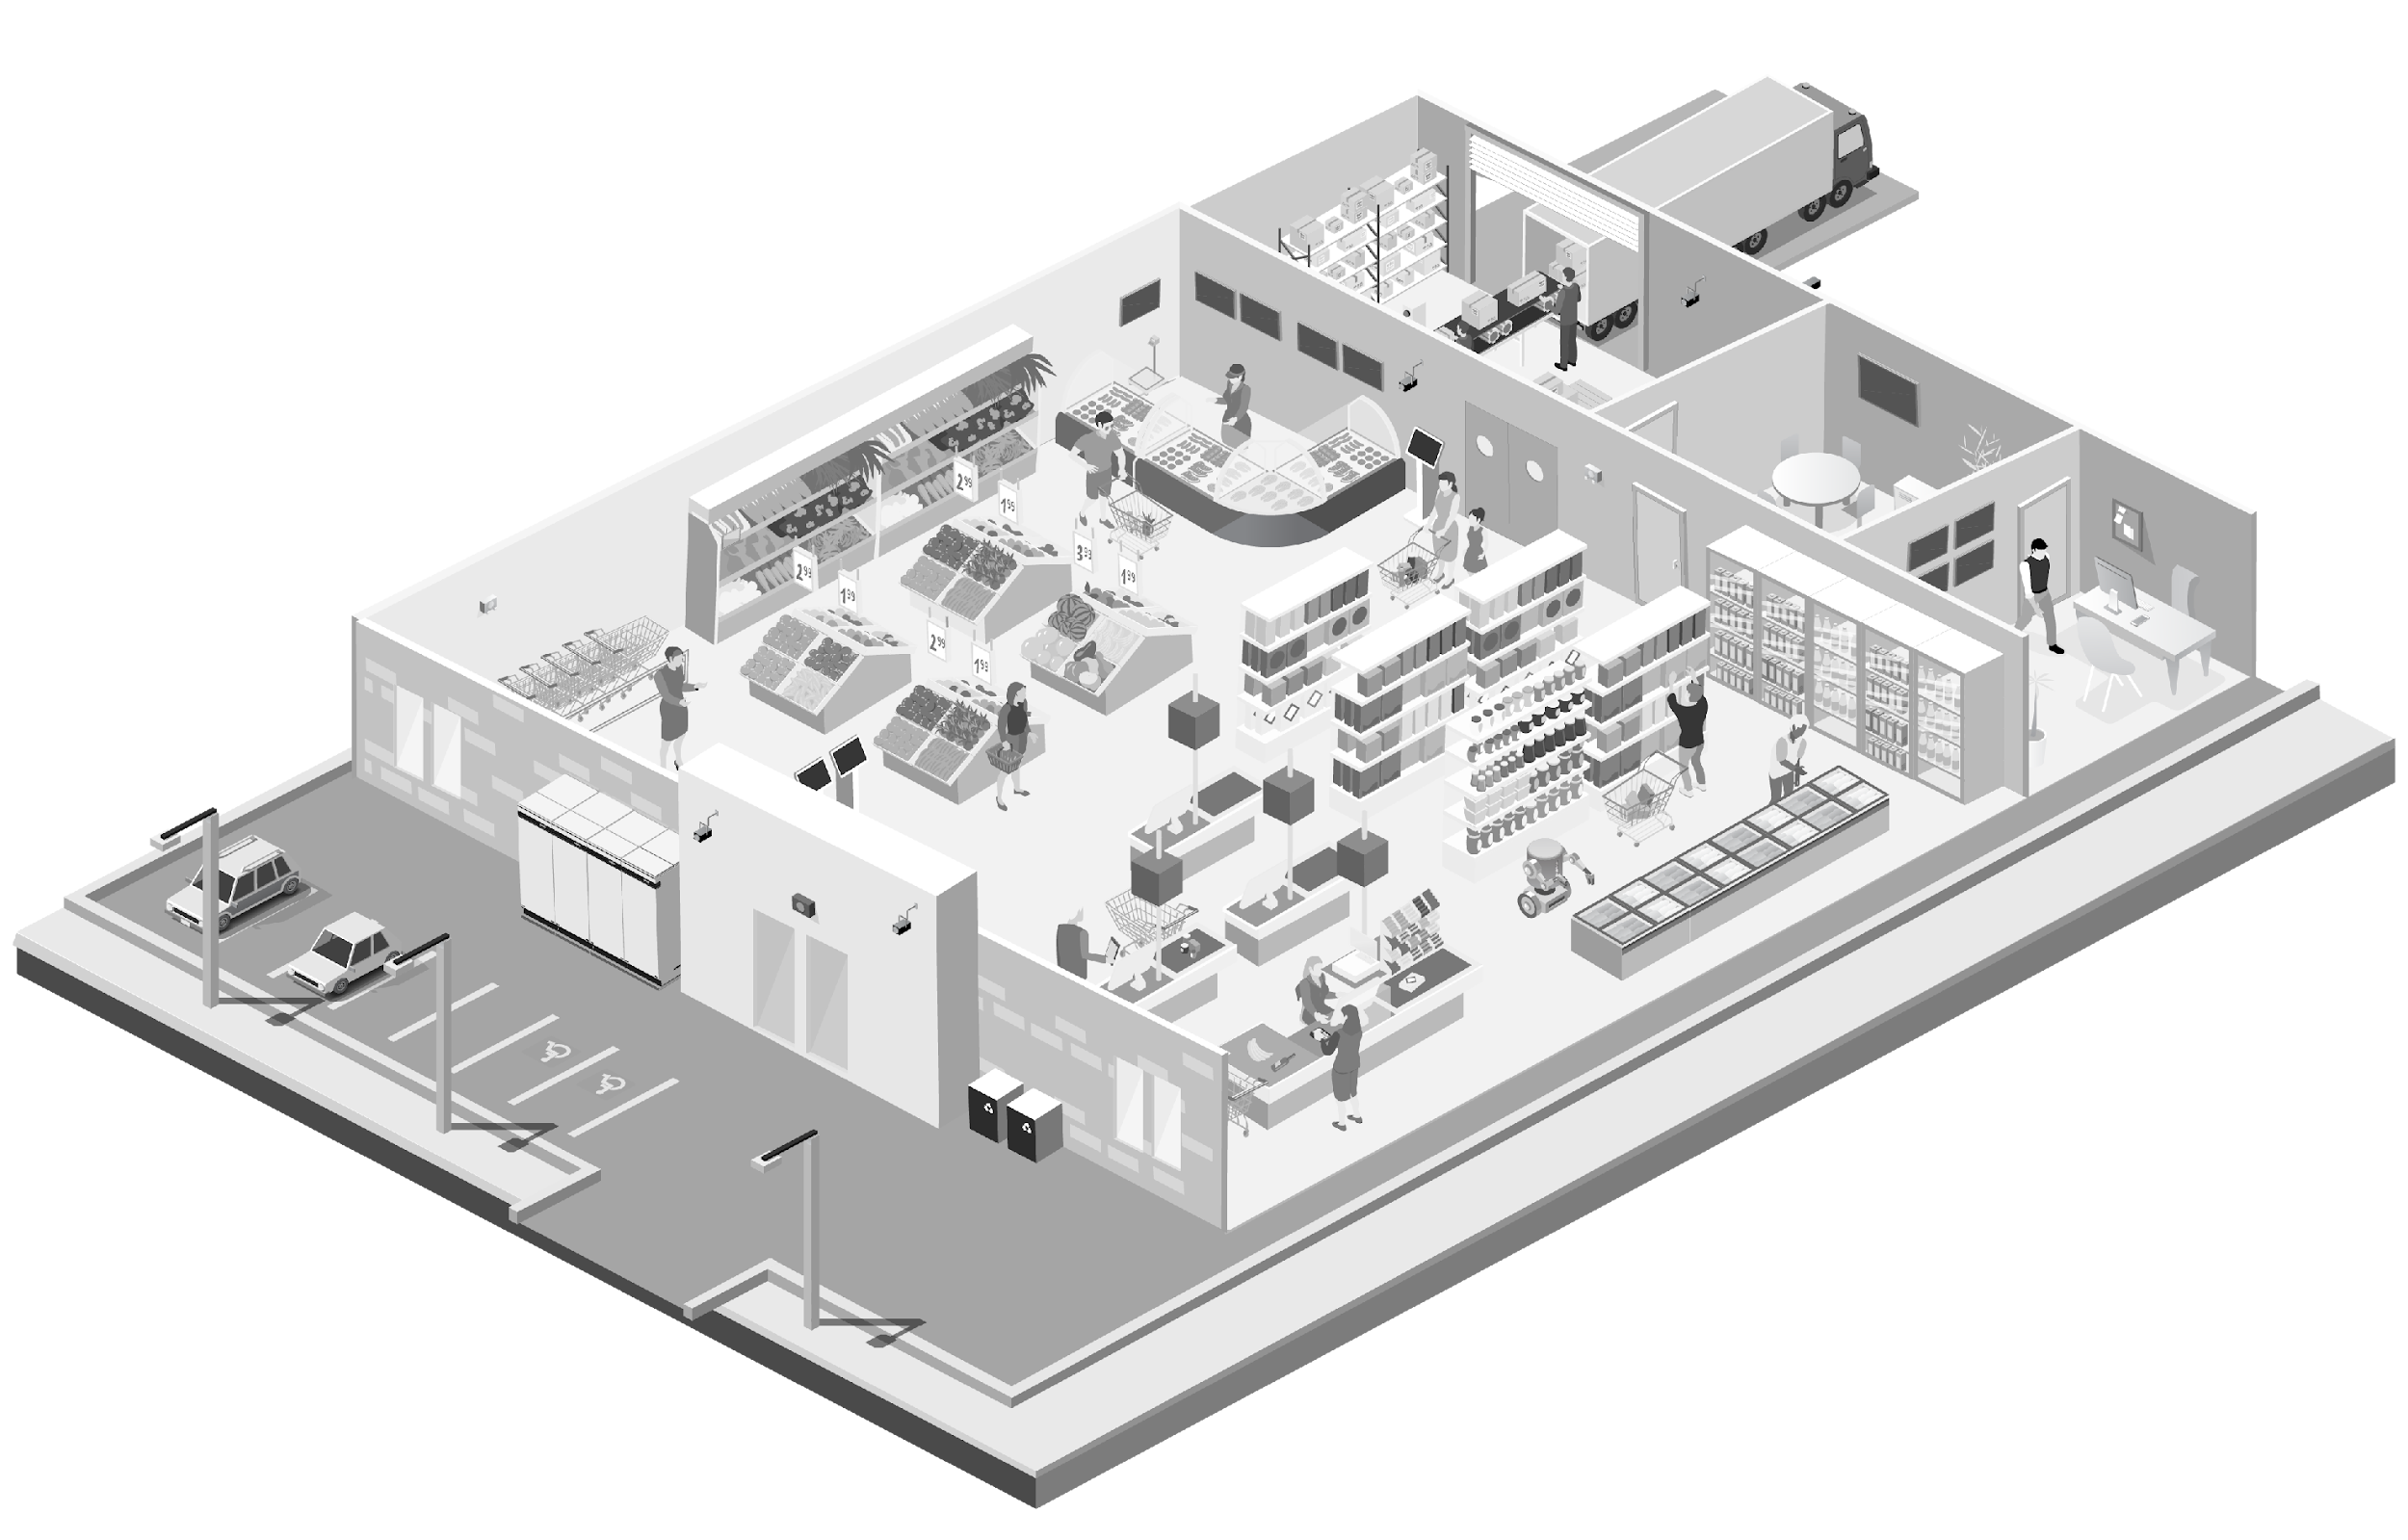
Modern Retail Reality
  Today’s Retail Runs on Connectivity
From checkout to curbside, today’s retail operations depend on:
Cloud-based POS systems
Digital payments
Mobile associates
Real-time inventory
Omnichannel fulfillment
Customer engagement tools
When connectivity fails, operations stop.

Slide 4

Planning for the Unpredictable
  Retail teams face constant disruption:
Internet outages
Power interruptions
Peak traffic surges
Weather events
System failures
Network congestion
Downtime doesn’t just slow business.
It costs sales.

Slide 5

What Happens When Your Network Fails?
  When connectivity goes down:
❌ POS systems stop
❌ Inventory freezes
❌ Cameras go offline
❌ Guest Wi-Fi fails
❌ Phones become unreliable
❌ Staff lose coordination
When connectivity goes down, there’s no business continuity.
Customers leave. Productivity drops. Revenue stops.

Slide 6
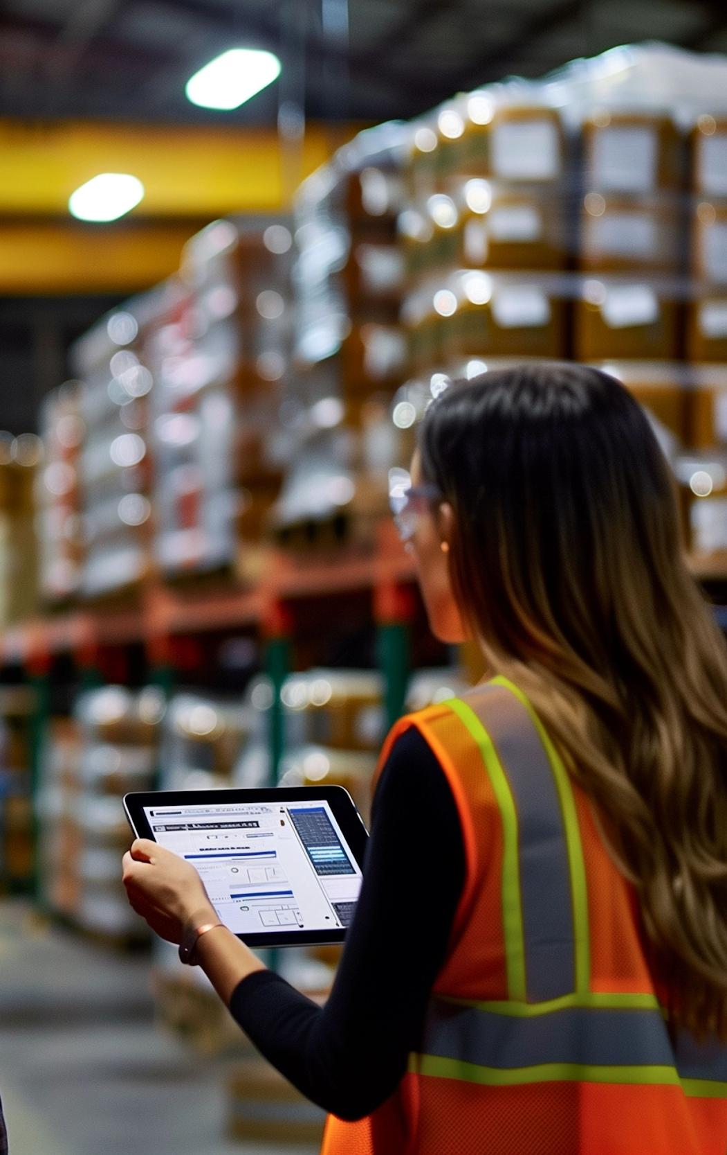
Where Connectivity Matters
  Every part of your store depends on reliable coverage:
Checkout counters
Sales floor
Stockroom
Manager offices
Curbside pickup
Parking lots
Delivery bays
Where are your blind spots?

Slide 7

Always-On Retail Infrastructure
  Your safety net when systems fail.
  Premier delivers:
Primary + cellular failover
Automatic switchover
Secure networks
Centralized management
Multi-store scalability
So your business never skips a beat.

Slide 8

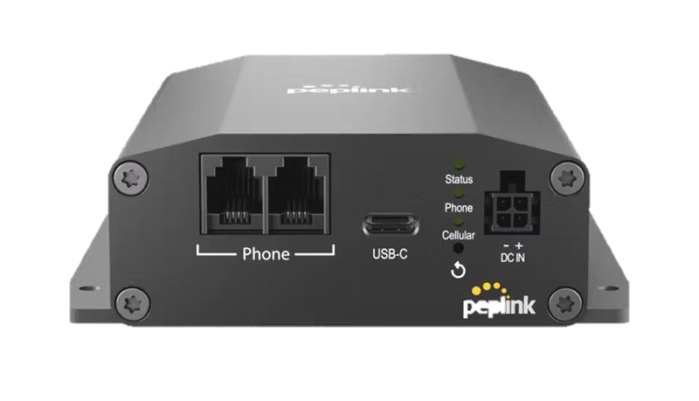
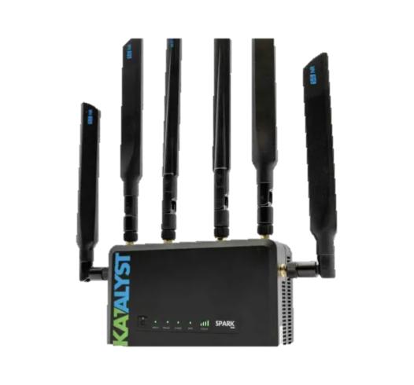

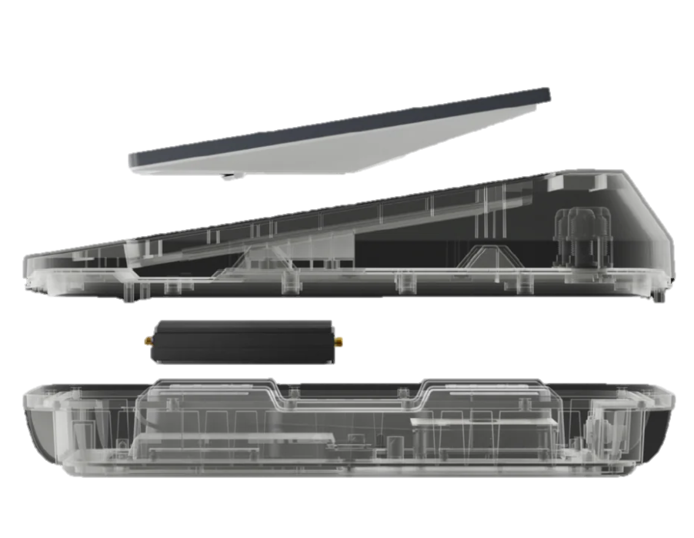
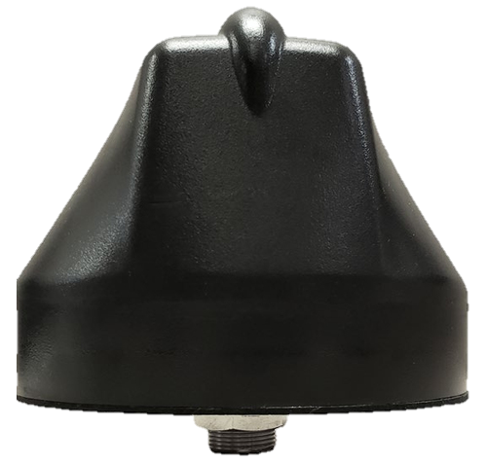
Store Internet & Failover Solutions
  Purpose:
Keep POS, cameras, and systems online — always.
High-speed primary internet
Automatic cellular backup
Plug-and-play deployment
24/7 monitoring
  Outcome:
No outages. No lost transactions.

Slide 9
Protecting the Customer Experience
  Every interaction matters.
From checkout speed to Wi-Fi quality, customers expect seamless service.
Connectivity enables:
✔ Faster checkout
✔ Better engagement
✔ Consistent service
✔ Higher loyalty

Slide 10


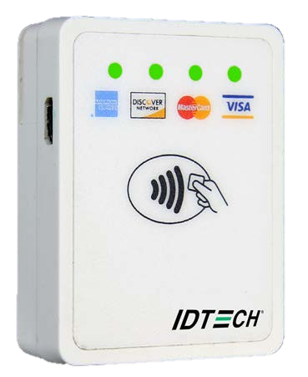
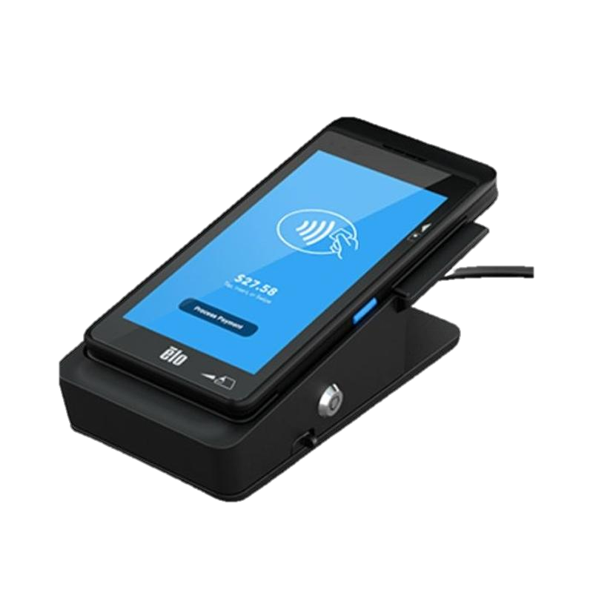
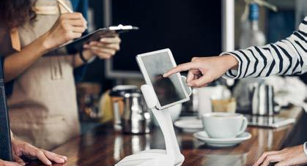
POS Systems & Guest Wi-Fi Solutions
  Every part of your store depends on reliable coverage:
Mobile POS anywhere in store
Secure guest Wi-Fi
Integrated analytics
Loyalty & marketing tools
  Result:
Shorter lines. Happier customers. More sales.

Slide 11
Loss Prevention & Store Visibility
  Shrink, theft, and liability threaten margins.
Retailers need real-time visibility.

Slide 12
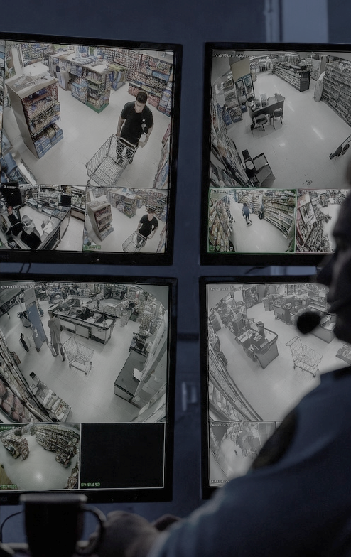
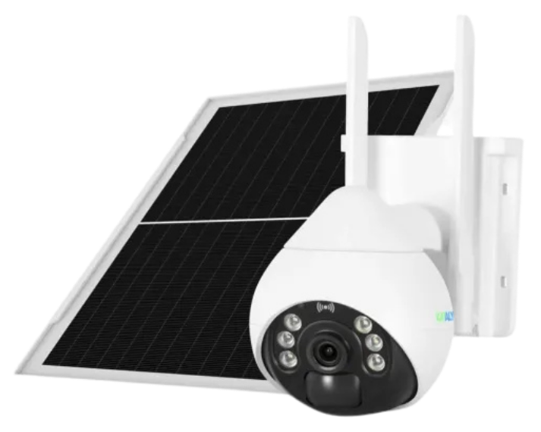
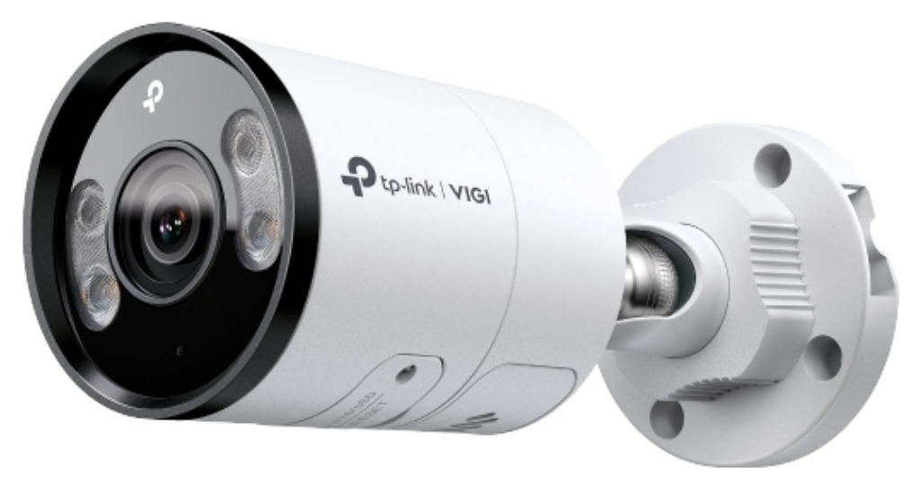
Smart Camera Systems
  Every part of your store depends on reliable coverage:
24/7 HD monitoring
AI-powered alerts
Cellular backup
Cloud storage
  Protects:
People • Product • Profits

Slide 13
Keeping Teams Connected
  When communication breaks down, operations suffer.
Retail teams need instant, reliable connection.

Slide 14

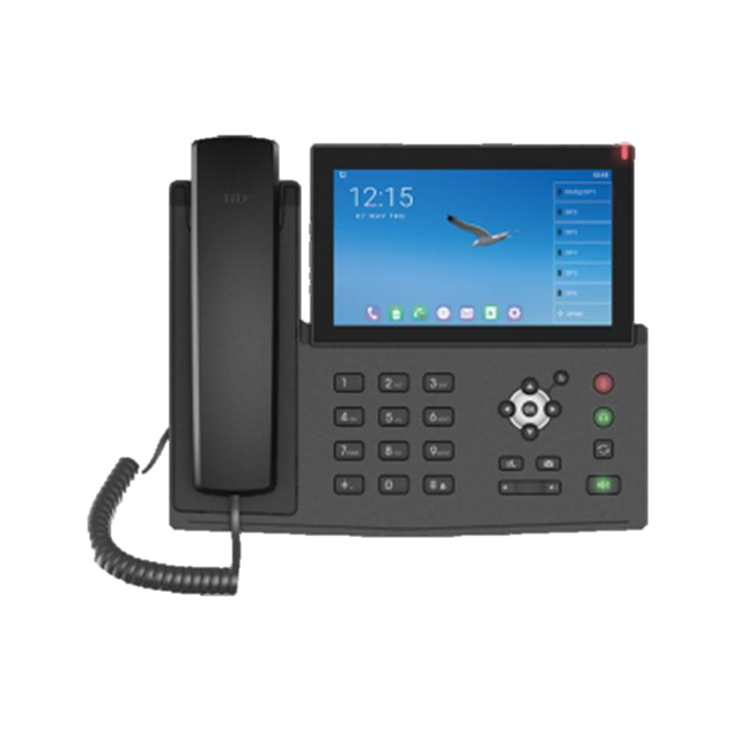
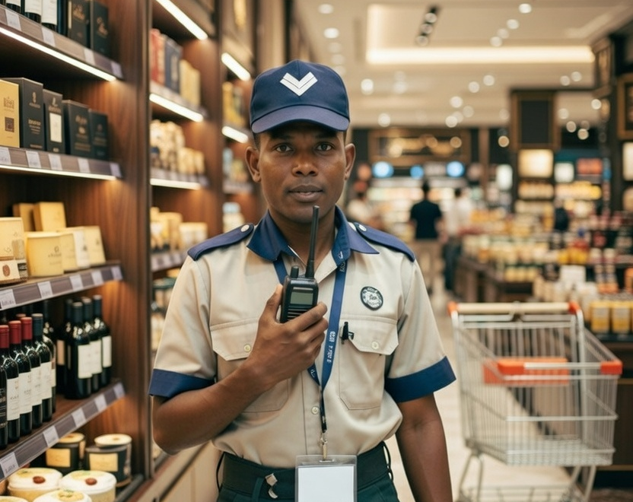
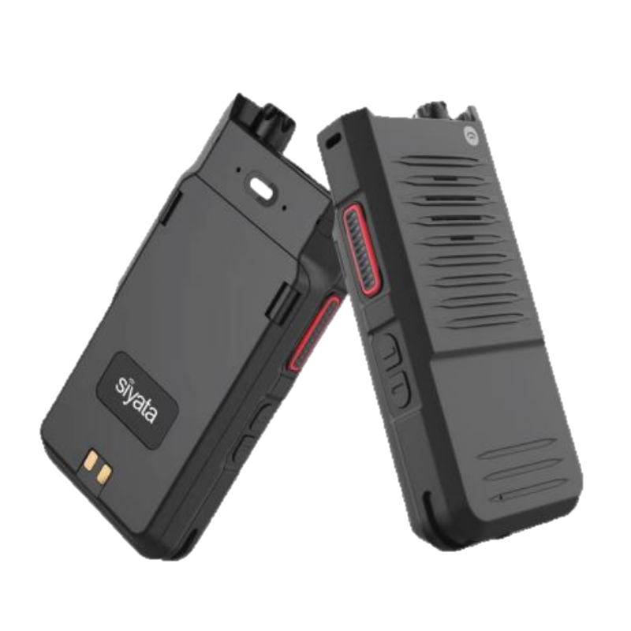
Communication Hub & Push-to-Talk
All-in-one communications hub for staff, managers, and security
Built-in battery backup for outages and disruptions
Nationwide cellular coverage—no local infrastructure required
Real-time emergency alerts and instant team notifications
Push-to-talk connects every role at the touch of a button
  Benefit:
Faster response. Fewer mistakes. Better customer experiences.

Slide 15
Smart Store Intelligence
  Data turns operations into advantages.

Slide 16

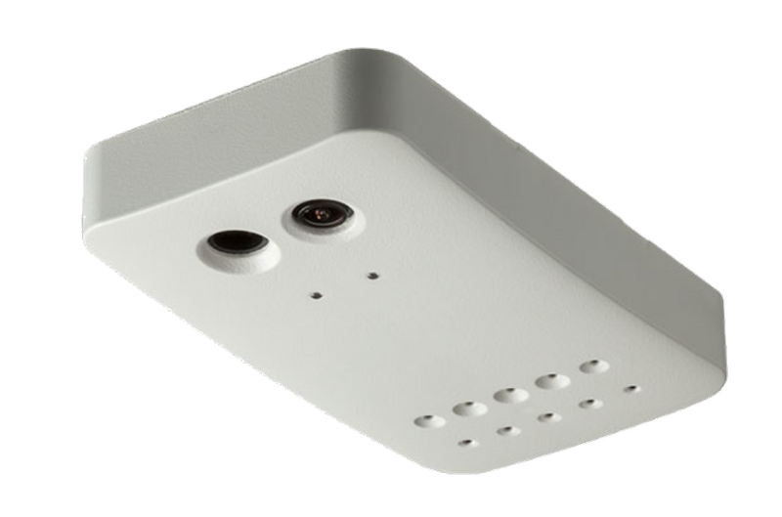
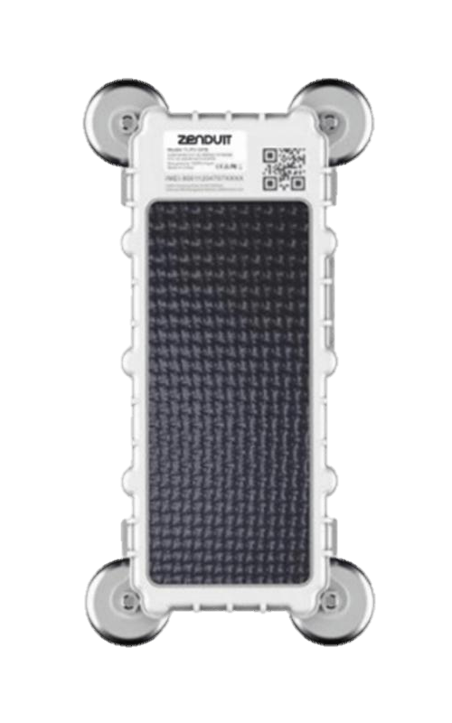
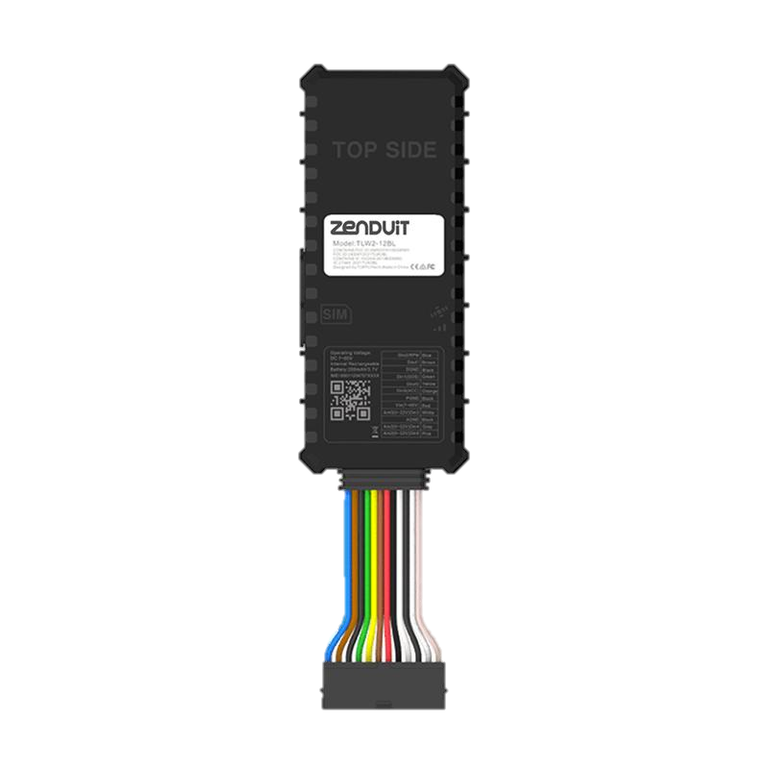

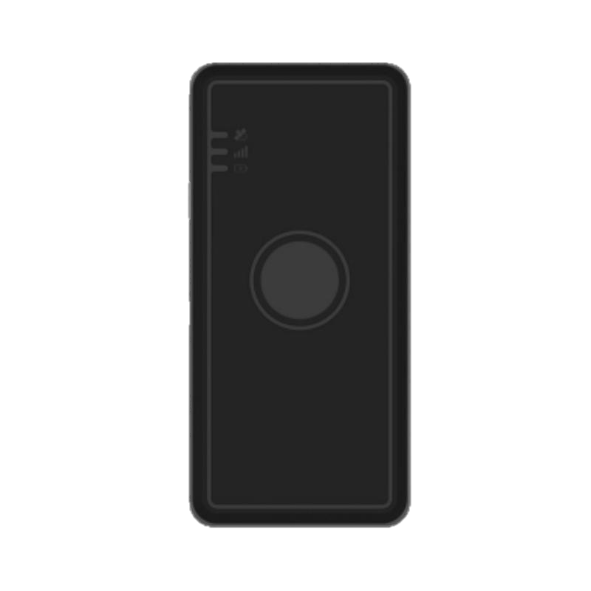
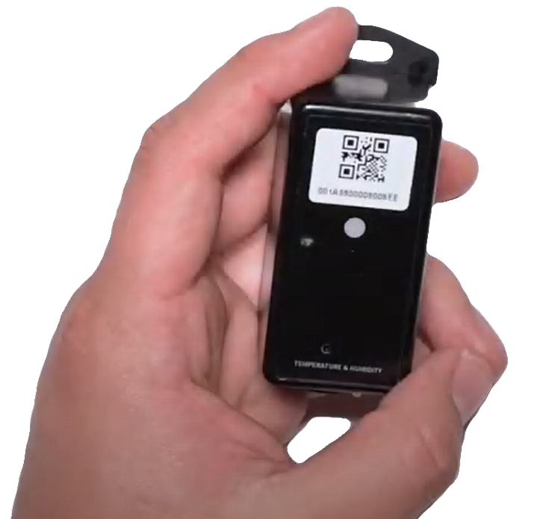
Connected Sensors & Asset Tracking
  Real-Time Visibility Across Your Store & Inventory
Monitor coolers, freezers, and storage areas to prevent spoilage
Track high-value equipment, carts, and mobile assets
Live mobile video monitoring for vehicles and moving assets with real-time alerts and playback
Analyze foot traffic to optimize staffing and merchandising
Receive instant alerts for temperature, movement, or anomalies
Centralized dashboards for multi-location management
  Enables:
Smarter staffing • Fewer losses • Higher margins • Better compliance

Slide 17
Unified Retail Operations
  Disconnected tools create blind spots.
Retail leaders need one source of truth.

Slide 18
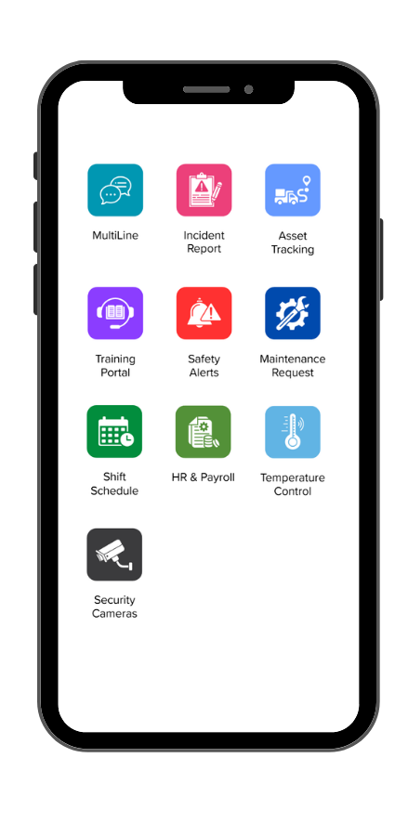
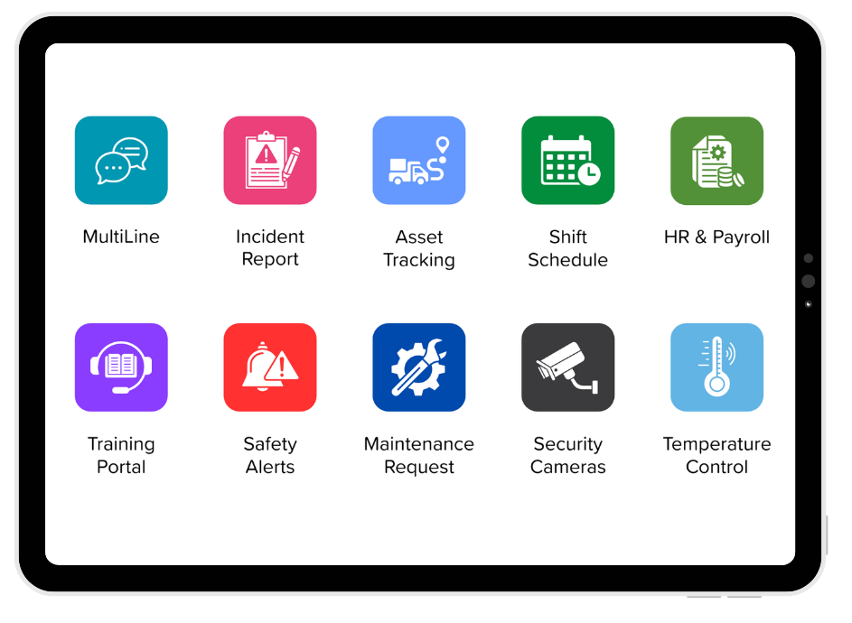
CPR³ Retail Operations Hub
The Mobile Command & Communications Platform
One Platform that Eliminates Inefficiencies Between Systems
  Problem:
  Solution:
One Platform for Total Store Control
One device. One platform. One command view.
Centralized communications and alerts
Real-time store and staff oversight
Built-in 5G backup connectivity
Faster incident and outage response
Secure, mobile management anywhere
Disconnected Stores. Disconnected Teams.
POS, phones, cameras, and alerts all live in different systems
No real-time visibility across locations
Slow response to incidents and outages
  What CPR³ Delivers
Instant communication across all locations
Real-time alerts and escalation
Centralized operational visibility
Rapid incident and security response

Slide 19

Your Trusted Retail Partner
  Premier Wireless
  Premier Wireless
Dedicated support
Integrated solutions built for efficiency
Turnkey deployment
Managed services
Retail expertise
Turnkey deployment
Managed services
Hospitality expertise
Dedicated support
  Powered by T-Mobile
Largest 5G network
Fastest 5G speeds
T-Satellite
Best 5G network
  Together: Technology + Partnership
*Coverage not available in all areas. We’ll help you confirm availability at your location.

Slide 20

What This Means for You
✔ Protected revenue
✔ Always-on operations
✔ Safer environments
✔ Better customer experience
✔ Lower IT burden
✔ Scalable growth
✔ Built-in business continuity across your entire operation
✔ Integrated solutions that increase efficiency

Slide 21

Let’s Build Your Resilient Store Network
Where are your biggest risks?
Which locations need protection first?
What systems can’t go down?
Who should join the next call?
  (281) 667-0404
Premier Wireless

