Slide 1


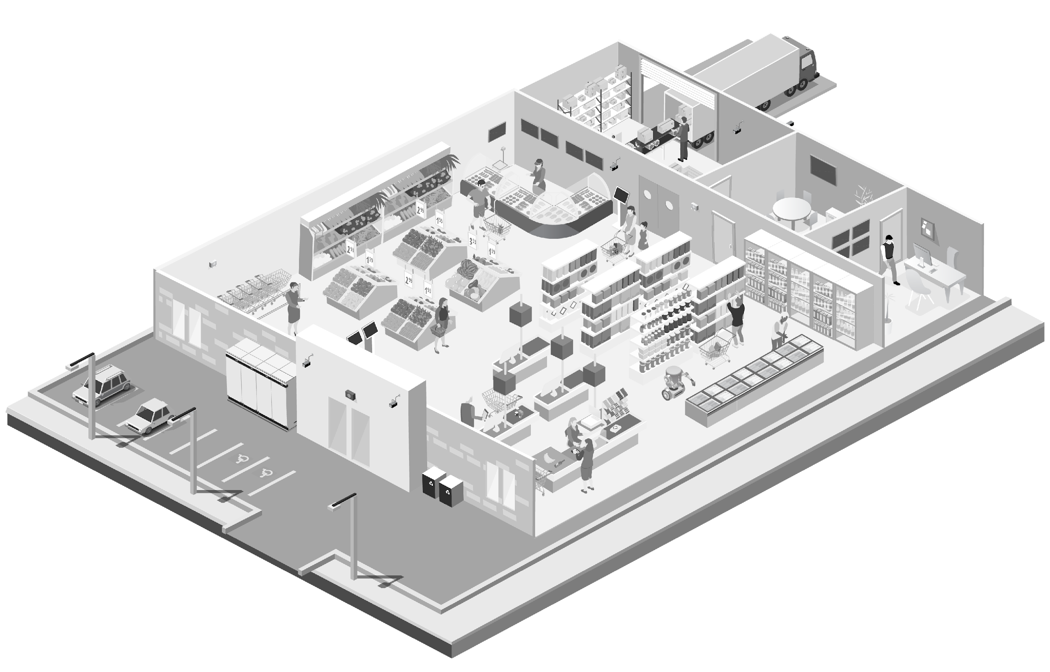
Retail: Business Continuity Solutions
From premier Wireless & T-Mobile
Contents
Industry Context & Solution Overview | 2
Value Pillars | 2
Segments and Verticals | 2
Buyer Concerns | 2
Conversation Starters | 3
How Our Solution Helps | 3-4
Which Product When | 5
Discovery Checklist | 5
Elevator Pitch | 6
Advice From Sales Specialist | 6
Phone & Voicemail Script | 7
Email Script | 8-9
1

Slide 2





Overview
Industry Context
Segments & Verticals
Retail Business Continuity ensures stores remain operational during outages, disruptions, or incidents.
From payments and connectivity to communications and visibility, continuity protects revenue, staff, and customer experience when systems fail.
Premier Wireless + T-Mobile delivers always-on retail infrastructure powered by the T-Mobile network—designed to keep stores open, connected, and profitable.
Single-Location Retail
Multi-Location Retail Brands
Big Box & Specialty Retail
Seasonal & Pop-Up Retail
Mall, Strip-Center, and Kiosk Locations
Retail operations depend on constant connectivity.
POS systems, digital payments, cameras, communications, inventory, curbside fulfillment, and customer engagement tools all rely on reliable networks.
Retail teams face growing disruption from:
ISP and internet outages
Power interruptions
Network congestion
Construction and line damage
Weather events
Increased theft and liability
When connectivity fails, operations don’t just slow—they stop.
Downtime directly impacts revenue, customer trust, and brand reputation.
Buyer Personas and Concerns
Value Pillars
Retail Owners / Operators
Lost revenue during outages
Store closures or degraded service
Protecting margins
IT & Operations Leaders
Single points of failure
Lack of centralized visibility
Managing multiple locations consistently
Loss Prevention / Security
Cameras offline during incidents
Delayed investigations
Increased liability exposure
Store Managers
Communication breakdowns
No clear escalation or response path
Revenue Protection
Always-On Operations
Store Safety & Visibility
Faster Incident Response
Reduced IT Burden
Scalable Retail Infrastructure
Why T-Mobile
Runs on the nation’s fastest, most reliable 5G network.
Delivers scalable connectivity solutions that support single storefronts or multi-location retail operations.
Why Premier Wireless
A T-Mobile Pinnacle Partner with proven expertise in retail.
Known for attention to detail, hands-on deployment support, and ongoing customer care to minimize downtime and keep your stores running smoothly.

Slide 3
Conversation Starters
Conversation Starters
What systems are impacted first if connectivity goes down at one of your stores?”
“How do you manage outages or incidents across multiple locations today?”
“If there’s an incident right now, how quickly could you respond?”
“Which systems absolutely cannot go offline?”
“Who’s in charge when this happens?”
“How do teams coordinate under pressure?”
“What happens when phones, Wi-Fi, and systems fail at the same time?”
How Our Solution Helps
Premier Wireless + T-Mobile supports retail continuity across four critical areas:
Always-On Connectivity
Primary internet with cellular and satellite failover ensures critical systems remain online—including voice, data, and device access—without manual switching. Phones and connected laptops stay online even when store networks fail.
Continuous Transactions
Mobile and resilient checkout options keep payments flowing—even during outages. Store associates and managers can coordinate via mobile voice when POS or Wi-Fi systems are degraded.
Operational Visibility & Safety
Cameras, alerts, and monitoring remain active during disruptions—supporting faster response and reduced liability. Voice provides immediate escalation during incidents—no app switching, no delays.

Slide 4
How Our Solution Helps Cont.
Unified Communication & Control
Retail teams need a single way to communicate, coordinate, and respond—especially during outages or incidents.
The CPR³ Retail Operations Hub brings voice, messaging, alerts, and connectivity into one mobile command platform—so managers and teams stay connected when systems fail.
It enables:
Unified voice, messaging, and alerts in one device
Real-time coordination between staff, managers, and security
Built-in cellular backup when store networks fail
Mobile access to critical systems and dashboards
Faster response during outages, incidents, or peak disruptions
When systems go down, CPR³ becomes the control point that keeps stores operating.
Resilient Voice & Workforce Connectivity (Sub-Callout)
Retail continuity depends on people being reachable.
Phones and connected laptops provide:
Reliable voice communication during outages
Direct access to cloud systems when store networks fail
Mobile coordination for managers and support teams
Secure access to email, ticketing, and operations tools
When fixed networks go down, voice becomes the fastest path to action.

Slide 5
Which Product When (Internal Use Only)
If the pain is: “We lose sales during outages”
→ EverLink or Simplifi Connect II
If the pain is: “Checkout slows / lines get long”
→ Elo Pay
If the pain is: “We can’t see what’s happening in-store”
→ SafeSight Cameras
If the pain is: “Teams aren’t coordinated during issues”
→ Communication Hub or CPR³ Retail Operations Hub
If the pain is: “Assets move or get lost”
→ SafeTrax365
If the pain is: “We lose communication during outages”
→ Business Voice (Phones & Connected Laptops)
If the pain is “We lose control or coordination during disruptions”
→ CPR³ Retail Operations Hub
👉 Products are prescribed—not pitched.
Retail Business Continuity Discovery Checklist
(Use live on calls or in discovery)
Which locations cannot afford downtime?
What systems must stay online at all times?
What happens today when internet or power fails?
How are incidents escalated?
Who needs real-time visibility during disruptions?
Where are current blind spots?
Are responses handled locally or centrally?
How do teams communicate if store phones or Wi-Fi go down?
Are managers reachable during outages?
Can leadership access systems from anywhere?
Do associates have a reliable fallback for voice communication?
What happens to customer calls during disruptions?

Slide 6

Elevator Pitch
Retail Business Continuity from Premier Wireless + T-Mobile keeps stores operational when systems fail. By designing always-on infrastructure across connectivity, payments, communications, and visibility, we help retailers protect revenue, reduce downtime, and deliver consistent customer experiences—even during disruption.
Industry landscape
Competitive Environment
Retailers are moving away from:
Single ISP dependency
Disconnected tools
Reactive outage response
They are adopting:
Redundant connectivity (cellular + satellite)
Centralized visibility and control
Proactive business continuity planning
Continuity is becoming a competitive advantage—not a nice-to-have.
Advice from Sales Specialist
Lead with impact, not technology
Focus on “what breaks first”
Tie continuity to revenue protection
Introduce products only after risk is acknowledged
Position Premier + T-Mobile as a partner, not a vendor

Slide 7
Phone & Voicemail Scripts
Cold Call Script
“Hi [Name], this is [Your Name] with T-Mobile/Premier Wireless..
I’m calling because we work with retail teams focused on staying operational during outages—whether that’s internet failures, payment interruptions, or in-store incidents.
Quick question—if connectivity went down at one of your locations today, what systems would be affected first?”
(Pause)
“That’s exactly what we’re seeing across retail.
Most stores have great systems—they’re just not designed to stay online when something fails.
We help retailers design always-on infrastructure so sales continue, teams stay connected, and stores don’t miss revenue.
Would it make sense to spend 15 minutes identifying where continuity matters most across your locations?”
Voicemail Script
“Hi [Name], this is [Your Name] with T-Mobile/Premier Wireless.
I’m calling because many retailers are re-evaluating how they stay operational during outages—keeping payments, communications, and visibility online when systems fail.
We help retailers design always-on infrastructure to protect revenue and reduce downtime.
I’ll follow up by email and look forward to connecting.”

Slide 8
Email #1 – Initial Outreach
Subject:
What happens if one of your stores goes offline?
Body:
Hi [First Name],
Retail today depends on constant connectivity—from POS and payments to cameras, communications, and inventory systems.
When one system goes down, the impact spreads quickly:
Transactions stop
Teams lose coordination
Visibility disappears
Customers leave
Premier Wireless + T-Mobile helps retailers design always-on infrastructure so stores remain operational during outages, disruptions, or incidents.
Rather than selling a single product, we focus on business continuity—keeping revenue flowing and customer experiences consistent.
If you’re open to it, I’d love to share how other retailers are identifying continuity gaps and protecting their operations.
Best,
[Signature]

Slide 9
Email #2 – Follow-Up
Subject:
Downtime doesn’t announce itself
Body:
Hi [First Name],
Most retail outages aren’t planned—they happen due to ISP issues, power disruptions, construction damage, or network congestion.
The retailers that recover fastest aren’t reacting—they’re prepared.
We work with retail teams to:
Keep POS and payments online
Maintain visibility during incidents
Coordinate teams across locations
Reduce revenue loss during disruptions
Would it be worth a short conversation to identify where continuity matters most across your stores?
Best,
[Signature]

