Slide 1


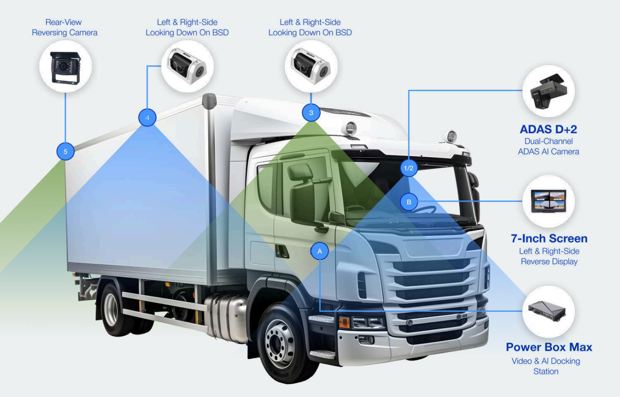
SafeSight: Connected Cameras for Transportation
Contents
Industry context & Solution Overview | 2
Value Pillars | 2
Segments and Verticals | 2
Buyer Concerns | 2
Top Reasons Customers Should Buy | 2
Elevator Pitch | 3
Competitive Environment | 3
Advice from Sales Specialists | 3
Conversation Starters | 4
Objection Handling | 5
Phone & Voicemail Script | 6
Email Script | 7
1

Slide 2





Overview
Industry Context
Value Pillars
Buyer Personas and Concerns
Transit agencies and commercial fleets face more pressure than ever to maintain safety, reduce liability, and modernize operations. Traditional DVR systems require manual SD card pulls, delay investigations, and often fail when footage is needed most.
Modern fleets require:
Real-time visibility into vehicles
Cloud-based video storage & retrieval
Driver behavior insights
Tools to reduce accidents, claims & operational costs
Faster response to road incidents, harassment, vandalism, and emergency events
SafeSight meets these operational demands with always-on, connected camera intelligence.
Passenger & Operator Safety
Fleet Managers / Operations Leaders
Need visibility into incidents as they happen
Concerned about rising insurance costs & false claims
Want tools to improve driver behavior and efficiency
Safety & Risk Management
Need indisputable video evidence
Must resolve complaints, accidents, and investigations faster
Want AI alerts to catch unsafe driving before it becomes costly
Transit Directors / City Transportation Agencies
Need real-time awareness on buses, shuttles & paratransit
Must protect passengers and operators
Want live video during disturbances, vandalism, or assaults
Small Business Owners / Contractors
Want a simple way to monitor service vehicles, deliveries & drivers
Need reliable footage for disputes, damaged goods, or theft
Want to prevent unauthorized use & protect assets in the field
IT & Technology Leaders
Prefer cloud-based systems with remote management
Want to eliminate outdated DVR & cabling headaches
Monitor interior and exterior activity in real time, reduce incidents, protect drivers, and improve passenger safety.
Driver Accountability & Coaching
AI monitors harsh driving, distraction, and unsafe behavior — helping reduce accidents, insurance costs, and vehicle wear.
Operational Efficiency
Cloud-based playback eliminates SD card pulls, accelerates investigations, and supports liability protection.
Emergency Response
Live video can be shared instantly with supervisors or first responders for faster decision-making during incidents, breakdowns, or threats.
SafeSight™ is a connected, SIM-based camera system that gives public transit agencies and commercial fleets real-time visibility, AI-powered insights, and cloud-based video access — with no manual SD card retrieval. Powered by T-Mobile connectivity, SafeSight improves operator safety, reduces risk, strengthens accountability, and enables faster response when incidents occur on the road or inside the vehicle.
Segments and Verticals
Core Values
360° coverage with AI dual cams (interior/exterior)
Live video streaming from any connected device
Cloud playback & storage — no SD cards needed
GPS tracking with harsh-driving detection
AI driver monitoring (fatigue, distraction, phone use)
Facial Driver ID for accurate trip/incident logging
BLE panic button for instant emergency alerts
Wi-Fi/cellular uploads to the cloud
Blind-spot visibility (side, rear, interior)
Automated alerts & incident clips for rapid response
Public Transit Agencies – City buses, trolleys, shuttles
Commercial Fleets – Delivery trucks, cargo vans, service vehicles
Logistics & Last-Mile Delivery – Package delivery, courier fleets
Municipal Services – Utilities, sanitation, public works, inspectors
Private Shuttle Operators – Hotels, casinos, corporate transport
Contractors / SMB Fleets – HVAC, plumbing, construction, landscaping

Slide 3
Conversation Starters
 | General Conversation Starters
 | “How long does it take today to retrieve footage after an incident?” “Do you get visibility into your vehicles as events occur?” “Are false claims or complaints costing your agency or company money?” “What tools do you use to monitor driver behavior across your fleet?” “How quickly can you respond if a driver presses an emergency alert?”
 | Responding to Buyer Concerns & Needs
 | Concern: “Will this work with our existing POS?” Designed for broad restaurant POS compatibility, integrating seamlessly with counter, drive-thru, kiosk, and tableside systems. Concern: “How do we ensure PCI compliance?” Built with fully encrypted, PCI-compliant payment processing to maintain secure, audit-ready environments across all locations. Concern: “What if our Wi-Fi is unstable?” T-Mobile’s network provides a reliable connection, keeping payments online even when local Wi-Fi slows down or drops. Concern: “Will deployment disrupt service?” Plug-and-play installation enables quick rollout with minimal downtime—no impact to rush periods or staff workflow.

Slide 4

Elevator Pitch
SafeSight™ provides real-time visibility, cloud-based video storage, and AI-powered driver monitoring for public transit and commercial fleets. With T-Mobile connectivity, it improves safety, reduces accidents, lowers operational costs, and eliminates SD card headaches — giving agencies and businesses a modern, connected fleet monitoring solution.
Industry landscape
Competitive Environment
Across transit and commercial sectors, fleets are moving away from offline DVR systems toward real-time, cloud-connected video. Rising insurance rates, increasing road incidents, operator shortages, and public safety concerns are driving the adoption of connected camera systems with AI and live streaming capabilities.
How Our Solution Helps
Gives supervisors real-time situational awareness
Improves passenger and operator safety
Reduces accidents through AI-based driver coaching
Supports rapid incident investigation & claim resolution
Protects businesses and municipalities from liability
Helps dispatch and operations make informed decisions quickly
Opportunity
Public Transit Agencies
Improve operator safety & reduce operator assaults
Monitor passenger behavior, vandalism & incidents
Enable live response visibility for dispatch
Commercial Fleets
Reduce insurance costs with video-backed evidence
Improve driver safety & reduce harsh driving events
Defend against false claims, damaged goods disputes
SMB & Contractor Vehicles
Track field service teams in real time
Verify job site arrival/departure
Protect expensive equipment inside vehicles
Municipal Fleets
Provide accountability for city services
Improve operator safety in high-risk areas
Support compliance & reporting
Advice from Sales Specialist
Lead with the elimination of SD card pulls — this is the top pain point across fleets.
Highlight AI driver behavior analytics that reduce accidents and insurance costs.
Emphasize real-time visibility for operators, dispatchers, and supervisors.
Focus on liability reduction: SafeSight protects organizations from false claims.
Stress that T-Mobile connectivity makes the system accessible anywhere, anytime.

Slide 5





Objection Handling
 | “We already have cameras.”
Response | Older DVR systems lack real-time access, AI insights, and cloud storage. SafeSight modernizes your fleet.
 | “We can’t afford downtime for installation.”
Response | SafeSight installs quickly and can be deployed incrementally across the fleet.
 | “Is this only for large fleets?”
Response | No — it’s scalable from 1 vehicle to 1,000.
 | “Is it secure?”
Response | Yes — SafeSight uses encrypted transmission, secure cloud storage, and strict access controls.
 | “What if the vehicle is out of coverage?”
Response | Footage is stored locally and automatically uploads once connectivity resumes.
Challenges SafeSight Solves
Removes SD card retrieval across the fleet
Provides live visibility into incidents & driver behavior
Helps prevent false claims and reduce liability
Enables faster response during emergencies
Improves fleet safety with AI alerts & monitoring
Provides visibility inside, outside & around vehicles

Slide 6
Phone & Voicemail Scripts
Phone Script
“Hi [Name], this is [Your Name] with Premier Wireless. Many fleets are dealing with outdated camera systems that require SD card pulls, delay incident reviews, and provide no real-time visibility. We’re helping transit agencies and commercial fleets upgrade to SafeSight — a connected camera platform with live streaming, driver AI monitoring, and cloud-based playback.
I’d love to learn more about your current camera setup and share how other organizations are reducing accidents, resolving claims faster, and improving driver safety. Would ___ or ___ work for a quick call?”
Voicemail Script
“Hi [Name], this is [Your Name] with Premier Wireless. I’m calling because many fleets want real-time visibility and faster incident resolution. SafeSight provides live streaming, cloud playback, AI driver monitoring, and emergency alerts — without pulling SD cards. I’ll follow up by email and look forward to connecting.”

Slide 7
Email
Subject: Real-Time Fleet Visibility With SafeSight™
Body:
Hi [First Name],
Many fleets are looking to modernize their camera systems, especially if they’re still relying on SD cards or can’t access video in real time. This slows down investigations, increases insurance costs, and limits visibility into the safety of drivers and passengers.
SafeSight™ is a connected camera solution powered by T-Mobile that delivers real-time video, AI driver insights, cloud-based playback, and instant emergency alerts. It helps fleets reduce accidents, protect operators, and streamline incident resolution.
If you’re exploring ways to improve fleet visibility and reduce liability, I’d be happy to share how other organizations are using SafeSight.
[Signature]

