Slide 1

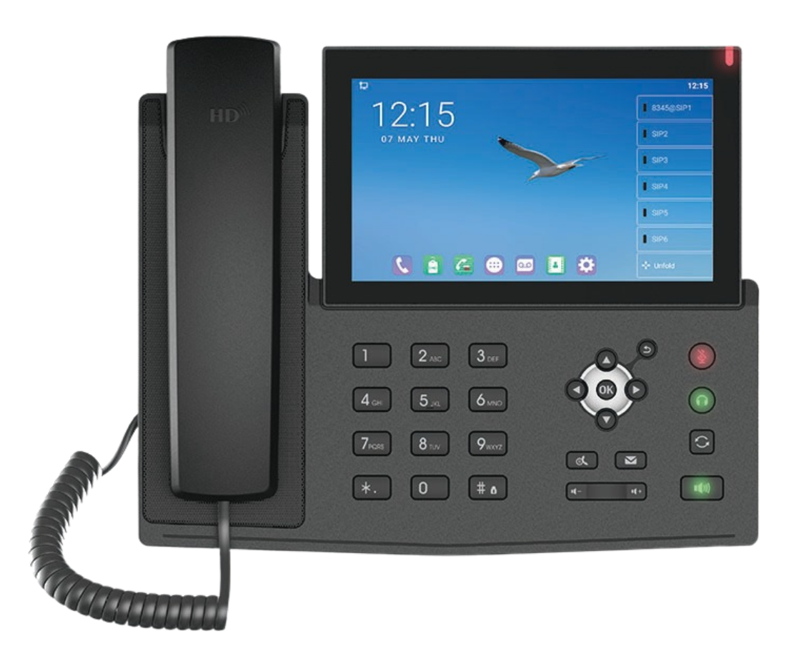
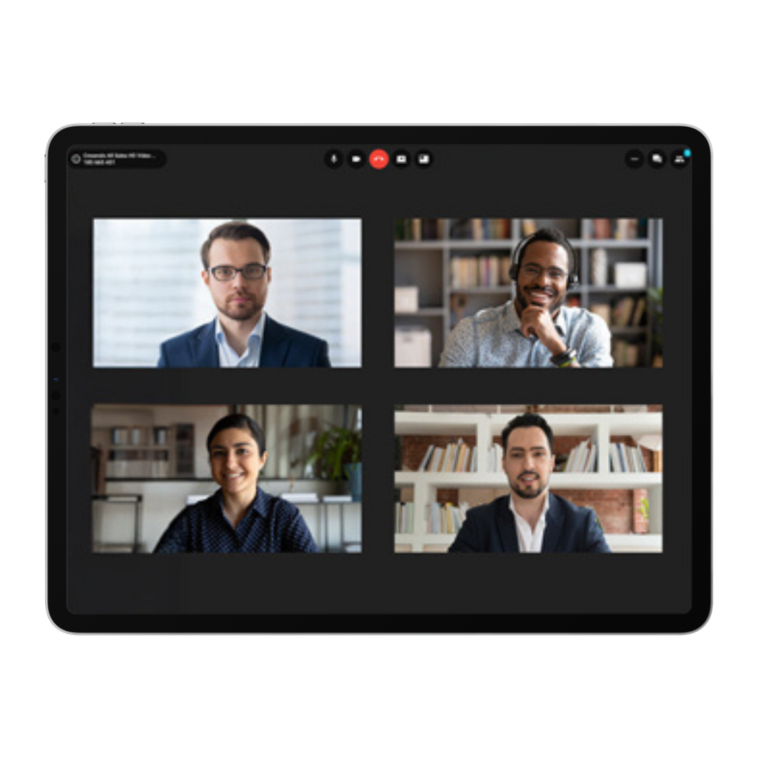
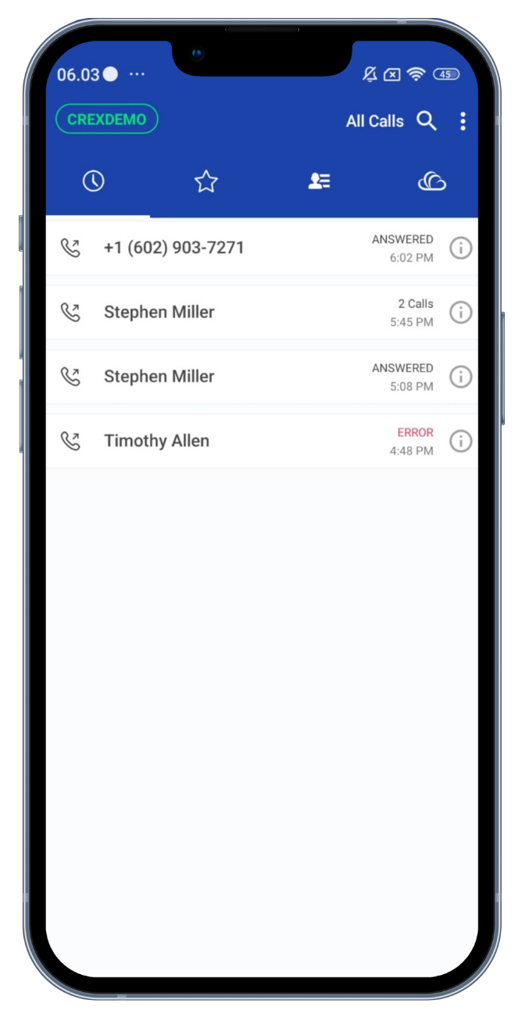

Crexendo®
Phones for Small Businesses
For T-Mobile Micro Business Accounts (1-9 Employees)
From Premier Wireless
Contents
Introduction to Crexendo for Small Businesses | 2
Industry Context & Solution Overview | 2
Primary Segments & Verticals | 3
Buyer Personas | 3
Core Value Pillars | 3
Why Businesses Buy Crexendo | 4
The Crexendo Platform | 5
New Phone Options | 6
Buyer Concerns | 7
How to Sell Crexendo | 7
Discovery Questions | 7
How Crexendo Helps | 8
Objection Handling | 8
Advice From Sales Specialists | 8
Core Messaging Reminder | 8
Email, phone & voicemail script | 9-13
Communication Hub
Tablet
Smart Phone
1

Slide 2
Introduction to Crexendo for Small Businesses
Industry Context & Solution Overview
The Small Business Communications
Crexendo provides cloud-based business phone solutions designed to help small businesses communicate more professionally while supporting today's mobile workforce. Whether a business has two employees or twenty, Crexendo can be right-sized to fit their needs today and grow with them as they expand.
Crexendo enables businesses to establish a professional communications environment with a main business number, employee extensions, direct company phone numbers, call transfers, voicemail, and business texting. Employees can answer calls and communicate through desk phones, smartphones, tablets, or laptop soft clients whether they are in the office, working remotely, or on the road. By providing capabilities typically associated with much larger organizations, Crexendo helps even the smallest businesses present a more professional image, improve customer responsiveness, and create a customer experience that supports growth.
For many small businesses, every missed call represents a potential lost customer or lost revenue opportunity. Crexendo helps ensure calls reach the right person regardless of location, allowing businesses to remain responsive and accessible even when employees are away from the office.
Equally important, Crexendo helps businesses maintain ownership of customer relationships. Instead of employees giving customers their personal cell phone numbers, businesses can provide company phone numbers and extensions that stay with the organization. Customers can continue reaching the employee wherever they are through the Crexendo platform, while the business retains visibility, continuity, and control of the customer relationship. This helps protect against one of the most common risks facing small businesses—employees leaving and taking valuable customer relationships with them.
Today's small businesses are expected to provide the same level of responsiveness and professionalism as much larger organizations.
As a result, businesses face growing communication challenges around:
Missed customer calls and lost opportunities
Difficulty reaching the right employee
Customers calling employee cell phones
Growing demand for business texting
Maintaining a professional image
Keeps customers connected to your business, not former employees
The challenge isn't simply answering every call—it's ensuring customers can reach the right person so they don't lose business.
How Crexendo Helps Small Businesses
Professional Communications
One business phone number
Employee extensions & direct numbers
Call routing & transfers
Business voicemail
Flexibility & Freedom
Desk phones, Smartphones, Tablets, and Laptops soft clients
Business calling & texting
Key Takeaway
Crexendo helps small businesses operate like larger organizations by providing professional communications, mobile flexibility, and customer continuity—all while keeping customer relationships tied to the business, not the employee's personal cell phone.
Protect & Grow
Reduce missed opportunities through faster response
Protect customer relationships from employee turnover
Gives you the tools to scale faster and fuel business growth

Slide 3



Primary Segments & Verticals
Buyer Personas
Primary Targets
Small Auto Dealers
Typical Buyers:
Owner/Operator/Office Mgr.
Focus Areas:
Main dealership number, sales calls on the lot, no missed deals
Cost of a lost sales:
$2500 - $20,000
Small auto dealers
Home services
Construction
Salons & spas
Medical & dental offices
Law firms
Accounting practices
Retail stores & restaurant
Home Services (HVAC, Plumbing, Landscapers, Movers)
Typical Buyers:
Owner/Office Mgr.
Focus Areas:
In office and out of office call transfers, urgent service calls
Cost of a lost sales:
$300 - $2500+
Strong-Fit Environments
Construction
Businesses needing a main number & extensions
Call transfers in/out of office
Companies replacing old POTS lines
Firms wanting to avoid personal cell use
Small businesses ready to scale professionally
Typical Buyers:
Owner/Office Mgr.
Focus Areas:
New client opportunities, transferring calls between employees
Cost of a lost sales:
$1,000 and up
Salons & Spas
Typical Buyers:
Owner.
Focus Areas:
Appointment calls, booking flexibility, customer retention
Cost of a lost sales:
$50 - $300
Core Value Pillars
Why promote Crexendo
Increases number of smartphone activations
Creates communication hub opportunities
Opens-up more business internet opportunities
Increases total number of T-Mobile activations per account
Provides you with bigger T-Mobile commission checks

Slide 4
Why Businesses Buy Crexendo
Buyer Personas
Across All Industries
Medical, Dental and Veterinary Offices
Typical Buyers:
Practice Manager
Focus Areas:
Appointment scheduling, patient follow-up, professional image
Cost of a lost sales:
$100 - $1000
Reduces Missed Calls
Improves Response Times
Supports Customer Retention
Mobile Call Transfer
Enables Office Texting
Creates Professional Image
Captures more opportunities
Enables Growth
Law Firms, Accountants & Other Professional Services
Typical Buyers:
Owners/Office Managers
Focus Areas:
Client calls, professional presence, missed deadlines, image
Cost of a lost sales:
$500 - $5000+
Small businesses don't lose customers because they aren't good at what they do—they lose customers because they aren't always easy to reach.
Retail Stores & Restaurants
Typical Buyers:
Owner/Manager.
Focus Areas:
Order calls, customer inquiries, reservations
Cost of a lost sales:
$20 - $200
Transportation
Typical Buyers:
Owners/Dispatcher
Focus Areas:
Driver access, dispatch communications, customer responsiveness
Missed loads = missed revenue opportunities
Cost of a lost sales:
$300 - $10,000+
Core Value Pillars
Small service companies lose around $126,000 per year due to missed calls.
62 percent of inbound calls to small businesses go unanswered
85 percent of callers never call back after leaving voicemail
Each missed calls represent about $1,200 in lost revenue
Businesses lose up to 20% productivity due to communication inefficiencies
Legacy phone systems often cost 30-50% more when maintenance, support, and upgrades are included
Source CallRail

Slide 5
The Crexendo Platform
Professional User $11.85/Mo. 2 Yr.Term
Advanced User $23.85/Mo. 2 Yr.Term
Elite User $26.95/Mo. 2 Yr.Term
Included with All Plans
100% uptime guarantee
Geo-redundant U.S. data center
24/7 customer support
Unlimited inbound calling
Auto Attendant with scheduling
HD voice quality
Work from anywhere capability
UC media storage (90 days)
QoS reporting and call analytics
Robust PBX telephony features
Best for users who need a business phone system with mobility and collabortion tools.
Includes:
Direct Inward Dial (DID) Number
1,000 outbound minutes/month
Voicemail-to-email & transcription
Call forwarding, transfer, park, and pickup
Audio conferencing
Find Me / Follow Me
Automatic call recording
AI Call Summaries (optional)
E911 Support
Ideal For:
Office staff, administrative users, and employees who need basic UCaaS functionality.
Best for power users, managers, and customer-facing employees.
Includes Everything in Professional, Plus:
Unlimited outbound calling (US & Canada)
Up to 5 devices per user
Mobile app for iOS & Android
Soft Phone for computers
Audio Conference Bridge
Auto Attendant w/scheduling
Microsoft Teams integration
CRM/SaaS Integration
Hot Desking & Presence
Hunt Groups
VIP Meetings
AI Meeting Summaries
Instant & Group Messaging
Ideal For:
Managers, supervisors, sales teams, and hybrid workers requiring advanced collaboration tools.
Best for executives, operators, and organizations needing the full collaboration suite.
Includes Everything in Advanced, Plus:
Up to 8 devices per user
Enterprise Messaging & Meetings
Enhanced AI capabilities
Advanced collaboration features
Expanded webinar options
Highest level of administrative capabilities
Full UCaaS feature set available within the Crexendo VIP platform
Ideal For:
Executives, receptionists, contact center supervisors, and users who require the most robust communications experience.
Additional Features
Discounts available for longer term agreements (3 year and 5 year discounts available)
Extension only lines are $6.95 per month
Additional DID numbers $1.00

Slide 6
New Phone Options
When To Position the Communication Hub
When To Position a Smartphone
Best Fit Industries
Office-Based Businesses
Medical Offices
Dental Practices
Law Firms
Accounting Firms
Customer Service Focused Businesses
Property Management
Insurance Agencies
Finanical Services
Call Centers
Best Fit Industries
Front Desk Envirnoments
Auto Dealers
Veterinary Clinics
Professional Offices
Nonprofits
Businesses
Multi-Employee Offices
Multi-Location Businesses
Teams Requiring Shared Call Handling
Best Fit Industries
Mobile Service Businesses
HVAC
Plumbing
Electrical
Landscaping
Cleaning Services
Retail & Hospitality
Restaurants
Retail Stores
Salons
Hotels
Best Fit Industries
Professional Services
Real Estate
Insurance
Consulting
Accounting
Legal
Field-Based Businesses
Construction
Delivery Services
Transportation
Home Services
Why Customers Choose It
Why Customers Choose It
The Communication Hub provides a professional business phone experience without requiring traditional desk phones.
Key advantages:
Professional business phone system in one application
Auto Attendant and call routing
Business texting and team messaging
Shared company phone number management
Transfer calls between employees Improve customer responsiveness
Works across desktop, mobile, and web
The Smartphone is designed for business owners and employees who need to stay connected while working from multiple locations.
Key advantages:
One device for business calls, messaging, and apps
Mobile access anywhere on the T-Mobile network
Business phone number on a mobile device
Supports remote and hybrid work
Familiar user experience with minimal training
Easy activation and deployment
Positioning Statement
Positioning Statement
"The Communication Hub is designed for businesses that need a professional phone system experience with call routing, team collaboration, and centralized communications."
"The Smartphone is ideal for businesses whose employees spend most of their time away from a desk and need full business communications wherever they work."
Activation Opportunity: To generate a new T-Mobile activation, you must position a SIM-enabled Communication Hub or Smartphone Solution with T-Mobile service.

Slide 7
Buyer Concerns
How to Sell Crexendo
Discovery Questions Continued
Common Questions:
Position Crexendo As
6. What happens when a customer reaches voicemail?
Uncovers missed opportunities
Uncovers responsiveness challenges
7. How are after-hours calls handled today?
Uncovers business continuity needs
Uncovers customer experience gaps
8. If an employee left tomorrow, would their customers call the business or call them?
Uncovers customer ownership risk
Uncovers employee turnover exposure
9. Do you have a main business number or do customers call employees directly?
Uncovers call routing opportunities
Uncovers professional image concerns
10. As your business grows, will your current communications process scale with you?
Uncovers growth opportunities
Uncovers future-state requirements
Bonus – How do you know when a customer couldn’t reach someone?
Uncovers missed call visibility
Uncovers reporting and accountability gaps
"Can I keep my existing phone numbers?“
Yes, your clients can port over their number to Crexendo. We handle everything!
"How difficult is the transition?"
It’s not difficult at all. Our team works directly with your client and schedules the port and switching their service
"Will this work for remote employees?"
  Yes – employees can have a communication hub at home, or use the app on a smartphone
"Can I use my mobile phone as my business phone?“
Yes, using the Crexendo app, the client can add the app to their smartphone and answer their business line anywhere and everywhere.
"How reliable is cloud phone service?“
  Crexendo has a 100% guaranteed up time
"How much training will my staff need?“
We provide training via Teams and we provide a library of how to videos
"Can it integrate with our CRM or business applications?“
Yes, generally speaking you can. Crexendo supports over 400 integrations today
Focus on business outcomes, not phone system features.
Improved customer experience
Increased employee productivity
Support for hybrid and remote work
Reduced telecom and maintenance costs
Better collaboration across teams
Scalability for future growth
Business continuity and reliability
Discovery Questions
10 Questions to ask on every call!
1. How are customers reaching your business today?
Uncovers main number, cell phones, call flow
2. Do employees use their personal cell phones for customer calls or texts?
Uncovers customer ownership risk
Uncovers smartphone opportunities
3. What happens when the person a customer needs isn't in the office?
Uncovers call transfer needs
Uncovers mobile workforce requirements
4. Do customers ever ask to text your business?
Uncovers business texting opportunities
Very easy question for owners to answer
5. If you could improve one thing about your business communications, what would it be?
Uncovers the true pain point
Let's the owner tell you what matters most
100% Uptime
Guarantee Geo-Redundant U.S. Data Centers
24/7 Customer Support
Mobile, Desktop & Web Access
AI-Powered Call & Meeting Features
Microsoft Teams Integration
CRM & Business Application Integrations
Built for organizations of any size
Powered by the Crexendo VIP Platform

Slide 8
How Crexendo Helps
Objection Handling
Advice From Sales Specialists
Customer Experience
"We’re too small for a phone system"
What Buyers Care About
Never Miss a Customer Call
Faster Response Times
Business Texting
Professional Communications
Reach the Right Employee
Response: Most of our customers felt the same way. Crexendo helps small businesses make it easier for customers to reach the business and the right employee.
Ask: What happens when a customer calls and the person they need isn't available?
Capturing every customer opportunity
Faster customer response times
Protecting customer relationships
Supporting mobile employees
Growing the business efficiently
Employee Productivity
Strongest Sales Angles
Mobile Call Transfer
Office & Field Connectivity
Anywhere Access
Unified Communications
Flexible Workstyles
“Our employees all use their cell phones."
Reduce missed calls
Improve customer responsiveness
Keep customers tied to the business
Extend the office to the field
Support business growth
Response: Crexendo keeps employees mobile while keeping customer communications tied to you, your business—not them and their phones.
Ask: What happens when an employee leaves and goes and works for your competition?
Business Protection
Customer Retention
Relationship Protection
Business Continuity
Revenue Protection
Growth Enablement
“It sounds expensive."
Core Messaging Reminder
Response: Most owners are surprised how affordable it is. The bigger question is the cost of a missed customer, appointment, or sale.
Ask: What would one additional customer per month be worth to your business? Would it cover this cost?
Missed calls often mean lost revenue.
T-Mobile and Crexendo help businesses answer, transfer, and manage calls from virtually anywhere, improving customer responsiveness and protecting opportunities.

Slide 9
Phone Scripts
Option 1 – Auto Dealers
Hi [Name], this is [Rep] with T-Mobile. I have a quick question for you. What happens when a customer calls asking for a salesperson who's out on the lot?
A lot of dealers like you, work hard and spend a lot of money generating leads, but often lose sales because customers can't reach the right salesperson, calls go to voicemail, or customers end up calling employee cell phones instead of the dealership.
T-Mobile is helping dealers improve customer accessibility, keep customer relationships tied to the dealership, and capture more sales opportunities. I'd love to share what we're seeing other dealers do and how its helping them. What does your calendar look like Thursday afternoon, or maybe Monday or Tuesday next week?
Option 2 – Home Services (HVAC, Plumbing, Electrical, Landscaping, Movers)
Hi [Name], this is [Rep] with T-Mobile. I have a quick question for you. What happens when a customer calls and the person they need is out on a job site?
Business owners like you work hard to generate leads and earn new customers, but often lose revenue because calls aren't answered, voicemails aren’t returned and when your, customers can't reach the right person, your opportunities go to a competitor.
T-Mobile is helping service companies improve responsiveness, support employees in the field, and capture more business. What does your calendar look like next week? Is Tuesday morning or Wednesday better for you?

Slide 10
Phone Scripts
Option 3 – Medical & Dental
Hi [Name], this is [Rep] with T-Mobile. I’m working with other doctor’s offices and I have a question for you. How often are your patients getting placed on hold or leave a voicemail because the office is busy helping other patients?
I know practice’s like yours work hard to attract and retain patients, but patient satisfaction suffers when calls aren't answered promptly or patients can't reach the right person quickly.
T-Mobile is helping doctor’s offices improve patient accessibility, reduce hold times and missed calls, ultimately creating a better patient experience. I'd love to share what other practices are doing. What does your calendar look like next week for a 15 – 20 minute call?
Option 4 – Retail, Restaurants, Salons & Spas
Hi [Name], my name is [Rep] with T-Mobile. I’m working with other businesses like yours and I have a quick question for you.. What happens when a customer calls and the person they need is busy helping another customer?
Many small businesses struggle to answer every call, transfer customers to the right employee, or support employees who aren't always near the phone. T-Mobile is helping small businesses create a more professional customer experience with one business number, simple call transfers, and the flexibility to stay connected whether employees are in the store, in the salon, or away from the front desk.
I'd love to share what we're seeing other businesses do. What does your calendar look like next week? Is Tuesday morning or Wednesday better for you?

Slide 11
Voicemail Script
Option 1 – Voicemail
Hi [Name], this is [Rep] with T-Mobile.
I'm reaching out because we're helping small businesses reduce missed calls, improve responsiveness, and make it easier for customers to reach you.
I have a few ideas I'd love to share. Please give me a call back at [Phone Number].
Again, this is [Rep] with T-Mobile. Thank you.
Option 2 – Voicemail
Hi [Name], this is [Rep] with T-Mobile.
Many small businesses don't realize how much business can be lost when customers can't reach the business or the person they are calling. In fact, research shows that up to 85% of callers whose calls go unanswered won't call back.
We're helping business owners solve that challenge, and I'd welcome the opportunity to share a few ideas. Please give me a call back at [Phone Number].
Again, this is [Rep] with T-Mobile at [Phone Number]. Thanks!

Slide 12
Email 1:
Subject Line: Are Missed Calls Costing You Business?
Hi [First Name],
Many small businesses don't realize how many customer calls go unanswered each week.
When customers reach voicemail, many don't leave a message—they simply call the next business. Customers today expect quick responses, and voicemail often leaves them wondering if they'll receive a call back or how long they'll have to wait.
T-Mobile is helping small businesses improve the way customer calls are handled, making it easier for customers to reach the business and the right employee when they need them.
I'd welcome the opportunity to learn a little more about your business and share a few ideas. Would you be available for a brief conversation next week?
Best regards,
[Name]
T-Mobile
[Phone Number]

Slide 13
Email 2:
Subject Line: 85% Won't Call Back
Hi [First Name],
Research shows that up to 85% of callers whose calls go unanswered won't call back.
For many small businesses, that means missed revenue, missed appointments, missed sales opportunities, and frustrated customers.
T-Mobile is helping business owners improve responsiveness, support employees wherever they work, and make it easier for customers to reach the business when it matters most.
If you'd be open to a brief conversation, I'd welcome the opportunity to share what we're seeing other businesses do.
Best regards,
[Name]
T-Mobile

