Slide 1

CPR³
Connecting People to Resources

Slide 2
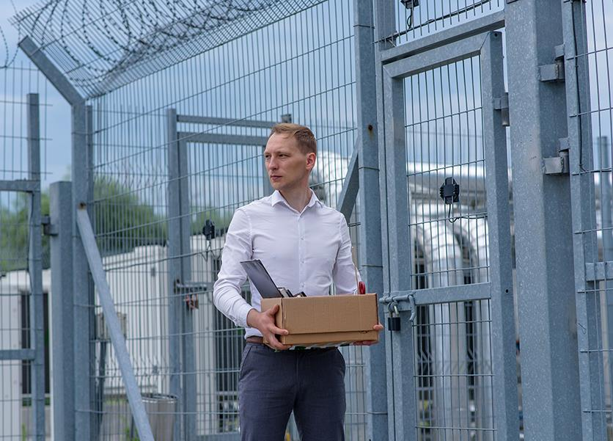
CPR³ : Connecting People to Resources
Parolees are challenged with adjusting to life on the outside.
76.6% of prisoners in the U.S. are rearrested within five years.
We can do better - we must do better.
We can help.
Source: Harvard Political Review

Slide 3

Parolee Challenges
Constructive engagement
Successful re-entry
Reduced recidivism
Food
Education
Job training
Finding & keeping a job
Legal assistance
Stable housing
Mental health services
Substance abuse
Family dynamics
Affordable healthcare

Slide 4
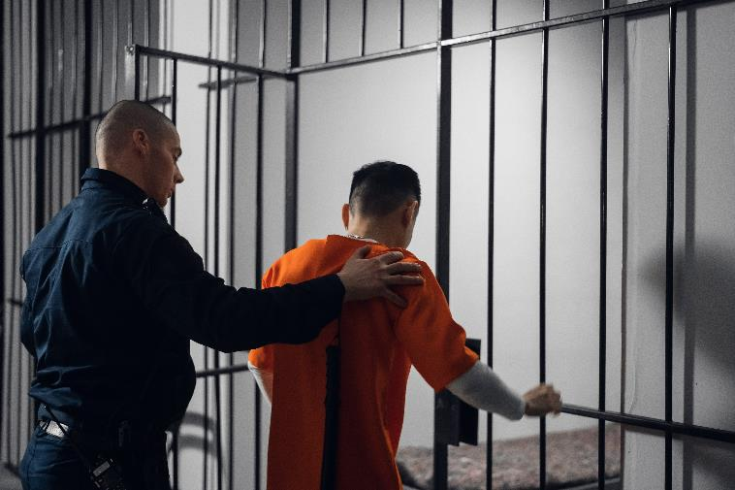
National Statistics: What are Yours?
Nationwide, 4.5 million people are on probation or parole—twice the incarcerated population, including those in state and federal prisons and local jails.
Each year, almost 350,000 of those individuals return to
jail or prison, often because of rule violations rather
than new crimes.
70% of America’s state prison inmates do not have a
high school diploma.
More than 60% of all prison inmates are functionally
illiterate.
  16% chance of returning to prison if they receive literacy help
  70% chance of returning to prison if they receive no help

Slide 5
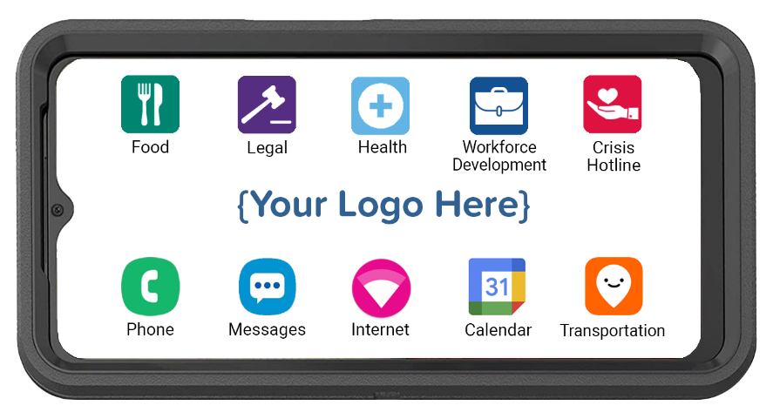
CPR³ Powered by T-Mobile
CPR³ Powered by T-Mobile
All-in-one device providing:
  Hand-held, body-worn computer
  Unlimited communication
  (voice, text, data & hotspot)
  Instant access to resources
Cost-effective solution for connecting parolees to critical resources anytime, anywhere, reducing recidivism

Slide 6
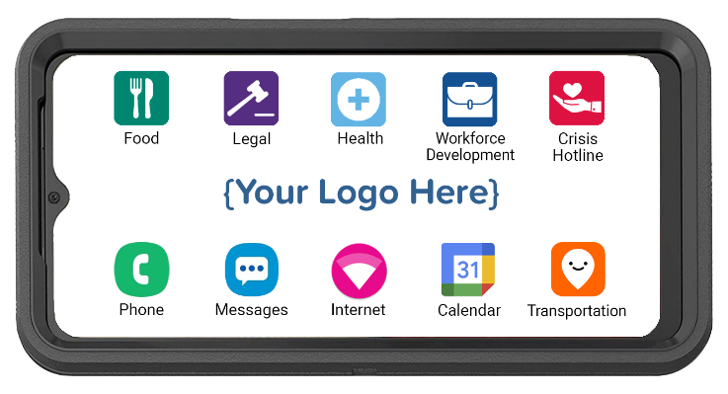




Customizing Your CPR³ Device
The CPR³ solution is custom-built to provide access
to many different resources.
Parolees simply tap the icon to access your list of
available resources.
Food
Legal
Health
Crisis Hotline
Local food banks
Local churches
SNAP (food stamps)
WIC
Legal Aid
Parole Officer
Court Dates
Drug Testing
Community Service
Telehealth
Mental Health
Local Clinics
Prescription Help
Medicaid/CHIP
Suicide Prevention
Human Trafficking
Domestic Violence
Substance Abuse
Icons can be an individual app, a link to a webpage, or a folder containing multiple apps and webpage links.

Slide 7
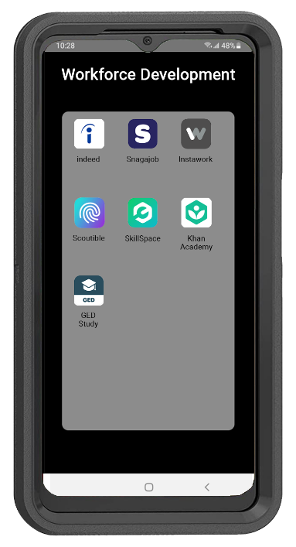

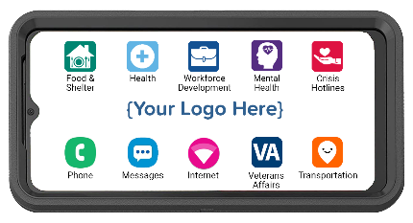


Workforce Development & Careers
Training and/or jobs icons provide access to a folder with basic education, skills training, and job resources.

Slide 8
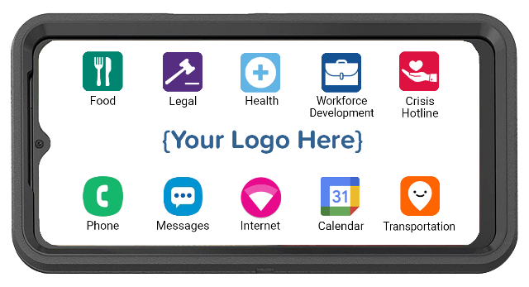
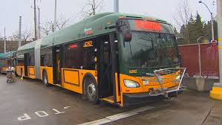
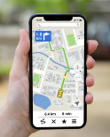
Access to Maps & Transportation
Map and transportation icons provide the ability to plan public transit usage and routes.
Google Maps and Access to
Transportation Options
Simplify Mobility Needs

Slide 9
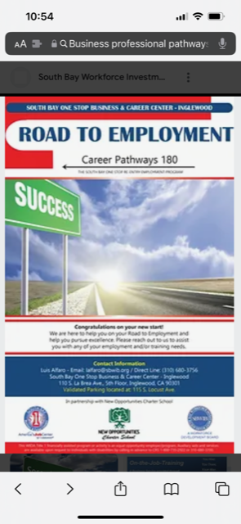
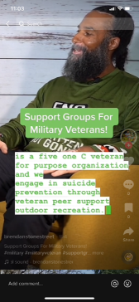
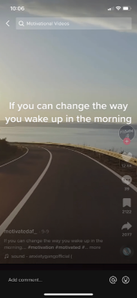
Teach, Reach & Motivate With Videos
Workforce Development
Virtual Support Groups
Music & Meditation

Slide 10
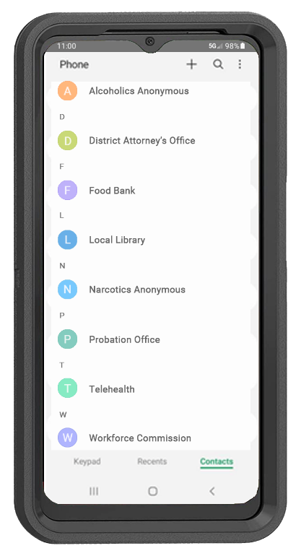


CPR³ Unlimited Communication
+
Provides the ability to call 911 in an emergency
Provides the ability to communicate with a stable
and consistent phone.
Provides parolees with a pre-programmed resource phone directory; easily update at any time.

Slide 11
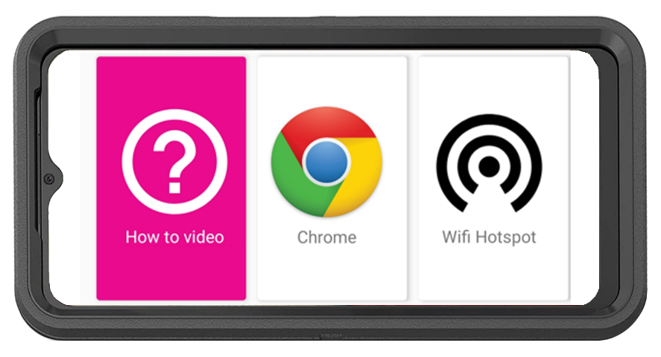
CPR³ Equity & Access
How-To Video with Step-by-Step Instructions to Connect Other Devices to the Hotspot.
  English
  Spanish
  Pashto
  Farsi
Unlimited On-Screen Data
11GB Hotspot Internet Access
Powered by T-Mobile, America’s Largest & Fastest 5G Network

Slide 12

Getting Started…
Identify:
Your goals
Your gaps
Your challenges
Your desired outcomes

Slide 13

Impact of the CPR³
Ensure continuous communication with parole
officer, courts & other legal services
Improve family re-engagement through
communication & access to family services
Empower parolee to ask for help & access resources
Increase reading levels, job skills & overall education,
critical for reducing reincarceration
Successfully transition parolees into functioning
members of their community

Slide 14

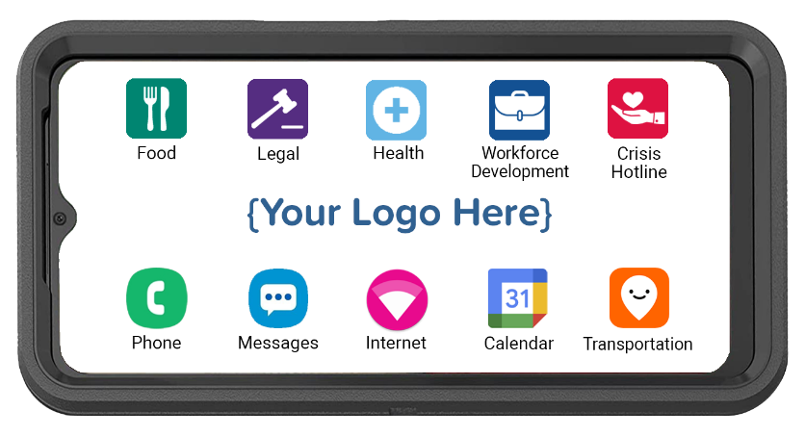
Let the CPR³ help your parolees become
successful members of your local community.

